Slide 1
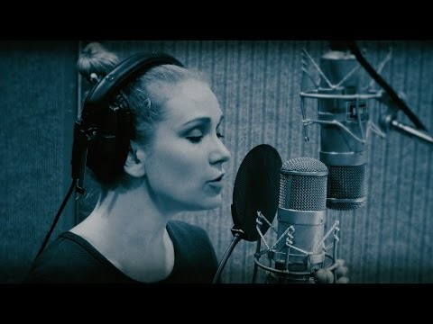
Notes:
https://www.youtube.com/watch?v=CMp9vnikU6M&t=1s
https://youtu.be/CMp9vnikU6M

Slide 2
What are our 6 school values?

Slide 3

Our Values
Resilient | Empathetic | Respectful
Independent | Courageous | Ambitious

Slide 4
Resilience
To overcome various obstacles that could have stopped you achieving your potential.
They did this by being resilient.

Slide 5
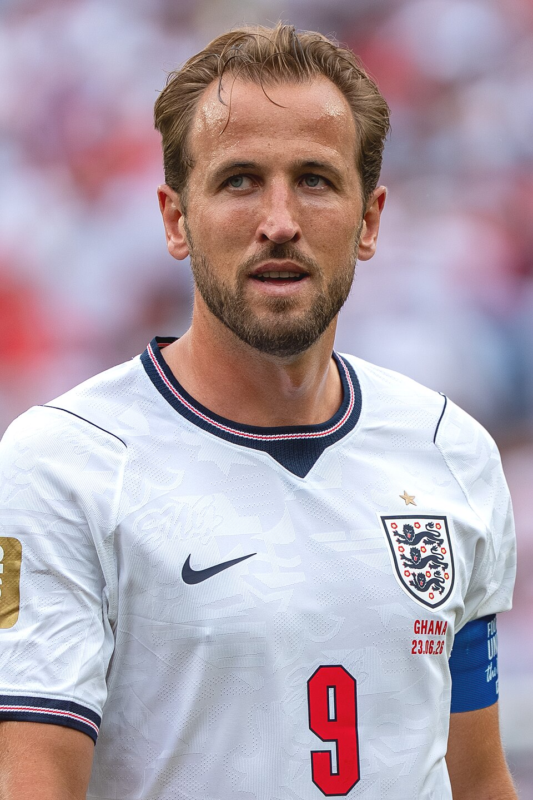

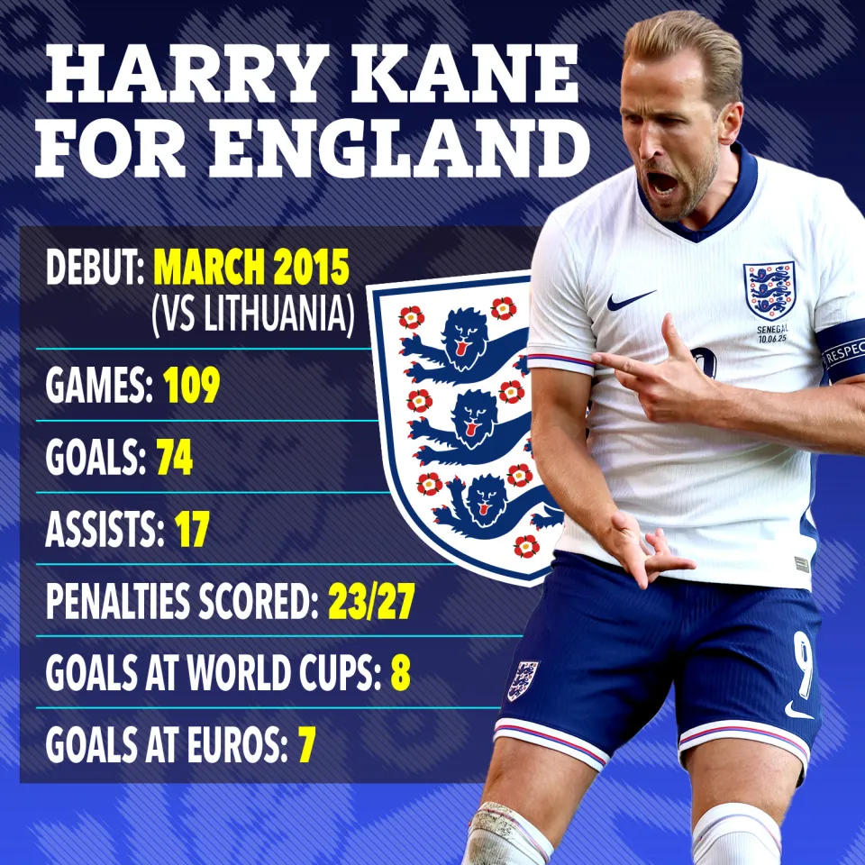
What is Resilience?
Notes:
Harry kean

Slide 6
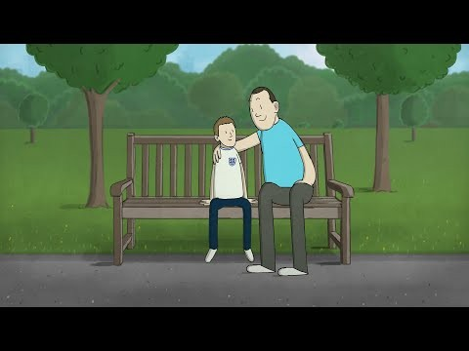
Notes:
https://www.youtube.com/watch?v=a7MmCj3liMs

Slide 7
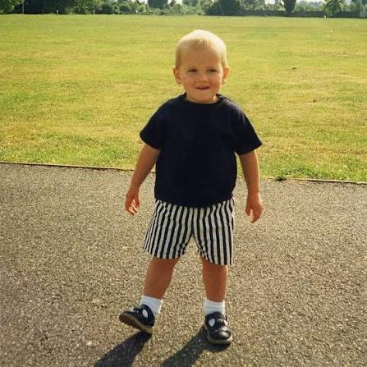
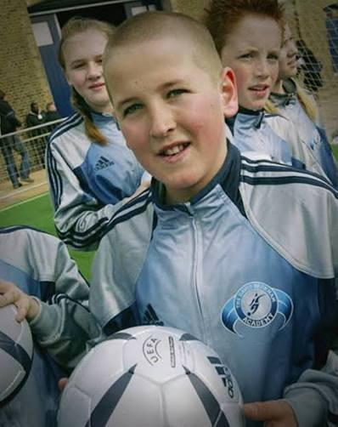
What can be learnt from Harry Kean?

Slide 8
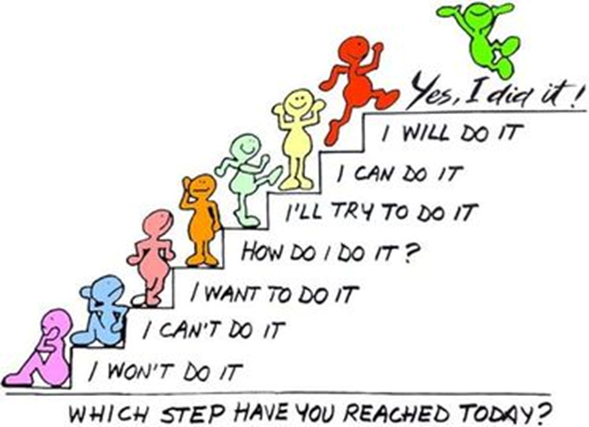
Things can knock our confidence and it is our resilience that will enable us take these issues in our stride and progress forward, rather than getting moody about it.

Slide 9
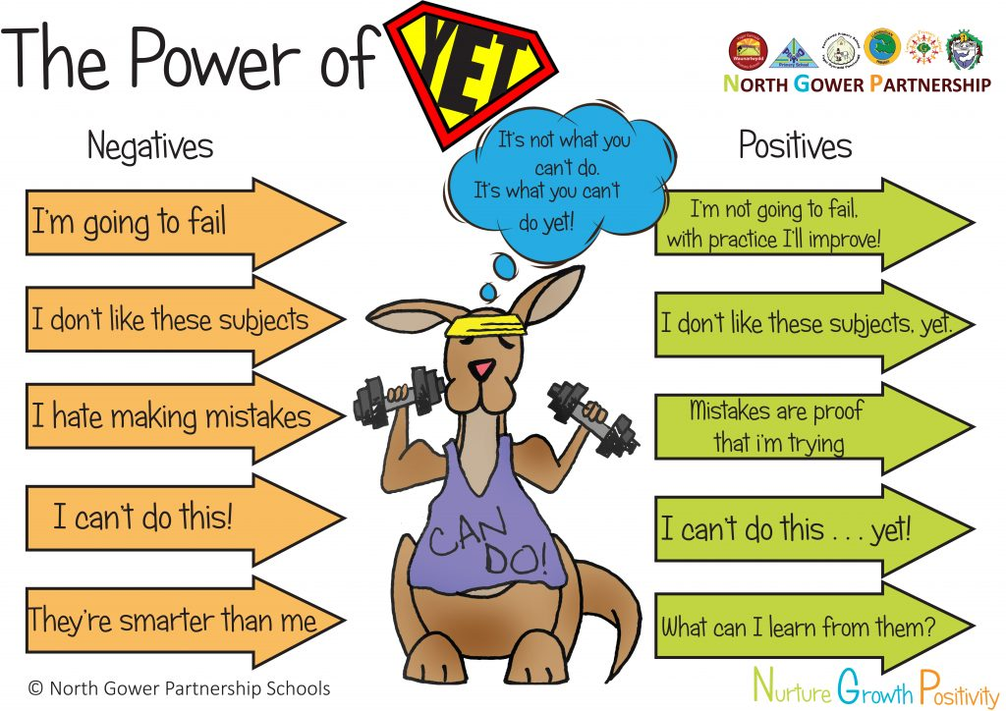
Notes:
https://www.youtube.com/watch?v=cPAbx5kgCJo

Slide 10
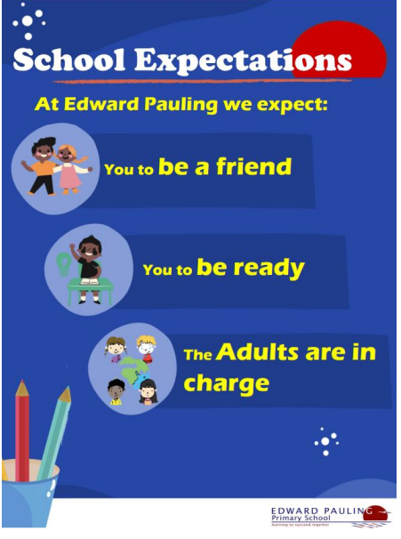
Reflection
Which School Expectation might you be able to show resilience?

