Slide 1

Notes:
https://www.youtube.com/watch?v=CMp9vnikU6M

Slide 2
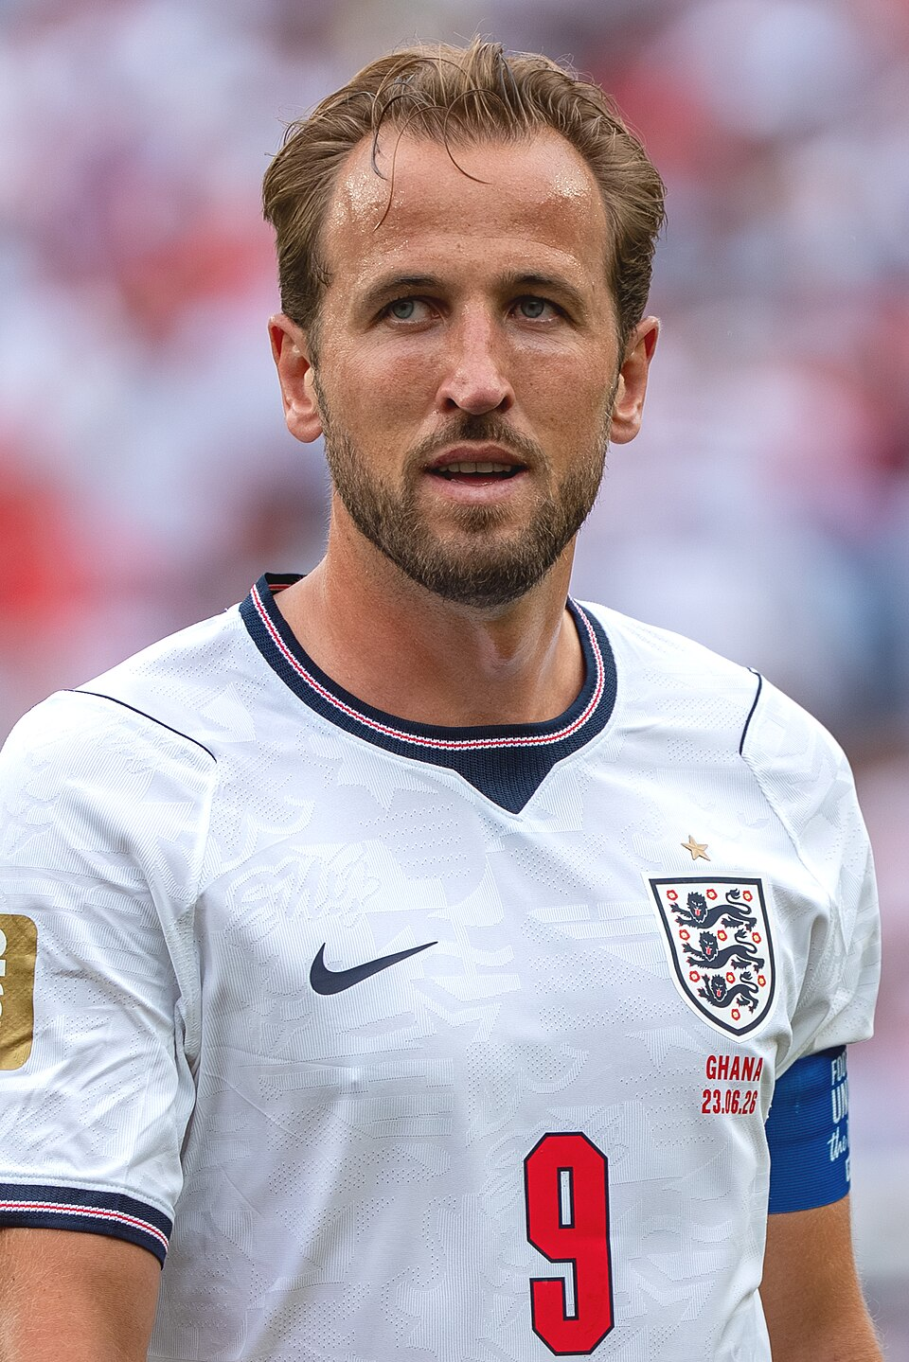

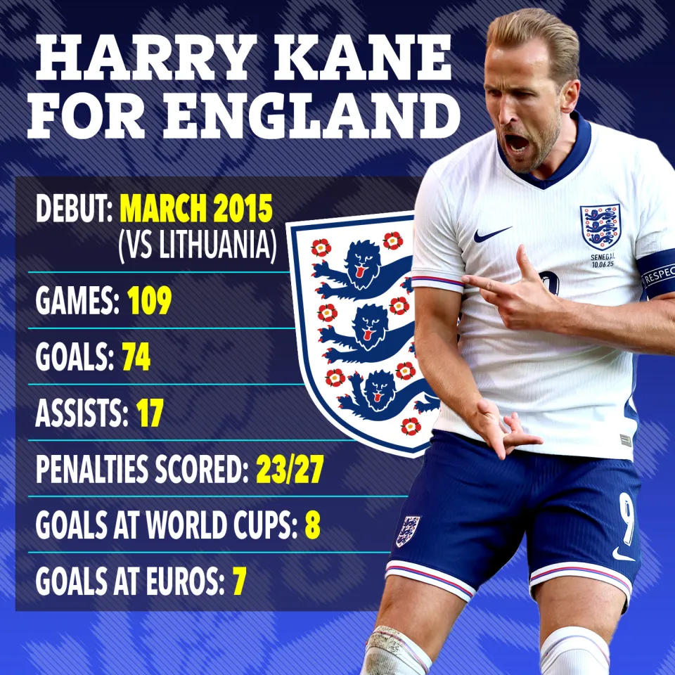
How did Harry Kane show Resilience?
Notes:
Harry kean

Slide 3
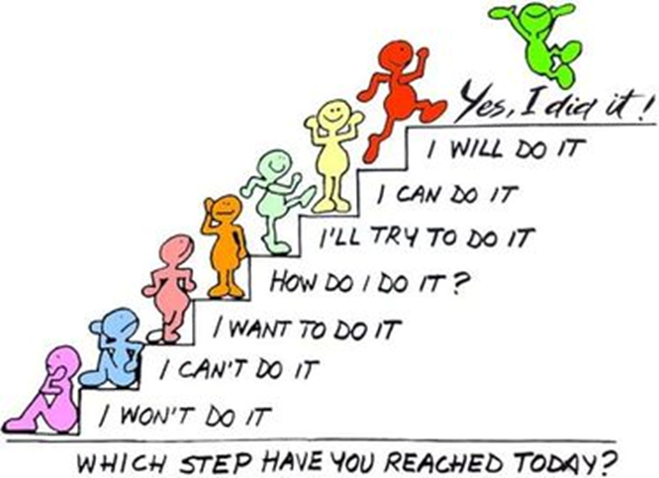
Things can knock our confidence and it is our resilience that will enable us take these issues in our stride and progress forward, rather than getting moody about it.

Slide 4

Resilience
Is more than not giving up.
It is about having faith that you can achieve
It is about dealing with your emotions when you are unsuccessful
It is about overcoming difficulties
Notes:
https://www.youtube.com/watch?v=CMp9vnikU6M&t=1s

Slide 5

Notes:
https://www.youtube.com/watch?v=BBm5DBIp-iE

Slide 6


Reflect: How is the growth of the seed like learning?

Slide 7
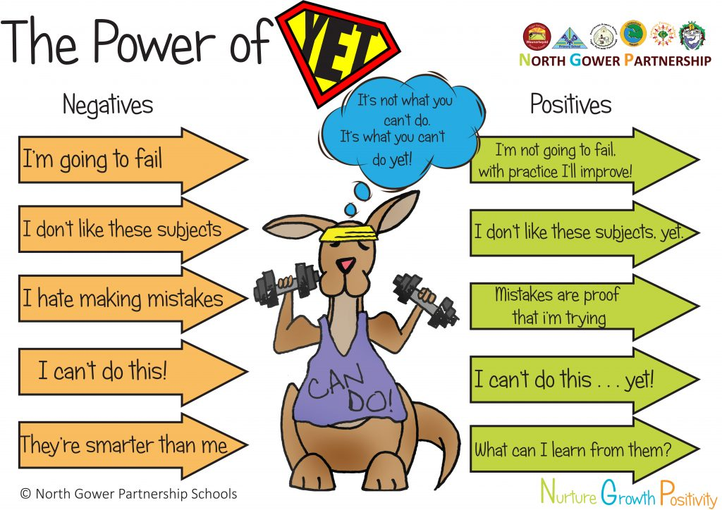

Slide 8
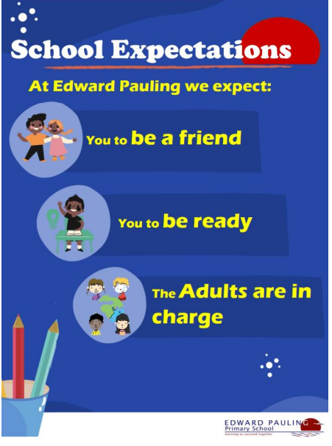
Reflection
Which School Expectation might you be able to show resilience?

