Slide 1
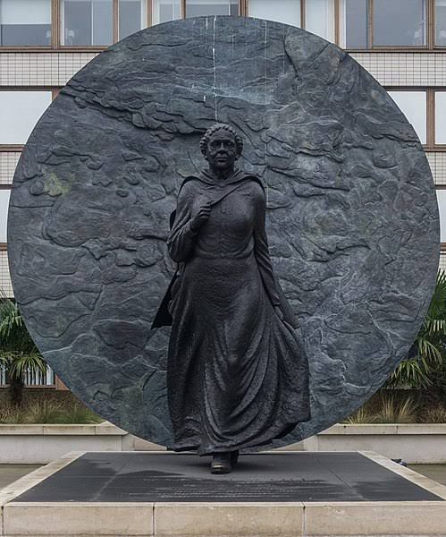
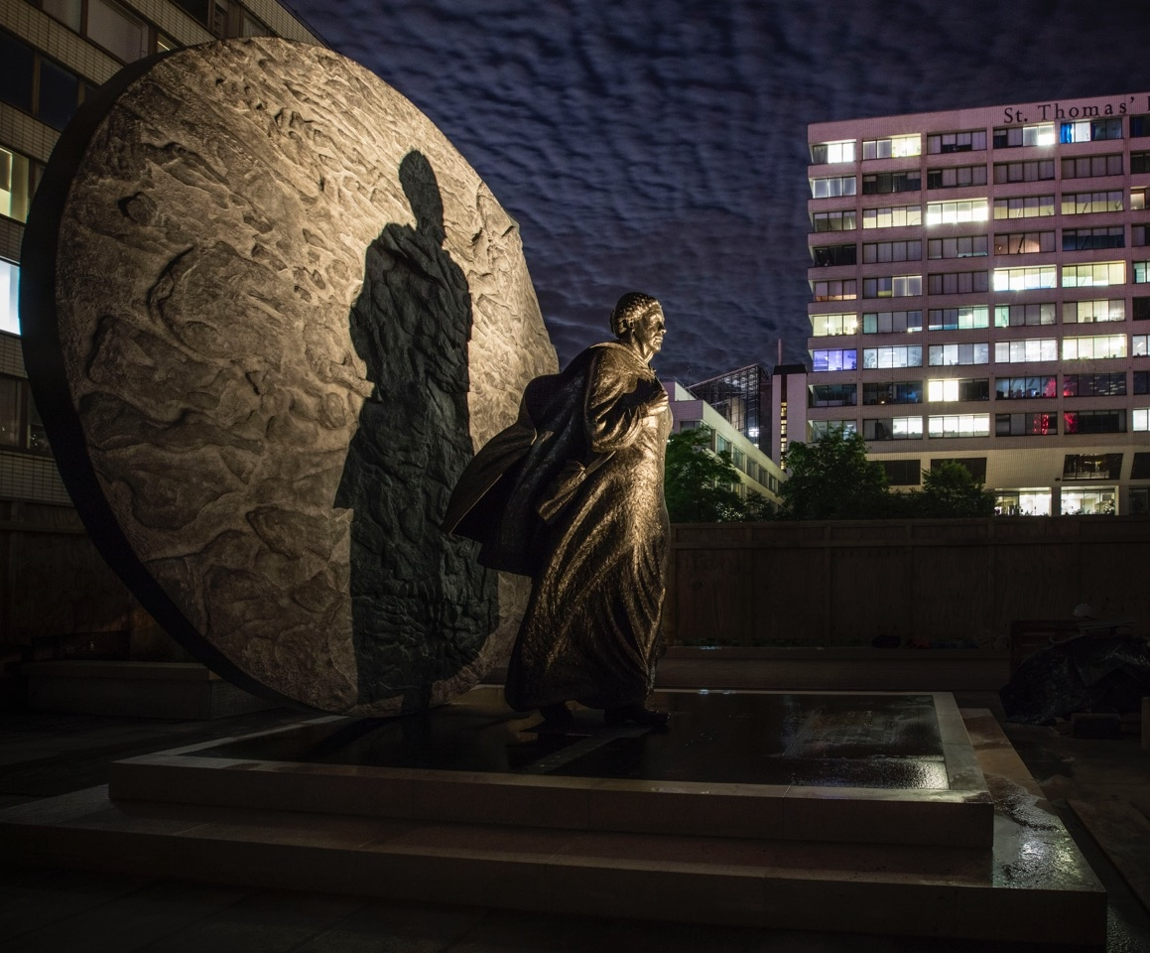
Look closely to notice 5 different things
Notes:
St Thomas hospital, London

Slide 2
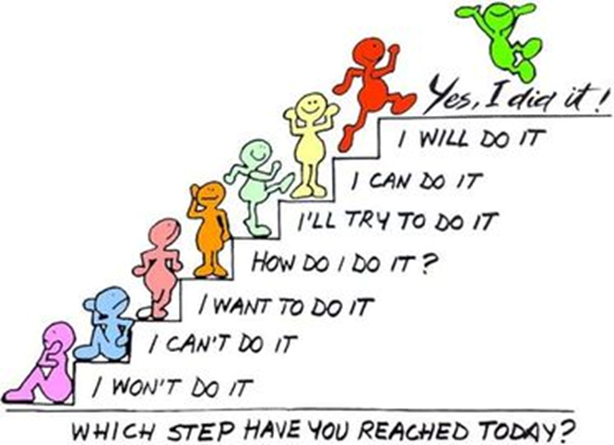
Recap
Things
Resilience is…..

Slide 3

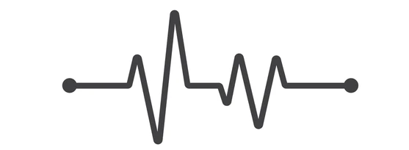
Recap
How is learning like seed growth?

Slide 4
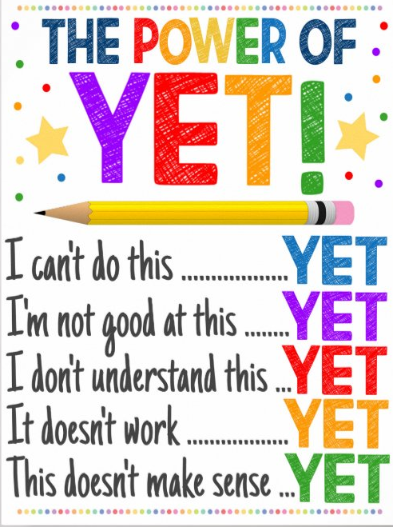
Resilience
Is more than not giving up.
It is about having faith that you can achieve
It is about dealing with your emotions when you are unsuccessful
It is about overcoming difficulties
Notes:
https://www.youtube.com/watch?v=CMp9vnikU6M&t=1s

Slide 5
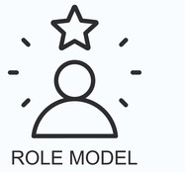
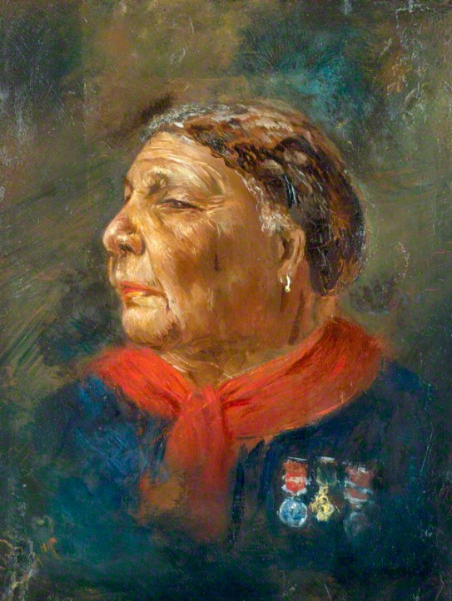
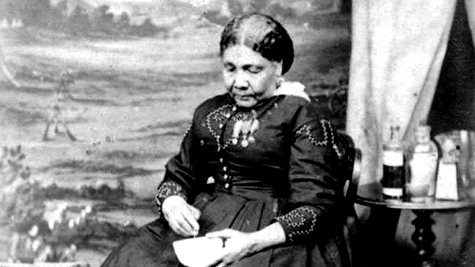
Mary Seacole
Notes:
Harry kean

Slide 6
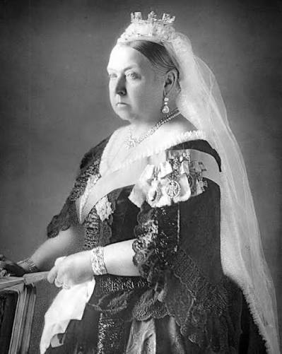
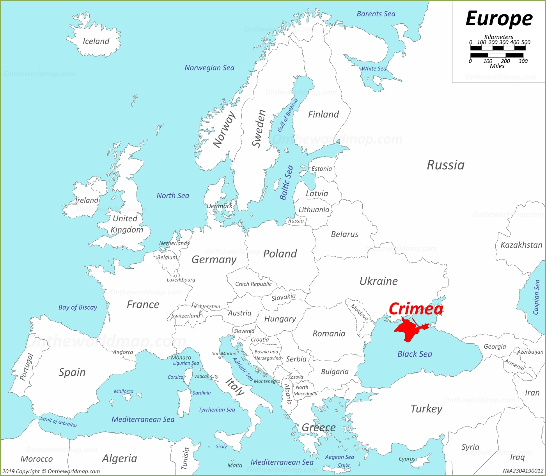
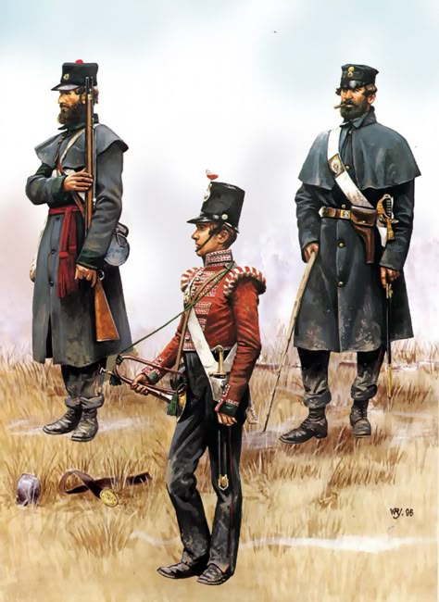
Background knowledge
Queen Victoria
The Crimean War (October 1853 – February 1856) was fought between the Russian Empire and an allied coalition of Britain, France, the Ottoman Empire

Slide 7
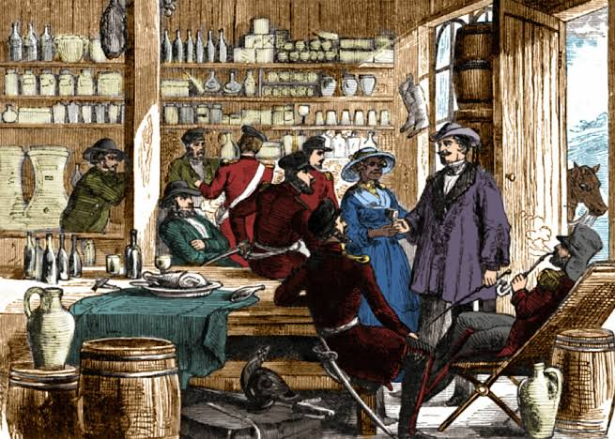
Background knowledge
British Hotel

Slide 8
Tell me 3 things that Mary Seacole did that shows she was Resilient.

Slide 9
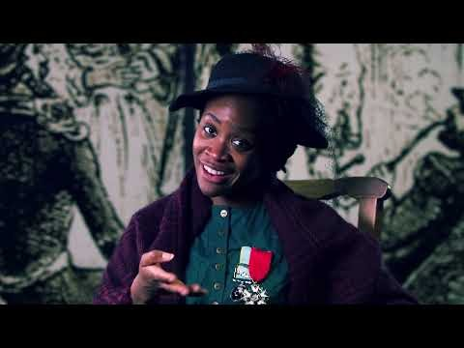
Notes:
https://www.youtube.com/watch?v=Bs32UDEvUDQ

Slide 10
What did we notice…..
Notes:
The Bronze Disc: The vertical bronze disc behind the figure is cast from an image of the earth where she built the "British Hotel". It symbolizes her global travels, pioneering independence, and the tiny fragments of earth over which conflict occurred
Forward Motion: Sculpted by Martin Jennings, the 4.9-meter-tall monument depicts Seacole marching forward against the wind, capturing her determination to reach the front lines independently after being refused sponsorship
Resilience Against Racism: The sculpture marks a historical correction for a figure whose contributions were largely overlooked in Victorian Britain after she was rejected for official military nursing roles due to her racial origin. Note the shadow is large than her figure symbolising that despite her being overlooked her achievements were heroic.

Slide 11
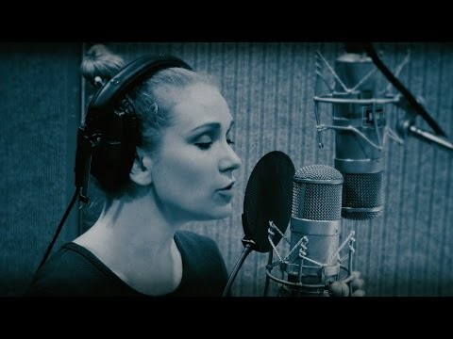
Notes:
https://www.youtube.com/watch?v=CMp9vnikU6M

