Slide 1

Learning To Succeed Together
Welcome Reception 2026
Notes:
Prefects- view of school, what learning is like, how has school prepare for later life, things they like/enjoy about school.

Slide 2


Vision and Values
At Edward Pauling Primary School, kindness and resilience are at the heart of everything we do. We believe every child deserves access to a broad and balanced curriculum that challenges and inspires.
We are committed to building a caring community where every child is seen, heard, and valued. We nurture brave, independent, and respectful learners who grow into confident and ambitious individuals, empowering them to succeed both now and in the future.

Slide 3
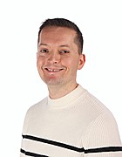
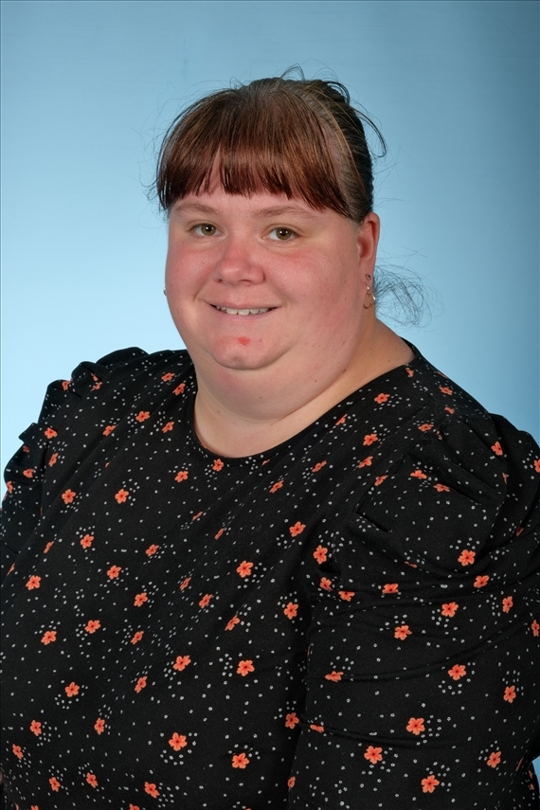
Who is Who?
Mr Malin Mrs Burnside Headteacher Deputy Headtecher and EYFS Lead
Miss Donnelly- SENDco
Mrs Grey – Admission Office and School Receptionist

Slide 4
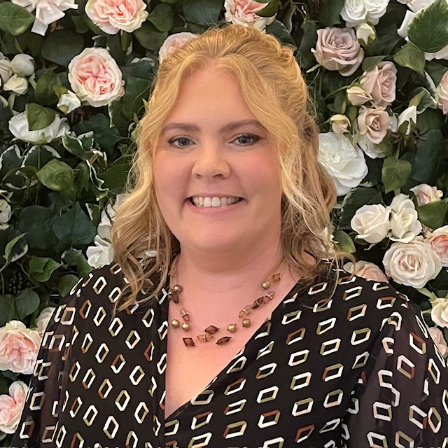
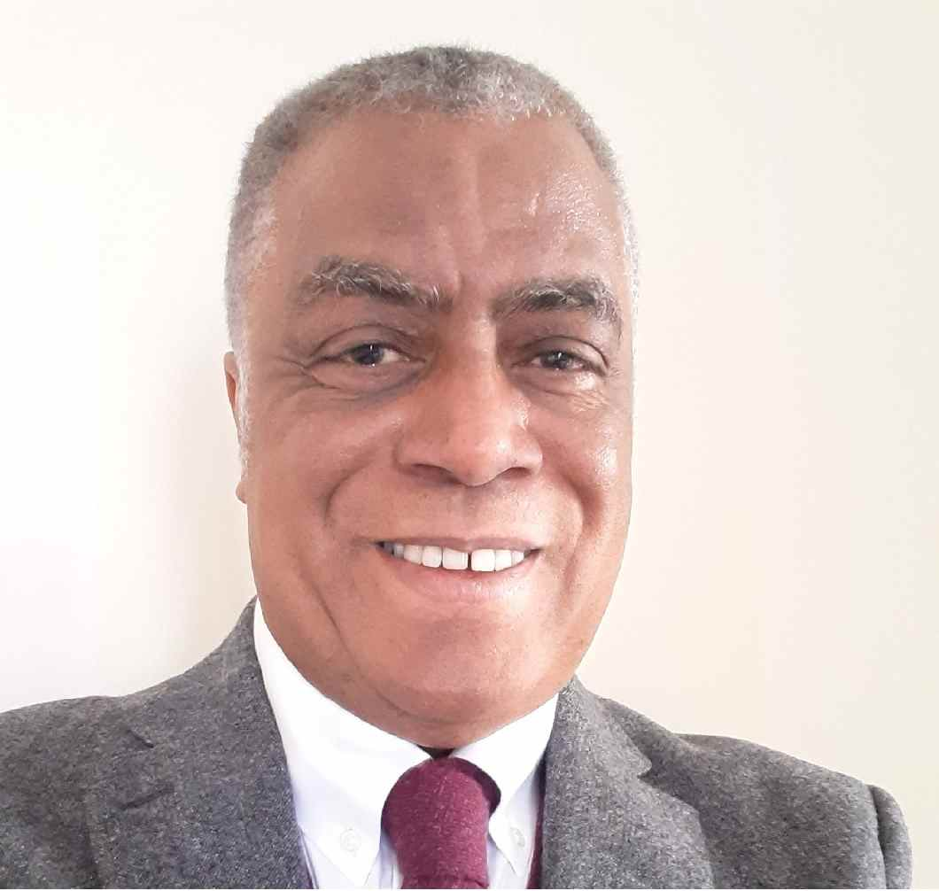
Governance
Ms Sarah Scott Mr Peter Tyndale Chair Vice- Chair

Slide 5
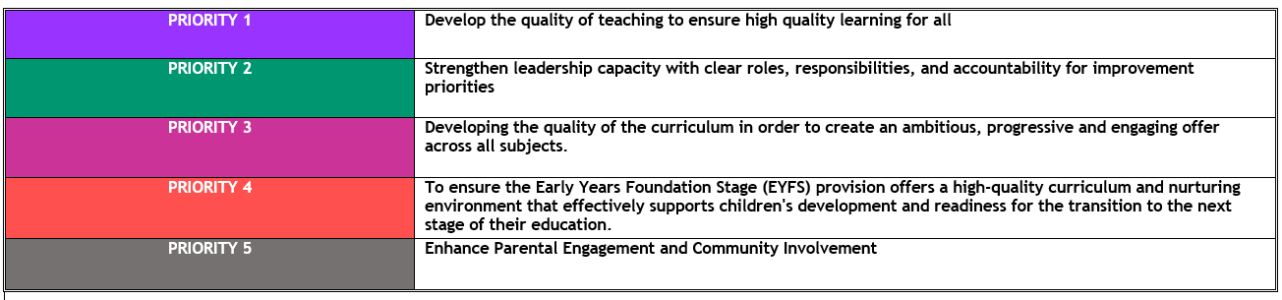
School Priorities

Slide 6

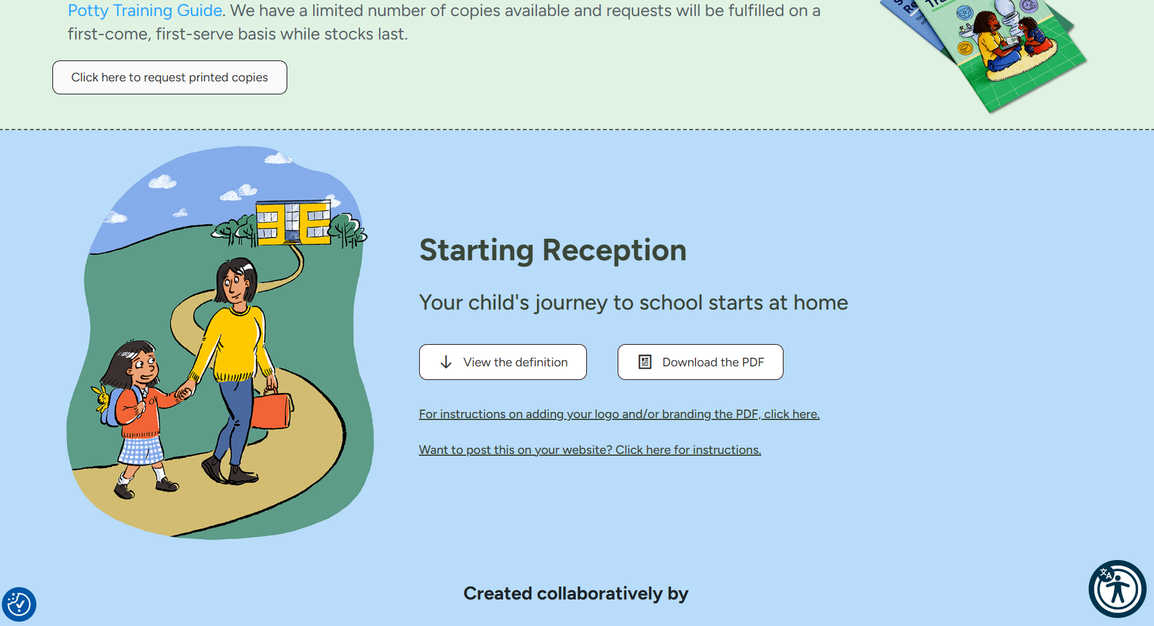
School Readiness
Growing independence
Play, creativity and curiosity
Building relationships and communicating
Communication and language
Listening and engaging
Physical development
Healthy routines
Starting Reception Checklist
www.startingreception.co.uk
Notes:
https://startingreception.co.uk/wp-content/uploads/2025/03/Starting-Reception.pdf

Slide 7
What should I do if I have concerns about my child’s development?
If you’re worried about your child’s progress, talk to your childminder/nursery/pre-school team, health visitor, local children’s centre or Family Hub.
​If your child has developmental delays or SEND (suspected or confirmed), speak to their childminder/nursery/pre-school team well before they start Reception.
You can work with your child’s early years setting to help your child with self-care, managing emotions, social skills, and communication in a way that suits their stage of development.
​You might want to share details about their development, needs, what motivates them, what might trigger difficulties, how they learn best, and what strategies work well.
Make sure you share important information with everyone supporting your child, including their new Reception teacher.

Slide 8
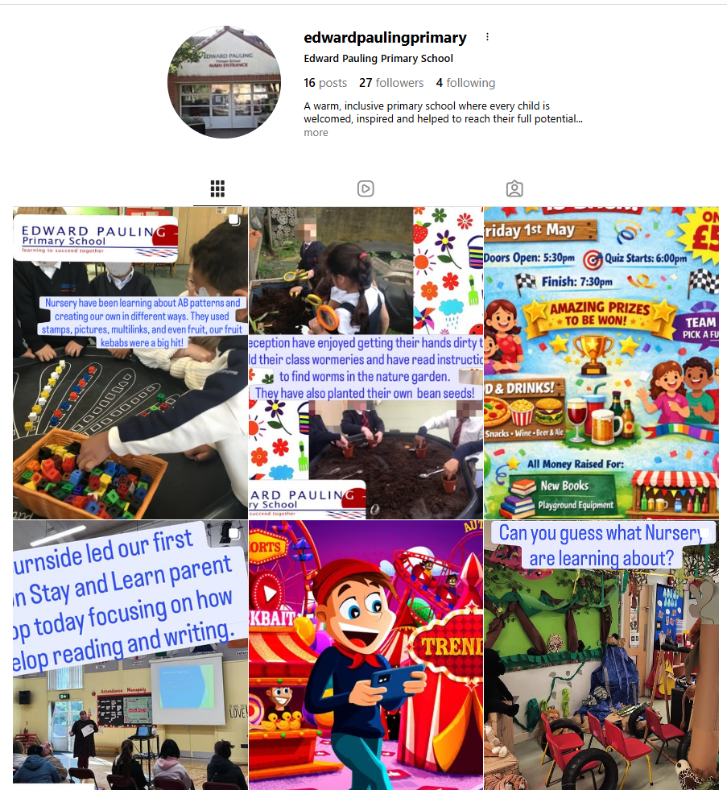
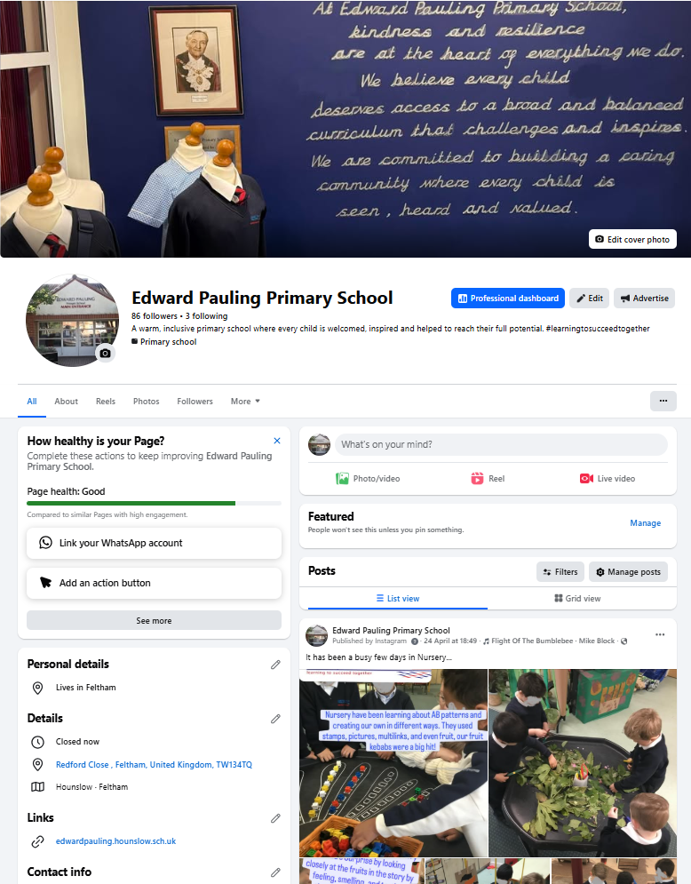
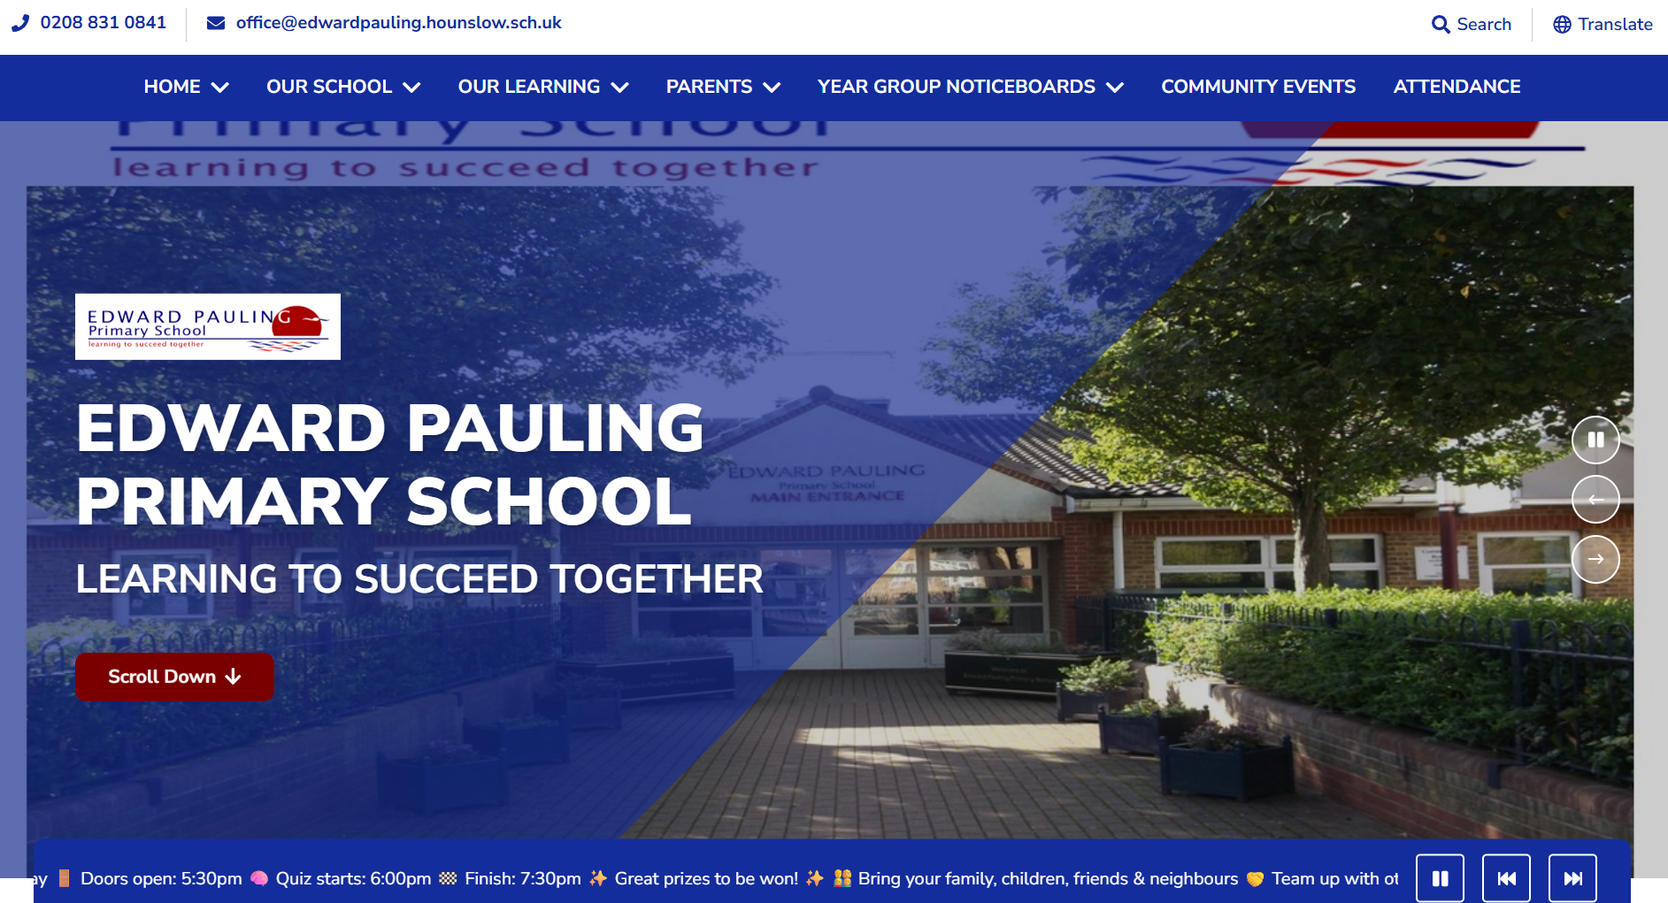
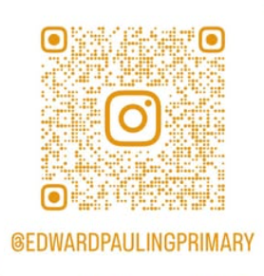
Stay in touch
Instagram
Facebook
School Website
www.edwardpauling.hounslow.sch.uk
https://www.facebook.com/
profile.php?id=61581992191099#
Notes:
Website- policies, class pages, curriculum , newsletters (Parents page)
Instagram and Facebook daily posts about school life

