Slide 1

Welcome

Slide 2
Welcome
Our aim:
Share our vision
Provide information regarding transition and school life
Provide opportunity to answer any questions
Notes:
We are incredibly privileged to be in this outstanding building with an opportunity to create something amazing from the beginning. This is a journey we want to do with you. We understand the importance of listening to our school community as we grow, so that our school reflects and responds to the needs of our community. The children are at the heart of our decisions and you as their parents know them best, so your contribution is invaluable.

Slide 3
Welcome
We, as parents, staff and children, make up the school community.
If we work together, communicate and model the school values at home, at school and in the community, every child will have the opportunity to achieve their hopes and dreams.
Their positive primary school experience will be one of a kind and will stay with them as they continue on their journey through life.
The staff at The Cambridge Primary are united: we want the best for your child. Our aim is to work with you to get to know your child so we can support them to achieve all they are capable of.
Notes:
We, as parents, staff and children, make up the school community. If we work together, communicate and model the school values at home, at school and in the community, every child will have the opportunity to achieve their hopes and dreams.
Their positive primary school experience will be one of a kind and will stay with them as they continue on their journey through life. The staff at The Cambridge Primary are united: we want the best for your child. Our aim is to work with you to get to know your child so we can support them to achieve all they are capable of.

Slide 4
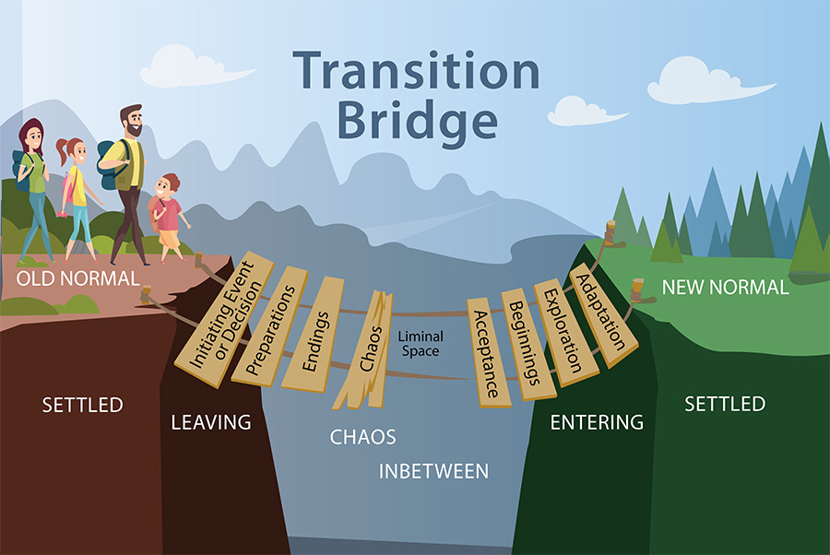
Welcome
It will take your child time to adjust.
Many children take this in their stride. Some are good at explaining things to you, telling you about their day. Others find it overwhelming and this can be expressed in different ways.
All we ask is that you talk to us – let’s work together to make this a positive start to what will be an incredible journey at The Cambridge Primary School.
Notes:
During the first few weeks in school, your child will be adjusting to a new phase of life and may find this a tiring experience. He or she is getting used to a group of new children and learning to deal with a many new situations in a new environment. Many children take this in their stride. Some are good at explaining things to you, telling you about their day. Others find it overwhelming and this can be expressed in different ways.
It does take time, we understand that, but they do all get there.
All we ask is that you talk to us – let’s work together to make this a positive start to what will be an incredible journey at The Cambridge Primary School.

Slide 5
Who is who?
Mrs Kennedy – Executive Head Teacher
Miss Tancock – Head of School & DSL
Mrs Edwards - Assistant Head Teacher (Lower School) (lowerschool@cambridgeschool.hants.sch.uk)
Miss Holmes – Assistant Head Teacher (Upper School)
Mr Tomlinson – Assistant Head Teacher & SENCO
Miss Gray & Miss Carey – Receptionist & Admin Assistant
(info@cambridgeschool.hants.sch.uk)
Miss Faul – Oak Class Teacher Miss Boyer – Willow Class Teacher
Mrs Bridge
Learning Support
HC3S Cook
Mrs Griffiths
Learning
Support (R)
Mrs Bridge
Learning
Support (R)
Mrs Dimmer
Learning
Support (R)
Mrs Hopwood
Learning
Support (Y1)

Slide 6
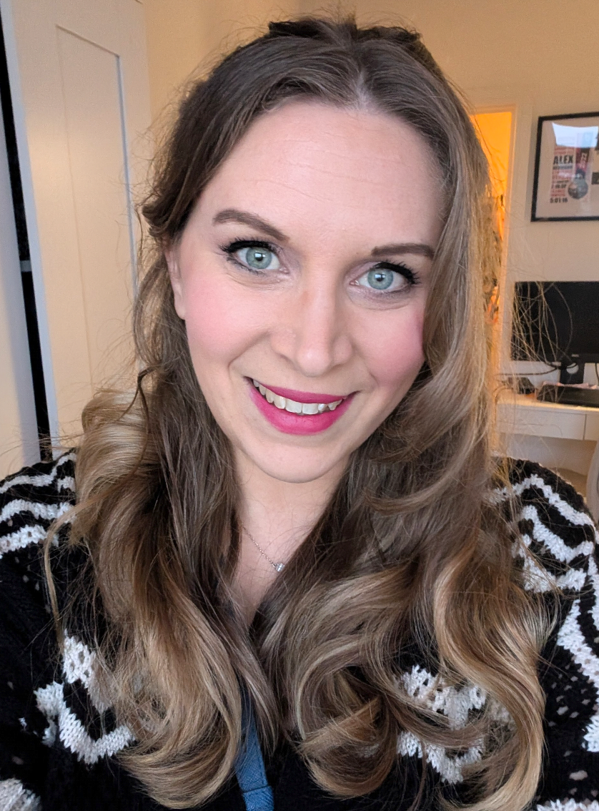
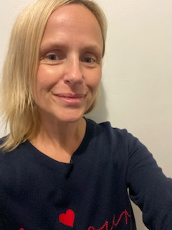
Who is who?
Mrs Bridge
Learning Support
HC3S Cook
Mrs Neumann – Oak Class Teacher
Miss Boyer – Willow Class Teacher
Mrs Griffiths
Learning
Support (R)
Mrs Bridge
Learning
Support (R)
Mrs Dimmer
Learning
Support (R)
Mrs Hopwood
Learning
Support (Y1)

Slide 7
Vision
Our School Values
Happiness
Honesty
Respect
Teamwork
Responsibility
Excellence
Notes:
The school has 6 key school values. These are our 6 half termly themes for learning and assemblies. They link in with our PSED teaching and are the values every member of staff model in their behaviour and interactions. We expect the children , and parents, to model these values too.
Happiness – we want the children to be happy. If they are happy, they are learning. School should be a positive experience and as individuals, we have the power to make others happy – a key part in our community.
Honesty – Our school, our relationships are build on trust. We want the children to feel safe and confident that they can be honest about their feelings.
Respect – Respecting not just each other but ourselves. Respecting the opinions and beliefs of others has never been more important in our world than it is today.
Teamwork – because we cannot be successful on our own, we all have different strengths and by coming together, we can achieve so much more.
Responsibility – the children are taught to take responsibility for their actions, behaviour, learning.
Excellence – we have high expectations for your children and we want them to have high expectations for themselves too.

Slide 8
Rules
Our School Rules
Be Respectful
be kind
be kind
Be Safe
Be Ready
Notes:
When it comes to school rules, we keep it simple. It is easy for everyone to remember. We expect all children to be respectful, be safe and be ready for learning. Everything comes back to these rules and the children learn them quickly. At the Cambridge, we use positive behaviour management, we praise the good behaviour and use a ‘proud cloud’ system in classes to do this. From September 2020 we will have a weekly head teacher’s award in classes to recognise the values and learning characteristics that children are showing.

Slide 9



Learning Characteristics
Notes:
We have identified 4 learning characteristics, which as a school, underpin the foundations of our teaching and learning. All learning opportunities are reviewed to ensure that there are opportunities for children to show these 4 learning characteristics. In Reception, this is in addition to the Characteristics of Effective learning which are identified by the DfE.
We are committed to ensuring that children have the opportunity to be Brave, be Innovative, Collaborate and take Ownership.

Slide 10
The Start of Term
Thursday 4th September – Tuesday 9th September – Home Visits
Wednesday 10th September – 9am – 12pm (staggered start, morning only)
Thursday 11th September – 8.30am – 1.30pm (Morning and Lunch only)
Friday 12th September – 8.30am – 3.15pm (First Full Day)
Monday 15th September onwards – Full days

Slide 11
The First Day
Wednesday 10th September
You have been given a time slot to arrive (8.35am, 8:50am, 9:05am, 9:20am)
Preparation: Talk – Try on uniform – Travel the route – Build excitement
The morning: Leave plenty of time – Use a visual timetable – Breakfast
The arrival: Come to front of the school (black side gate)
Keep yourself busy: Plan something, keep busy!
The collection: Arrive for 12pm – Wait outside the black reception gate
Later that day: Talk about the day
Notes:
On their first day, Wednesday 9th September, as mentioned, the children will arrive in groups. This is to reduce the number of people around, allowing us to support you and your child with drop off and reduce the potential of feeling ‘overwhelmed’ by lots of adults.
We would suggest talking to your child about that first day, trying on uniform, talking about travel building excitement. There are likely to be lots of nerves, not just from you!! So talking it through, even ‘walking’ it through over the summer will help. Make sure you leave plenty of time, so that there is no rush. We have put a visual timetables in your packs (next week) which you are welcome to use to help structure the morning. Make sure you have breakfast and if timing and circumstance allow, enjoy it together as a family! After drop off, keep yourself busy. This is a big day for parents, it marks the end of an era and the emotions will hit you (even if you think you will be fine!!) – so plan something to keep your mind busy.
Come 12pm it will be time to collect and then talk about their day. They will all say that they didn’t do anything, that will never change, even by Year 6 – but I can assure you they will have been busy!

Slide 12
School Bag
Named Water Bottle
Named Sun Hat/Coat
Named Sun Cream
Named Spare Uniform/Underwear (in PE bag)
Named Wellies (if possible to leave at school)
We would ask that PE kit is in school everyday.
Please do not let your child bring in toys or other treasures to school, unless asked by the teacher to do so.
Notes:
Please note: The children do not need a large back pack. They can carry all they need in a small book bag.

Slide 13
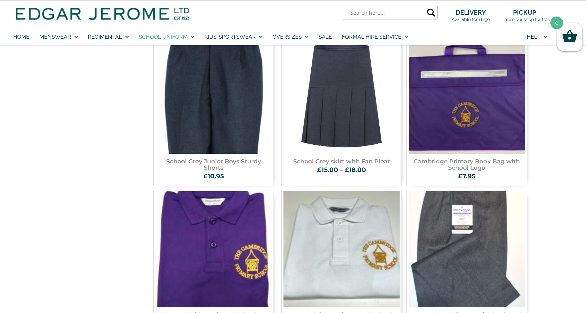

Uniform
We are proud to be working with Edgar Jerome Ltd – who are stocking our uniform.
Ways to purchase School Uniform
Website In Store

Slide 14

Uniform
Please ensure all uniform is named and spares are in their school bag.
Please buy clothing your child can manage alone (e.g. Velcro fastenings rather than laces)
In Reception, Pupils are expected to wear a school uniform selected from the following garments:
Polo Shirt (Branded optional)
Purple Branded V Neck Jumper/Cardigan
Grey Trousers/Shorts/Skirt
Grey/White/Purple Socks/Tights
Black Shoes or Sandals (with closed toe)
(PE) Purple Branded Polo Shirt
(PE) Black Shorts (leggings)
(PE) Branded Hooded Sweatshirt / Black Hoodie (plain) / Zip Up
(PE) Children do educational gymnastics in bare feet. Trainers can be worn for outdoor activities. Please make sure trainers are always in their bag. Boot trainers are not considered suitable.
Optional: Purple Summer Dress, Purple Summer Cap, Purple Jacket, Book bag, PE Bag
Pre-loved Uniform
Teddy Bears Picnic

Slide 15
The Drop Off
From Thursday 11th onwards
The school gates are opened at 8.30am for registration and at 8.45am the outside doors and gates are locked to ensure safety of the children. You make your way through the black gate and drop your child off at the gate to the Reception outside area.
We ask parents and children to wait in the queue on the right hand side at the front of the school before 8.30am.
If your child arrives after 8.45am, please enter via the school office.
Notes:
To support with drop off, please bring your child to the classroom door where an adult will greet them. In our experience, a speedy drop off works well. We understand this may be different to what your child may be used to at nursery and we will support them to adjust to this drop off routine.

Slide 16
The Drop Off
Each child has a named peg. There are boxes for their school bags/book bags to go in. There is also a named spot for their water bottle to be placed. Your child only needs a small book bag and a draw string PE bag – the pegs can get very busy otherwise!
If you wish to speak to the class teacher briefly, this can be done at drop off time. If you wish to discuss something in more detail, please arrange a mutually convenient time or contact Mrs Edwards.
lowerschool@cambridgeschool.hants.sch.uk

Slide 17
The Pick Up
The school day finishes at 3.15pm.
Parents queue outside the front of the school as in the morning. When the gates open, make your way to the Reception area where the teachers will be waiting with the children. If you have make alternative arrangements for pick up – please let the class teacher know by letter or the school office know by answer phone.
If you are not at school by 3.30pm, your child will be taken to the Nest and you may incur a charge.

Slide 18
Travelling to School
Parking at school and travelling to school are usually contentious issues at school.
We have no parking at school. Either:
Walk/Scoot/Cycle from home
Park and Stride from further afield (Garrison Cathedral, Fox Lines)
Support us in creating a Healthy, Safe, Happy Community.
Where at all possible, Walk, Scoot or Cycle to school.
Notes:
As with all schools parking can be a contentious issue. Even with our school, where we are not in a built up area and small numbers, we have had issues – all of which come back to one or two parents not being respectful of what the school is asking. The road outside the school and the park and stride car park do not belong to the school and there is little I can do to enforce anything there, other than plead with parents to be respectful and safe when parking, dropping off and collecting.

Slide 19

The Nest
Breakfast club from 7.30am
After School Club until 6pm
The Nest: Early Birds:
7.30am - 8.30am: £6
The Nest Session:
Session 1: 3.15pm – 4.15pm: £6.50
Session 2: 4.15pm – 6pm: £11
Session 3: 3.10pm – 6pm: £13
Booking is essential
(details how to do this will follow)
Notes:
As with all schools parking can be a contentious issue. Even with our school, where we are not in a built up area and small numbers, we have had issues – all of which come back to one or two parents not being respectful of what the school is asking. The road outside the school and the park and stride car park do not belong to the school and there is little I can do to enforce anything there, other than plead with parents to be respectful and safe when parking, dropping off and collecting.

Slide 20
Keeping us healthy - NHS
The School Nurse Team will pop in at several points over the course of the year to check vision, height and weight in addition to nasal immunisation.
The school nurse team are also there to support our families. They offer regular support. If you have any concerns regarding your child’s development, let us know. We may be able to sign post you in the direction of support with the help of the school community nurse team.
They are providing a ‘School Ready’ Workshop on 16th July before the Teddy Bears Picnic.
Notes:
The School Nurse Team will pop in at several points over the course of the year to measure the children, administer nasal immunisations and check hearing and vision.
The school nurse team are also there to support our families. If you have any concerns regarding your child’s development, let us know. We may be able to sign post you in the direction of support with the help of the school community nurse team.

Slide 21
Absence
If your child is absent due to illness, please inform the school by telephone (01252 314884) before 9.30am on the first day of the absence. When your child returns, a letter or email (info@cambridgschool.hants.sch.uk) of explanation will be required for our records, in addition to the original phone call.
Please see our Attendance Policy (on the school website) for more information regarding requests of leave of absence.

Slide 22
Absence
We firmly believe that all pupils benefit from regular school attendance. Full and regular attendance at school is crucial for a child’s future life chances and establishes a positive work ethic early in life.
Coughs and colds are highly likely, particularly during the autumn term. Children can attend school with a mild cough or cold.
If necessary, we will administer medicine to your child, but this must be signed in at the office daily (and will be sent home daily). Please see our policy on Administering Medicine (online) for more information. No medicine in school bags!

Slide 23


Snack Time
Snack time is a social activity in which we will sit down as a class, talk and learn about the food we eat, share and take responsibility for handing out the food.
This will be flexible around the children’s learning and play.
Thanks to the School Fruit and Veg Scheme, supported by NHS, all children in KS1, will be able to choose from a variety of Fruit and Vegetables every day.
Children under 5 (or children eligible for Pupil Premium funding) receive free milk every day. Once your child turns 5, you must pay a monthly subscription, around £14, to continue their daily milk. We will register your child for you, providing Cool Milk with their name and Date of Birth. If you would NOT like your child to receive free milk, please let us know. Other wise your child will receive free milk until the Friday before their 5th birthday.

Slide 24
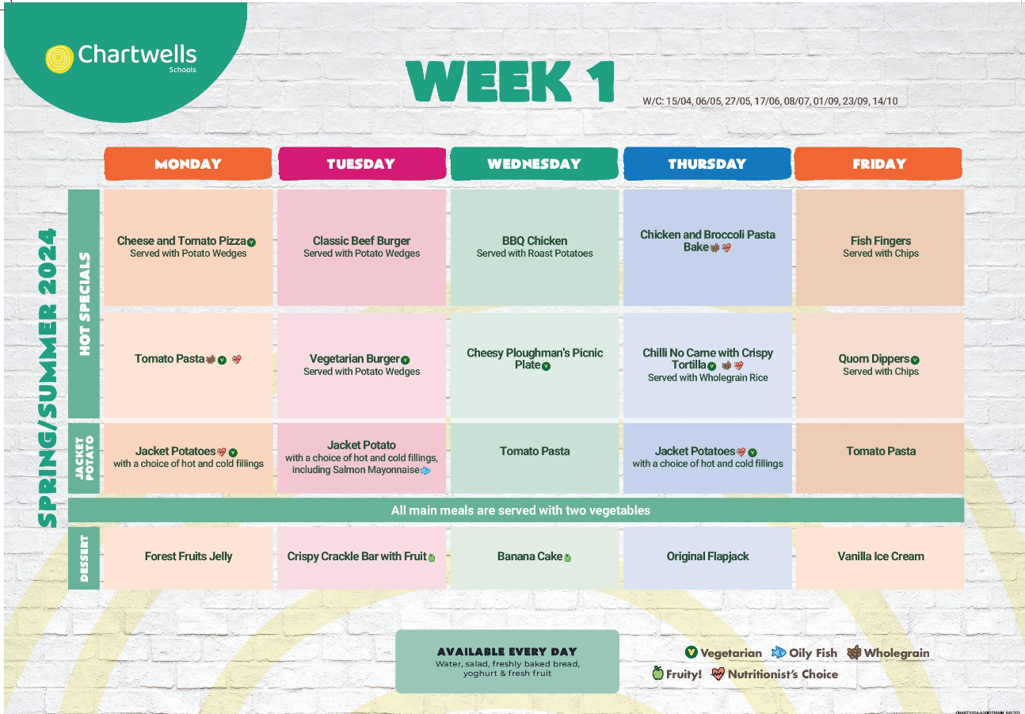
Lunchtime
Chartwells provide our catering.
A copy of the menu will be available on our website.
There are a variety of meal options including meat, vegetarian, pasta and jacket potato. You will be able to preselect your child’s lunch via Arbor (details to follow) but your child will also be able to tell their teacher which meal they would like. Hot, healthy school dinners are free in Reception and we would encourage all children to have a hot dinner, no matter how fussy!
If your child has a Medical Special Diet – please speak to us.
Continue to communicate with us!

Slide 25
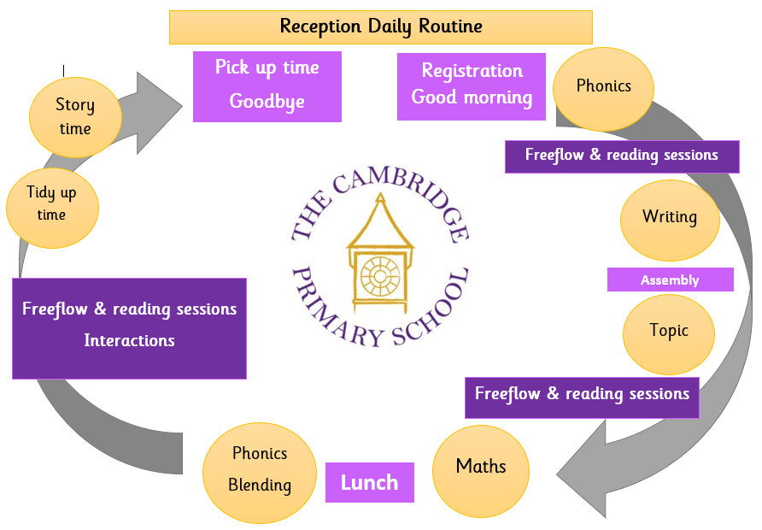
Daily Routine
Our aim is to provide an engaging environment, in which the children can play, explore, create and think; supporting them in their journey to become effective, motivated learners. Our school day has a flexible structure, allowing opportunity for teacher led and child led learning and play.

Slide 26
Curriculum
In Reception, we follow the Early Years Statutory Framework for the Early Years Foundation Stage. This Framework is separated into Prime and Specific areas for development. The prime areas begin to develop quickly in response to relationships and experiences, and run through and support learning in all other areas. The prime areas continue to be fundamental throughout the EYFS. These are:
Communication and Language development
Personal, Social and Emotional Development
Physical Development
The specific areas include essential skills and knowledge. They grow out of the prime areas, and provide important contexts for learning. These are:
Literacy
Mathematics
Understanding the World
Expressive Arts and Design

Slide 27
Curriculum
Underpinning these areas for development, we provide opportunities of the children to develop their characteristics for effective learning; providing opportunities for the children to engage with other people and their environment – playing and exploring, active learning, and creating and thinking critically.
Over the course of each day, there are a variety of engaging activities which the children can freely move between, some of which are teacher led and some are child led. There is daily teacher input for maths and phonics, which are then linked to some of the continuous provision challenge areas, inside and outside of the classroom, which the children can explore independently.
Notes:
CofE is in addition to and complimenting our school’s learning characteristics (Brave, Innovative, Collaborative and taking Ownership)

Slide 28

Curriculum
Our curriculum is delivered through topics.
During each topic there are Hook Days!
For more information, please see our Curriculum Policy and our Early Years Policy, available on our website under School Info/Policies.
Notes:
Our curriculum is delivered through engaging topics. There are 6 during the year which begin with questions to promote the children’s curiosity. The children start by talking about what they know and what else they want to find out. This steers the learning as experiences are planned to support the children to make discoveries.

Slide 29
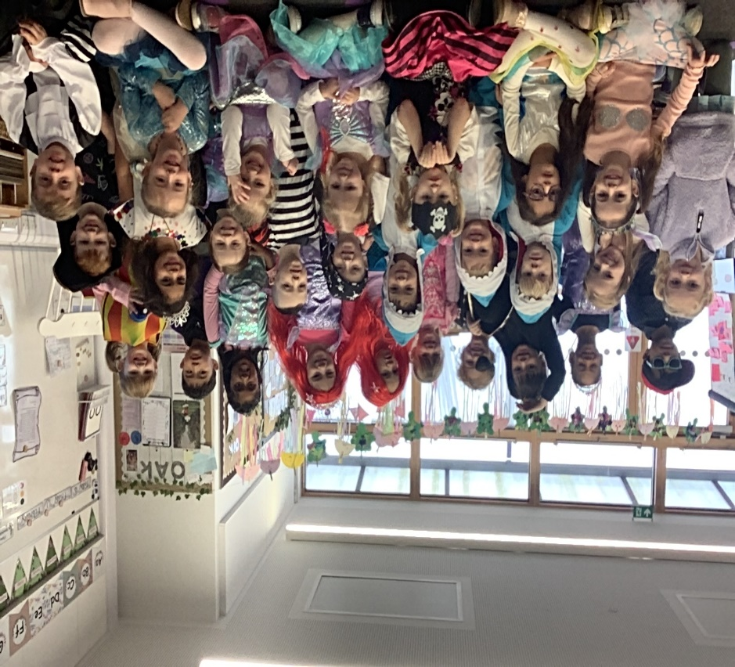

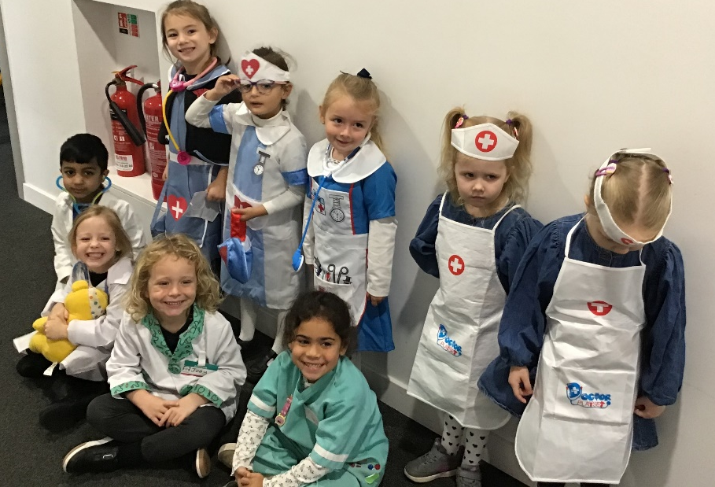
Hook Days

Slide 30

Tapestry
Your child’s learning at school is documented using Tapestry. This is a secure online Learning Journal to record photos, observations and comments. It builds up a record of your child's experiences during their time in Reception.
Share out of school learning experiences such as reading, a family walk, playing with a favourite toy or helping out at home. This can include photos or videos. The children particularly like sharing these with their class.

Slide 31
Home Learning Expectation
Research has also repeatedly shown that parental involvement in their child’s schooling is a more powerful force than other family background variables, such as social class, family size and level of parental education. Parental involvement has a significant effect on pupil achievement throughout the years of schooling.
The purpose of home learning is to enhance a child’s learning and provide a partnership between home and school that is clearly identifiable to the child.
The tasks set should not intrude unreasonably into the interests of the children beyond the school day. We suggest setting aside a specific time for your child to complete their home learning to embed routines that will develop their study skills as they progress through school.

Slide 32
Home Learning Expectation
Parents receive a home learning letter every Friday detailing the phonics , maths and topic for the week. In addition, there are suggestions for Home Learning Projects during each topic.
In Reception, the expectations are:
Reading: Daily 10 minutes - recorded in their Reading Record.
Phonics: Daily 5 minutes
Maths: Daily 5 minutes
This is shared in a weekly learning letter, which is sent home and uploaded to the website.

Slide 33
Reading
“Children are made readers on the laps of their parents.” Emilie Buchwald
“The more that you read, the more things you will know. The more you learn, the more places you’ll go.” Dr. Seuss
“Reading should not be presented to children as a chore or duty. It should be offered to them as a precious gift.” Kate DiCamillo
“Once you learn to read, you will be forever free.” Frederick Douglass
Reading enjoyment has been reported as more important for children’s educational success than their family’s social economic status (OECD, 2002).
Evidence suggests that reading for pleasure is an activity that has emotional and social consequences (Clark and Rumbold, 2006).
Notes:
We cannot emphasise enough the importance of reading for the children. Reading is prioritised at The Cambridge, including developing reading for pleasure, the joy of sharing books in addition to learning to read. During our topics, learning is based upon rich texts which the children listen to repeatedly.
In the pack you received today, there is a summer reading record for you to complete every time you complete a reading–related activity together.

Slide 34

Reading
We teach reading using the phonics programme Little Wandle Letters and Sounds.
In our classrooms, we have fully phonetically decodable reading books to match your child’s stage of reading development.
Two reading books a week:
Learn to Read book (matching the child’s phonic development-read every day for 1 week, to build confidence and fluency). This book will be sent home for the weekend but must be returned on the following Monday.
Love to Read book (to be shared and enjoyed, used to develop comprehension and promote love of reading)
The children will be reading regularly at school, to an adult, but for good progress, reading must be part of a child’s daily home routine.

Slide 35
Assessment
Purpose: To identify where your child is against the objectives in our Reception curriculum, to set targets and put personalised learning experiences in place where necessary
How: Discrete assessments using observations, teacher led tasks, 1:1 activities over the first half term, Statutory Baseline Assessment, Little Wandle Phonics Assessment, Reading Assessment (Running Record), Maths Assessment

Slide 36
Assessment
Initial Assessment
Statutory Reception Baseline Assessment
– September/October
Ongoing Assessment – Throughout the year
End of Year Assessment – Against the Early Learning Goals

Slide 37
Assessment
Communication of Assessment
Autumn Term Parents’ Evening (December 2025)
Spring Term Parents’ Evening (March 2026)
End of Year Report (July 2026)
Optional Summer Term Parents’ Evening (July 2026)
Additional meetings with your class teacher available throughout the year.

Slide 38
Summer Preparation
Gently talk about it, drop it in
Try on uniform (and wash it)
Practice the route to school (visual timetable)
Draw pictures
Look at school website
Reading (Summer Reading Record), Start a ‘Reading Routine’
Toilet Training/Hand Washing
Knife and Fork skills
Use the checklist we have provided

Slide 39
Communication
In the event of an emergency, such as school closure in adverse weather, we will send a text message and email to all parents. Emergency information is also posted on the school website. It is therefore very important that the school office is informed of any changes to your contact number and email addresses.

Slide 40
Communication
Communication between home and school is essential.
Newsletters, Parent Workshops. Please also check your child’s bag daily for letters and their reading record. A weekly letter is sent home every Friday.
Please note, majority of school correspondence is sent by e-mail to parents using the e-mail addresses given on the admission form. Newsletters will also be uploaded to the school website.
There will be regular opportunities to come in (stay and play, mystery reader)!
If you need to change your normal collection arrangements, please notify the class teacher by letter or the school office by our answer phone system. We will not let the children go until we see an appropriate adult waiting.

Slide 41
Communication
If you have any concerns, worries or queries, get in contact:
lowerschool@cambridgeschool.hants.sch.uk
info@cambridgeschool.hants.sch.uk
Or arrange a time to come and speak to us.
Keep in touch!

Slide 42

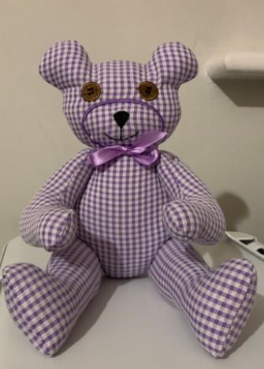
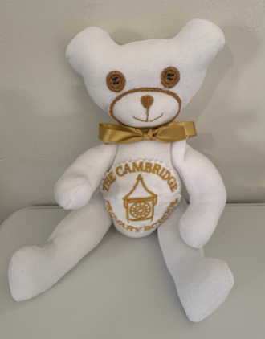
Transition
Wednesday 16th July 2025
2.45pm-3.15pm School Nursing Team ‘School Ready’ Workshop (school hall)
3.30pm to 4.30pm Teddy Bears Family Picnic (Early Years area)

Slide 43

“We are delighted with the progress he has made since September. He loves learning new sounds and learning to read new words.”
“He is always excited about what he will be doing at school. We couldn't be happier!”
“We really appreciate the Head teacher being at the gates in the morning greeting all the parents and children, [my child] loves this too.”
“I love how the school encourages the children's good behaviour by using positive reinforcement.”
“Since starting school we have seen a massive difference identifying letters, numbers and even blending words.”
“This school is nurturing and inspiring. We really couldn't be happier!”

