Slide 1


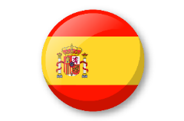

Knowledge organiser: The calendar and celebrations.
Noun Bank
lunes - Monday
martes - Tuesday
miércoles - Wednesday
jueves - Thursday
viernes - Friday
sábado - Saturday
domingo - Sunday
Noun Bank
enero - January
febrero - February
marzo March
abril - April
mayo - May
junio - June
julio - July
agosto - August
septiembre – September
octubre – October
noviembre – November
diciembre - December
Grammar
When you ask a question in Spanish you can turn a sentence into a question by raising the pitch of your voice at the end of the question. Practice reading these phrases!
Hoy es lunes. – Today is Monday.
¿Hoy es lunes? – Is it Monday today?
Question and Answer Bank
¿Cuándo es tu cumpleaños? - When is your birthday?
¿Qué día es hoy? - What day is it today?
Grammar
When words are the same in two languages we call them cognates and when they look very similar we call them semi-cognates.
Fact Bank
Months of the year and days of the week in Spanish do not have a capital letter.
Phonics
mier
ma
ju
bre
Fact Bank
Some of the Spanish days of the week are named after the planets!
e.g. martes → Mars

