Slide 1
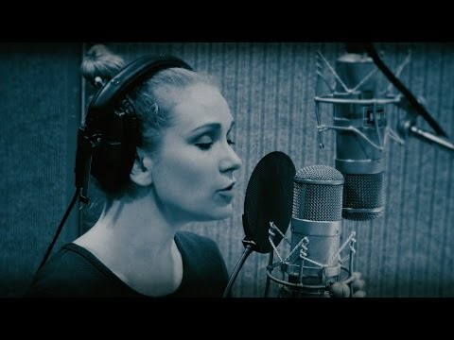
Notes:
https://www.youtube.com/watch?v=CMp9vnikU6M&t=1s
https://youtu.be/CMp9vnikU6M

Slide 2

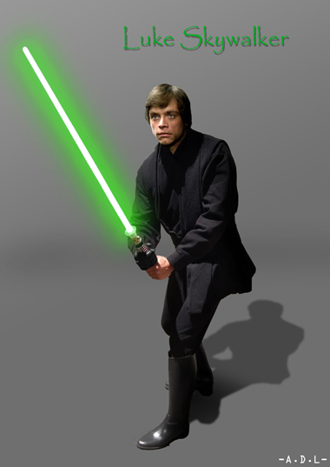


What do these characters have in common?

Slide 3
Resilience
All of these characters have overcome various obstacles that could have stopped them achieving their potential.
They did this by being resilient.

Slide 4
What is Resilience?
How did the characters show resilience?

Slide 5
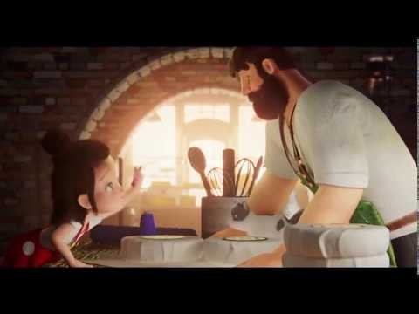
Notes:
https://www.youtube.com/watch?v=jfqj7Qs-9Is

Slide 6
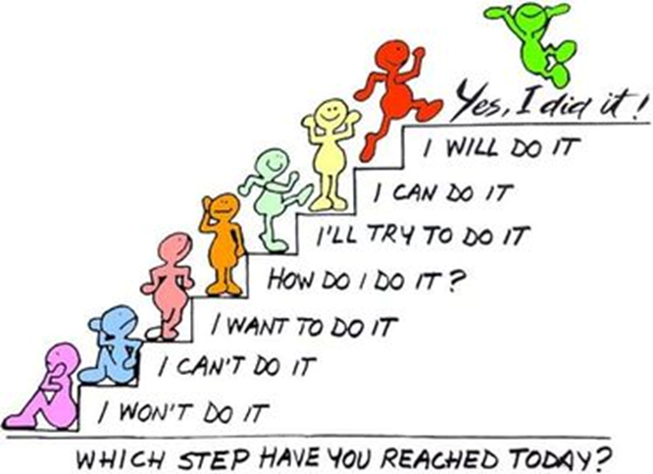
Things can knock our confidence and it is our resilience that will enable us take these issues in our stride and progress forward, rather than getting moody about it.

Slide 7
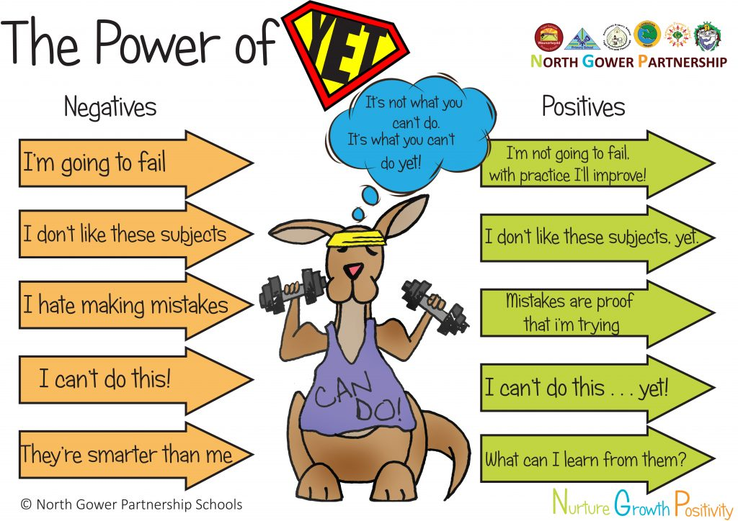
Notes:
https://www.youtube.com/watch?v=cPAbx5kgCJo

Slide 8


