Slide 1
Resilience
Assembly 2-22.09.25

Slide 2
https://www.youtube.com/watch?v=CMp9vnikU6M&t=1s
Notes:
https://www.youtube.com/watch?v=CMp9vnikU6M&t=1s

Slide 3
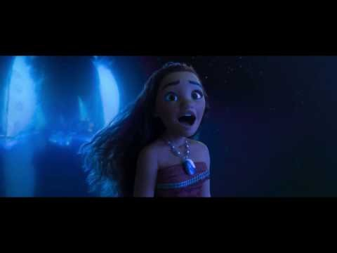
Notes:
https://www.youtube.com/watch?v=HEiSF8HpyDg

Slide 4
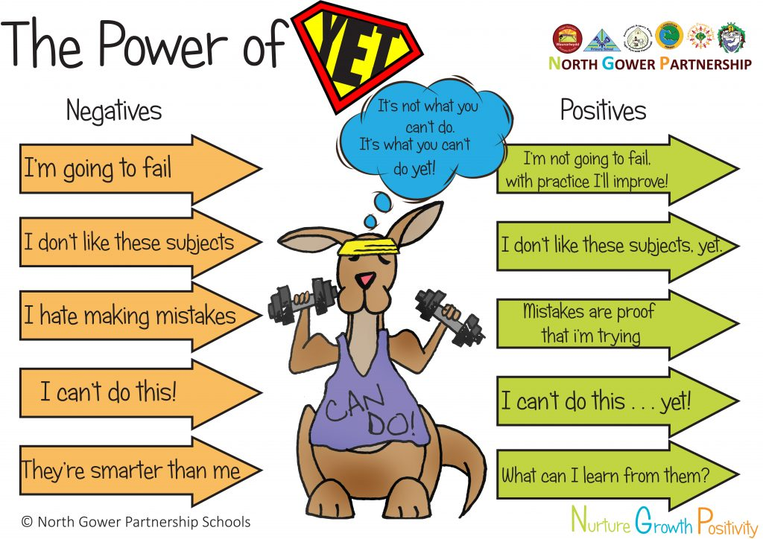
Do you know who you are?

Slide 5
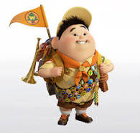
How would you describe Russell?

Slide 6
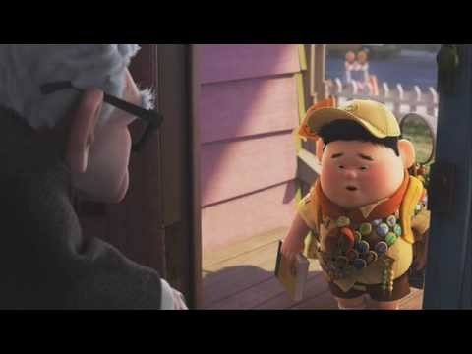
Notes:
https://www.youtube.com/watch?v=08K3WNKt-Lg

Slide 7
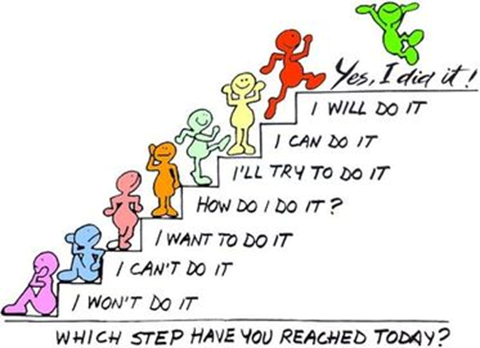
Russell
How is he showing Resilience?

Slide 8

Resilience
Is more than not giving up..
It is about having faith that you can achieve
It is about dealing with your emotions when you are unsuccessful
It is about overcoming difficulties
Notes:
https://www.youtube.com/watch?v=CMp9vnikU6M&t=1s

Slide 9
In Class reflection- class teacher follow up
In Class- Link to the power of yet.
What did Mona want to achieve?
What goals did she set herself?
What choices could she have made- why might she have made those choices?
Would it have been easy for her to have given up- why didn’t she ?
How would you have shown resilience if you were in
the same situation?
https://www.youtube.com/watch?v=OrYv1McKk7U

Slide 10
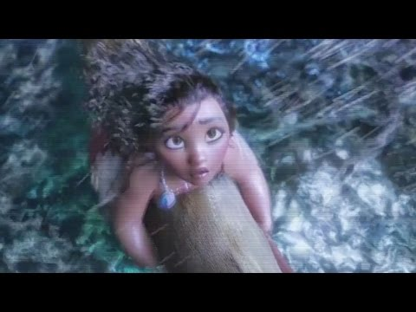
Notes:
In Class- Link to the power of yet.
What did Mouna want to achieve? What goals did she set herself?
How would you have shown resilience if you were in the same situation?
https://www.youtube.com/watch?v=OrYv1McKk7U

