Slide 1
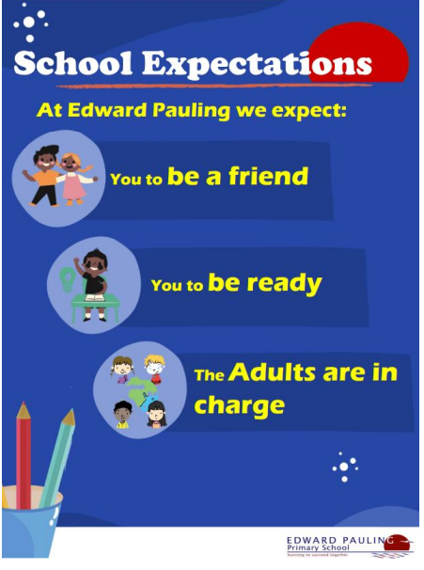
What do our school Expectations mean?
Why they important in our school?

Slide 2
Resilience
Assembly 3- 06.10.25

Slide 3
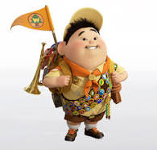
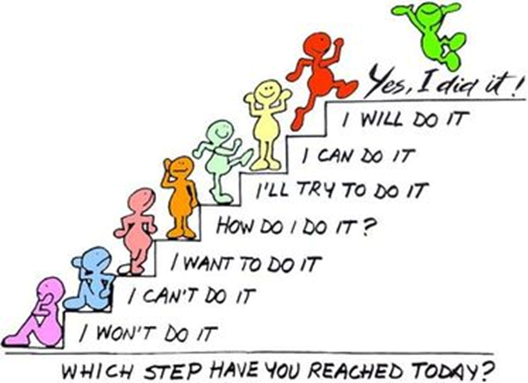
Russell
How is he showing Resilience?

Slide 4
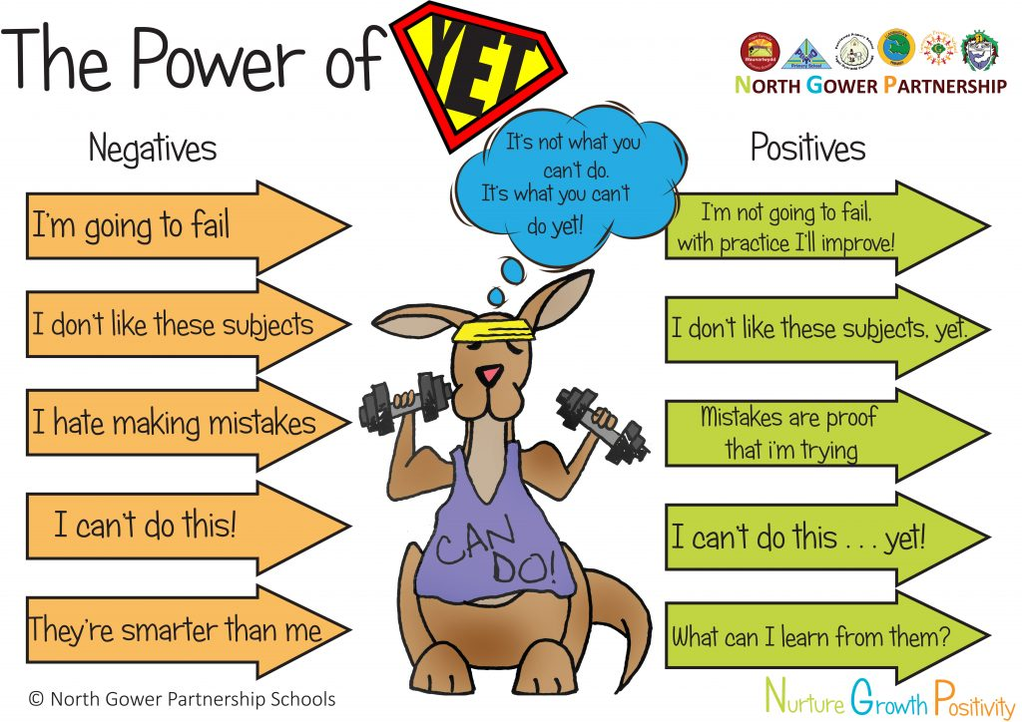


Recap- class Assembly
What did Mona want to achieve?
What choices could she have made-
why might she have made those choices?
How would you have shown resilience if you were in
the same situation?

Slide 5
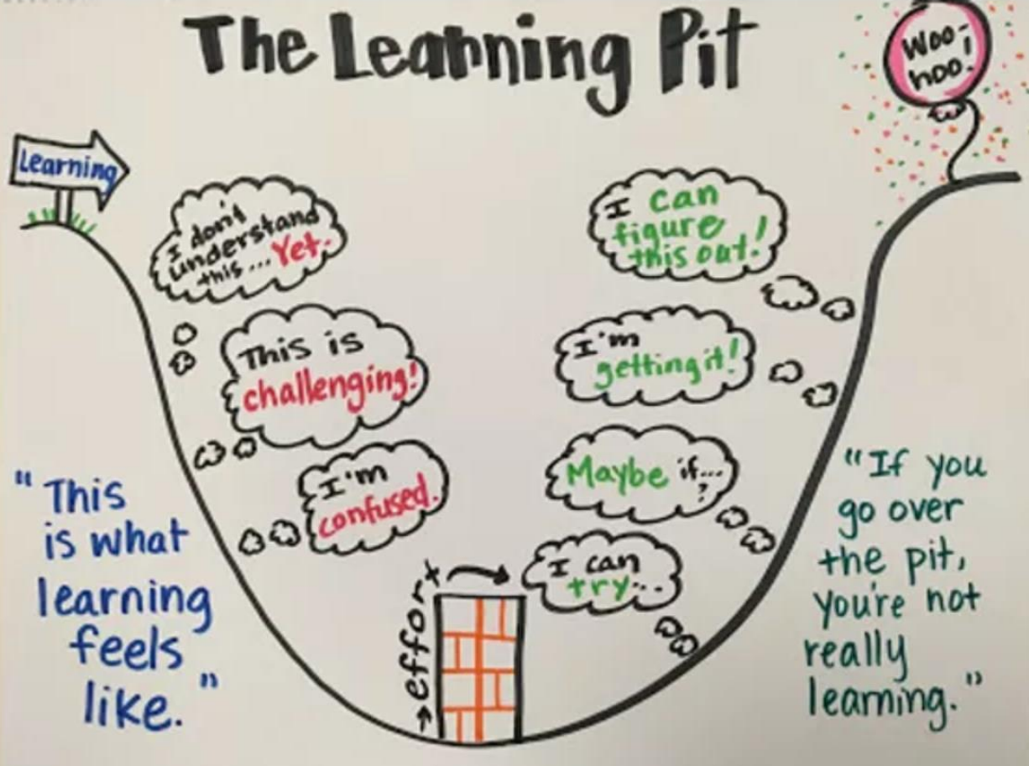
Resilience

Slide 6
Our Values
Resilient | Empathetic | Respectful
Independent | Courageous | Ambitious

Slide 7
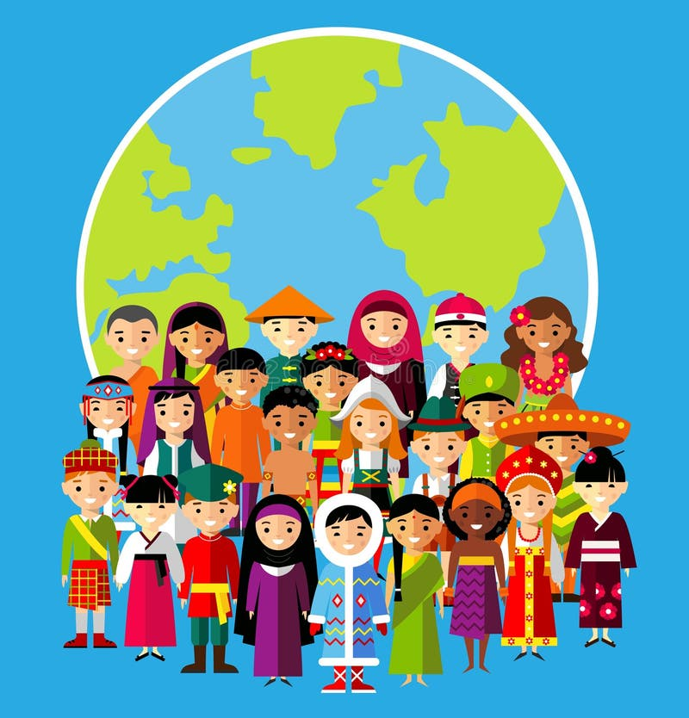
“A value is a principle that guides our thinking and behaviour

Slide 8
Our Values
Resilient | Empathetic | Respectful
Independent | Courageous | Ambitious

Slide 9
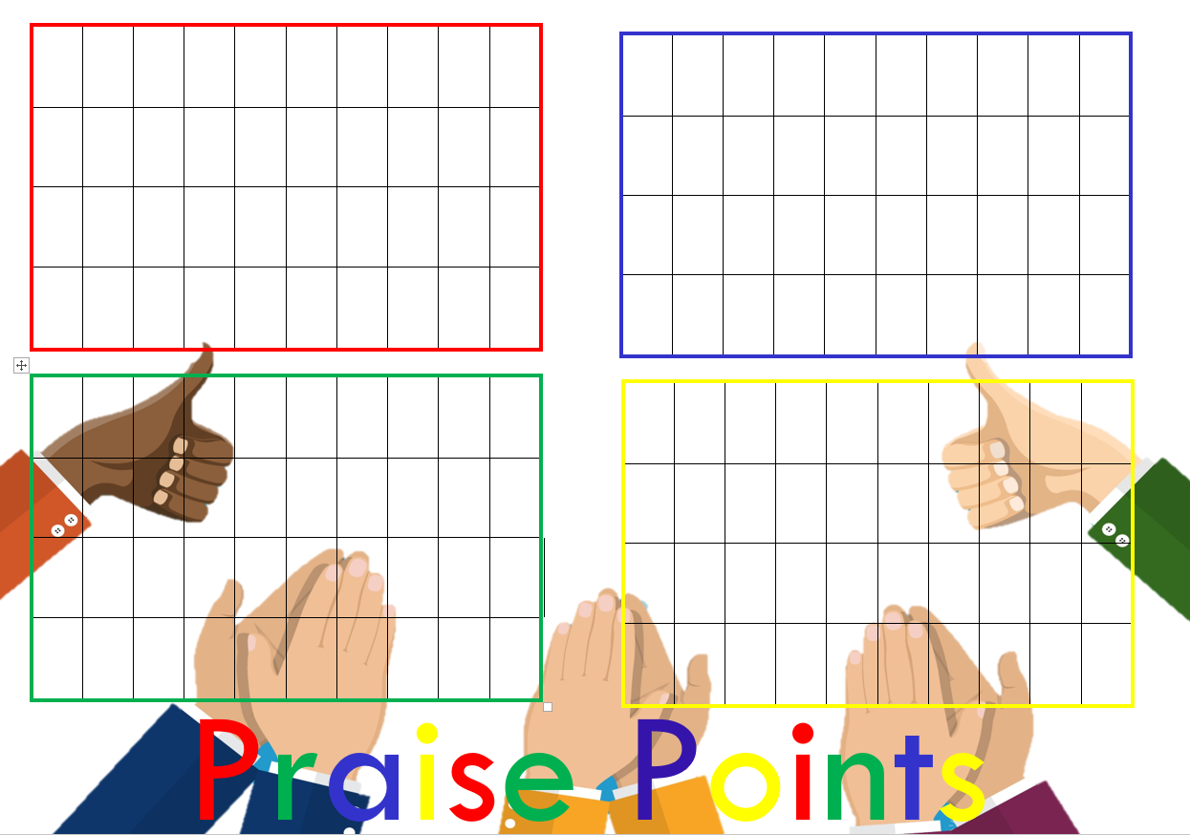

Slide 10


