Slide 1
Resilience
Assembly 4 13.10.25

Slide 2
https://www.youtube.com/watch?v=CMp9vnikU6M&t=1s
Notes:
https://www.youtube.com/watch?v=CMp9vnikU6M&t=1s

Slide 3
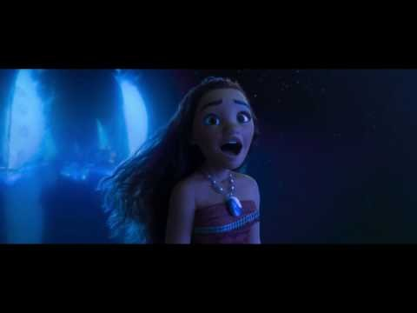
Notes:
https://www.youtube.com/watch?v=HEiSF8HpyDg

Slide 4
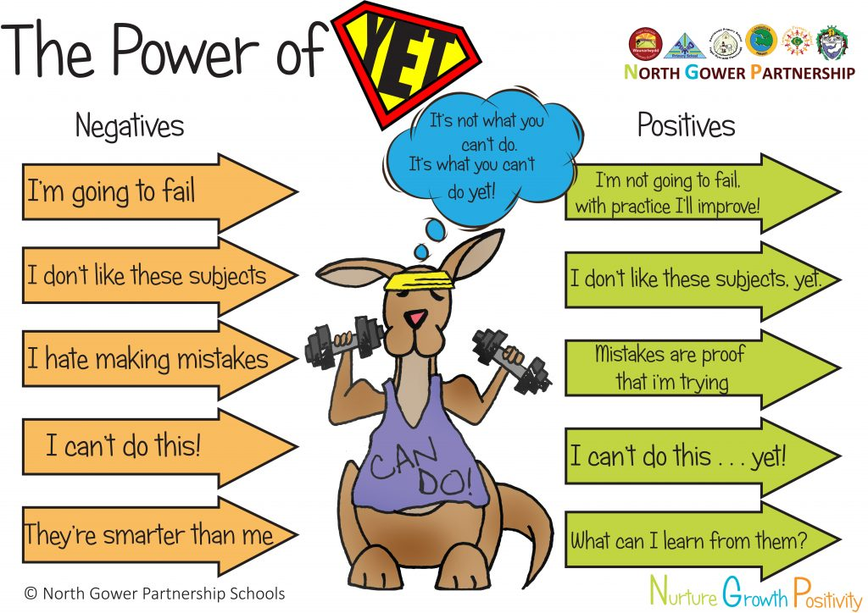
Do you know who you are?

Slide 5
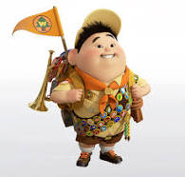
How would you describe Russell?

Slide 6
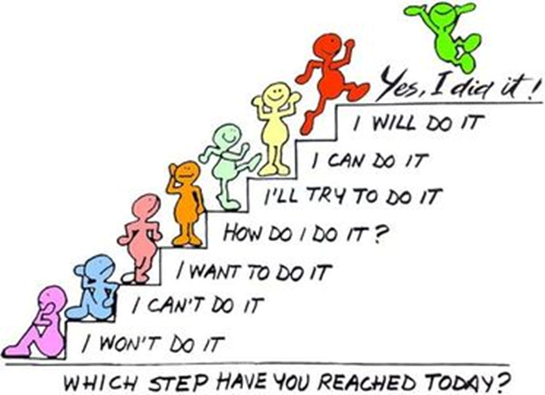
Russell
How is he showing Resilience?

Slide 7
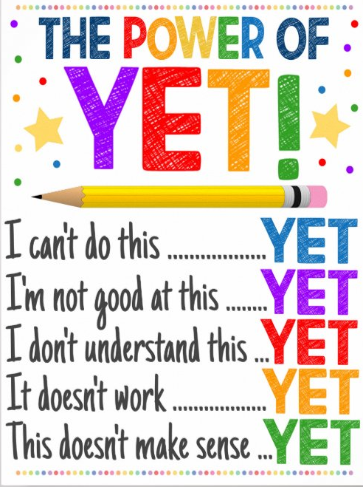
Resilience
Is more than not giving up..
It is about having faith that you can achieve
It is about dealing with your emotions when you are unsuccessful
It is about overcoming difficulties
Notes:
https://www.youtube.com/watch?v=CMp9vnikU6M&t=1s

Slide 8
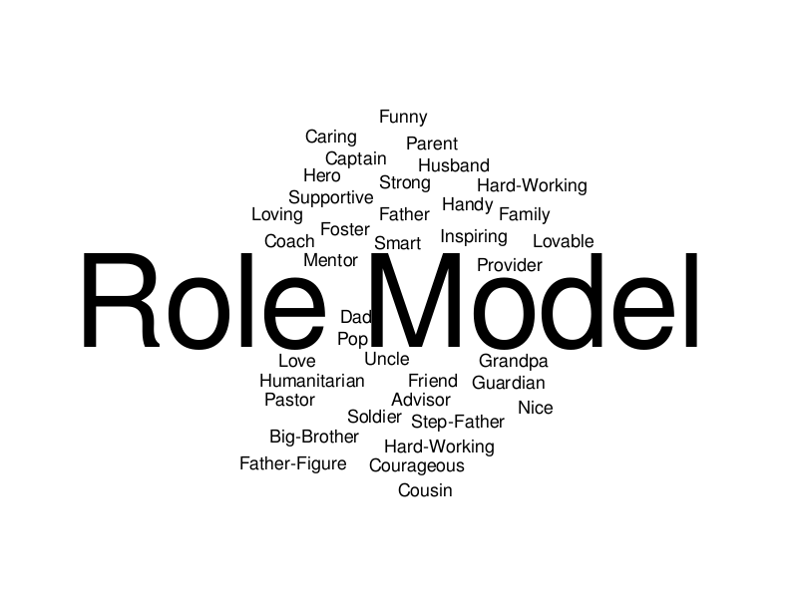
What is a role model?

Slide 9
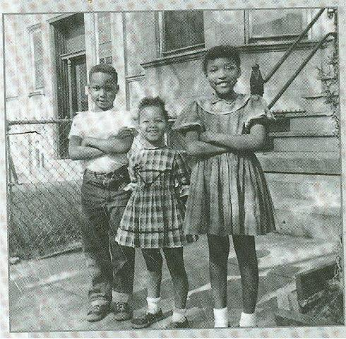
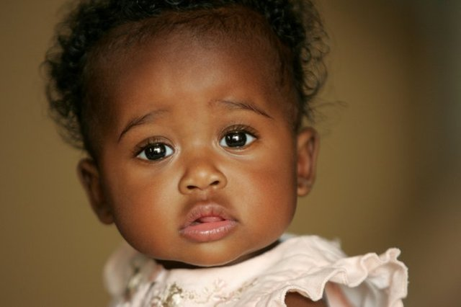
What was this child's achievement?

Slide 10
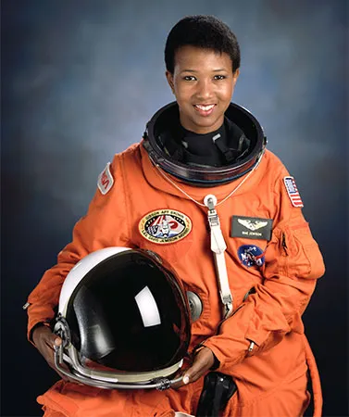
Why was this such an achievement?
Mae Jemison was the first African American woman to become an astronaut. In 1992 she spent eight days orbiting Earth as a science mission specialist aboard the space shuttle Endeavour.

Slide 11
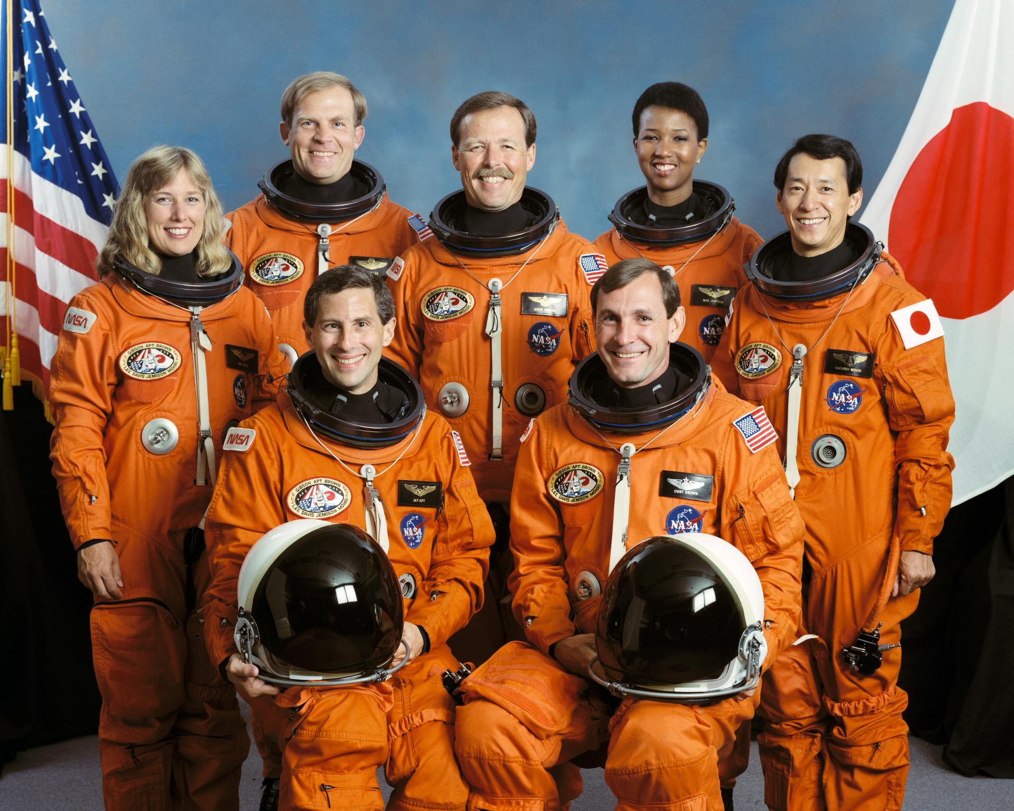
Why was this such an achievement?

Slide 12
https://www.youtube.com/watch?v=B0vGDfuWhfI&t=24s

Slide 13
What can we learn from mae Jemison?

