Slide 1
Empathy
Assembly 1- 10.11.25

Slide 2
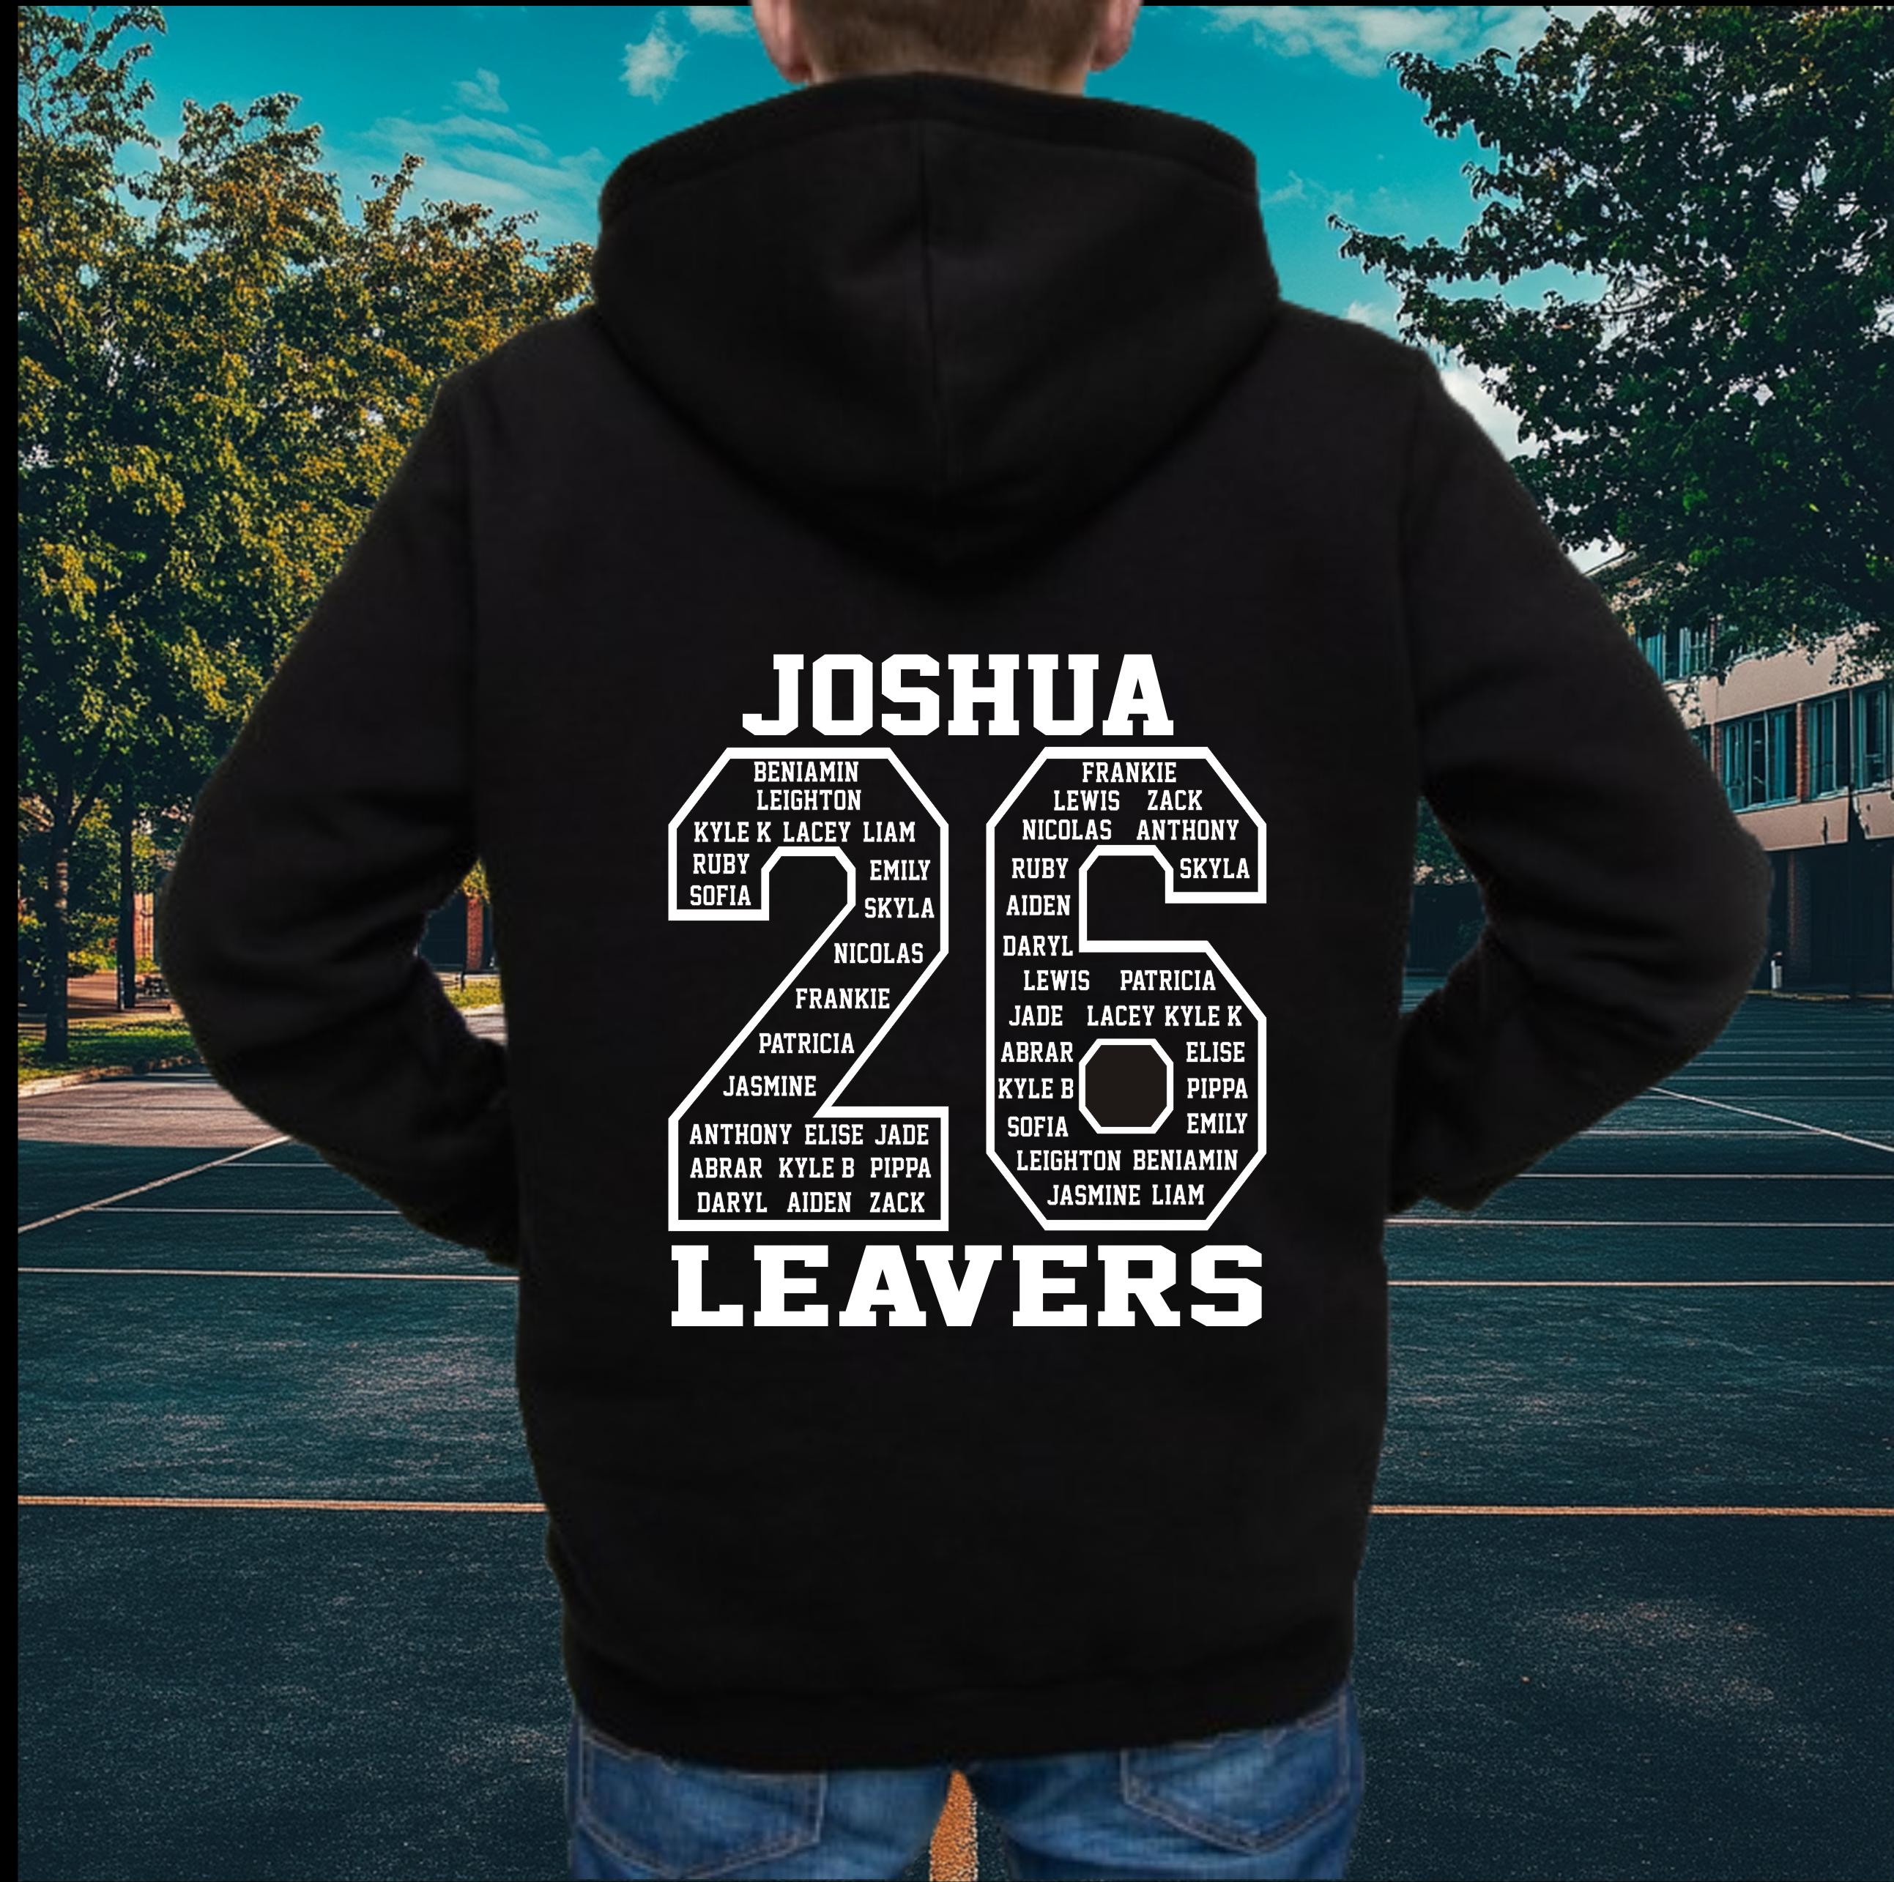

Why do we have school values?

Slide 3
What are our 6 school values?

Slide 4

Our Values
Resilient | Empathetic | Respectful
Independent | Courageous | Ambitious

Slide 5

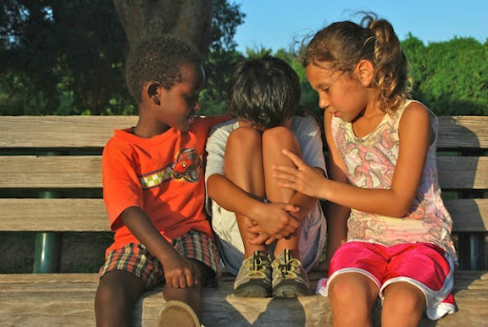
Empathy
Try to understand how others feel and be kind.

Slide 6
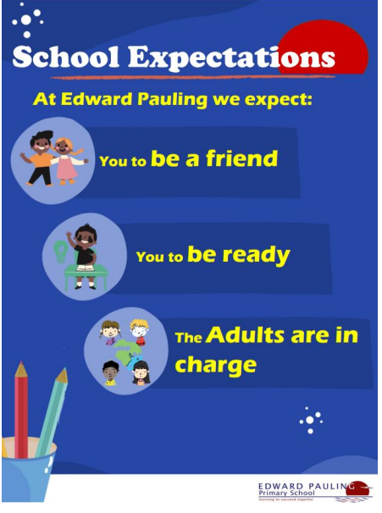
Which school Expectation might you be able to show empathy?

Slide 7

Notes:
https://www.youtube.com/watch?v=1lo-8UWhVcg

Slide 8
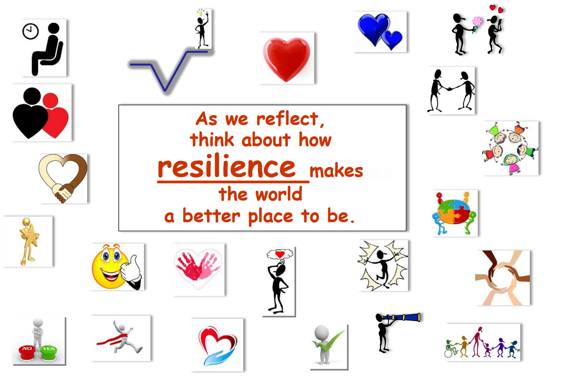
As we reflect think about how showing Empathy makes the world a better place to be.

Slide 9

class Assembly
Linked to the colour monster- what emotions might you experience if you were to show empathy?
What might our school feel like if people show / do not show empathy towards each other?
How might our school feel if adults and children showed empathy towards each other.
Produce a class poster to share in assembly about what it might look like in our school of children and adults showing empathy.

