Slide 1
Empathy
Assembly 2- 01.12.25

Slide 2
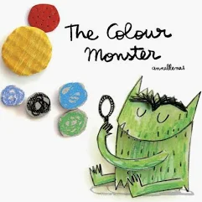
Recap
Linked to the colour monster- what emotions might you experience if you were to show empathy?
What might our school feel like if people show / do not show empathy towards each other?
How might our school feel if adults and children showed empathy towards each other.
Produce a class poster to share in assembly about what it might look like in our school of children and adults showing empathy.

Slide 3

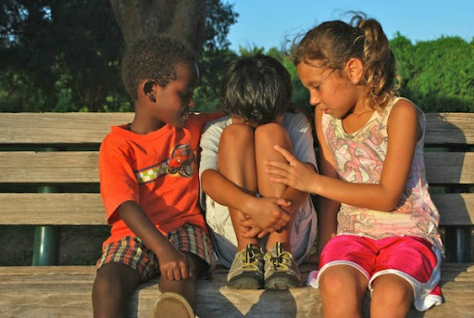
Empathy
Try to understand how others feel and be kind.

Slide 4

Notes:
What might this saying mean

Slide 5
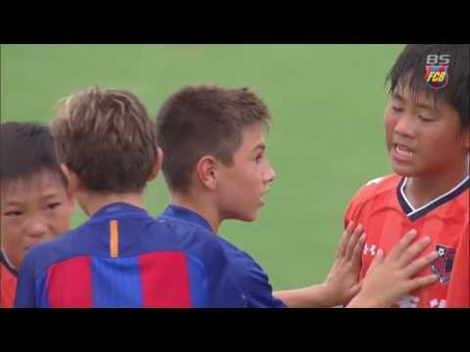
What is happening in this video?
Notes:
https://www.youtube.com/watch?v=tbvlM4Higy4

Slide 6
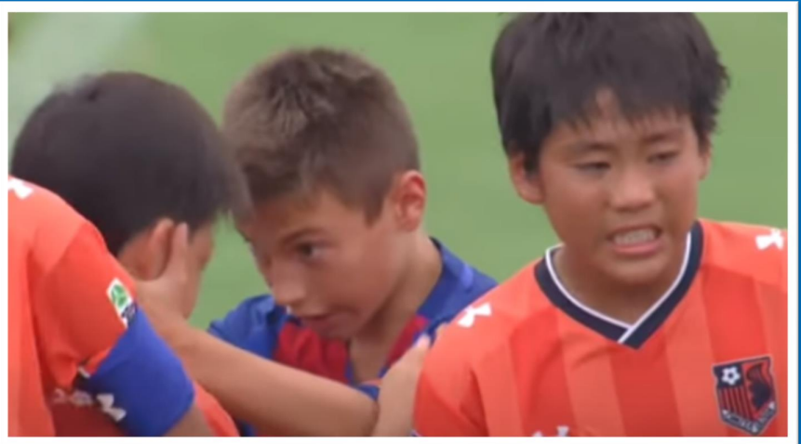
What happened in the video?
Who has shown empathy?
What did they do to show empathy?
What can you learn from this video?

Slide 7
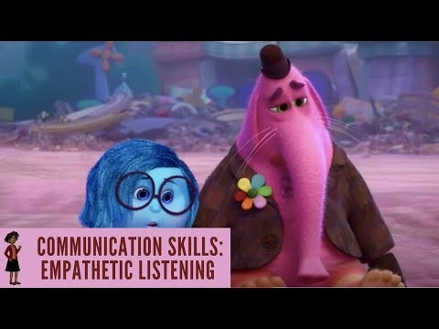
What is happening in this video?
Notes:
https://www.youtube.com/watch?v=t685WM5R6aM

Slide 8
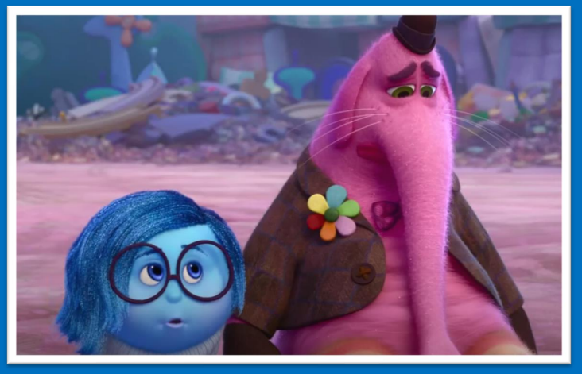
What happened in the video?
Who has shown empathy?
What did they do to show empathy?
What can you learn from this video?

Slide 9
So, we know that…
Empathy is about trying to understand how others feel.
When we know how they feel, we can do something to help them.

Slide 10
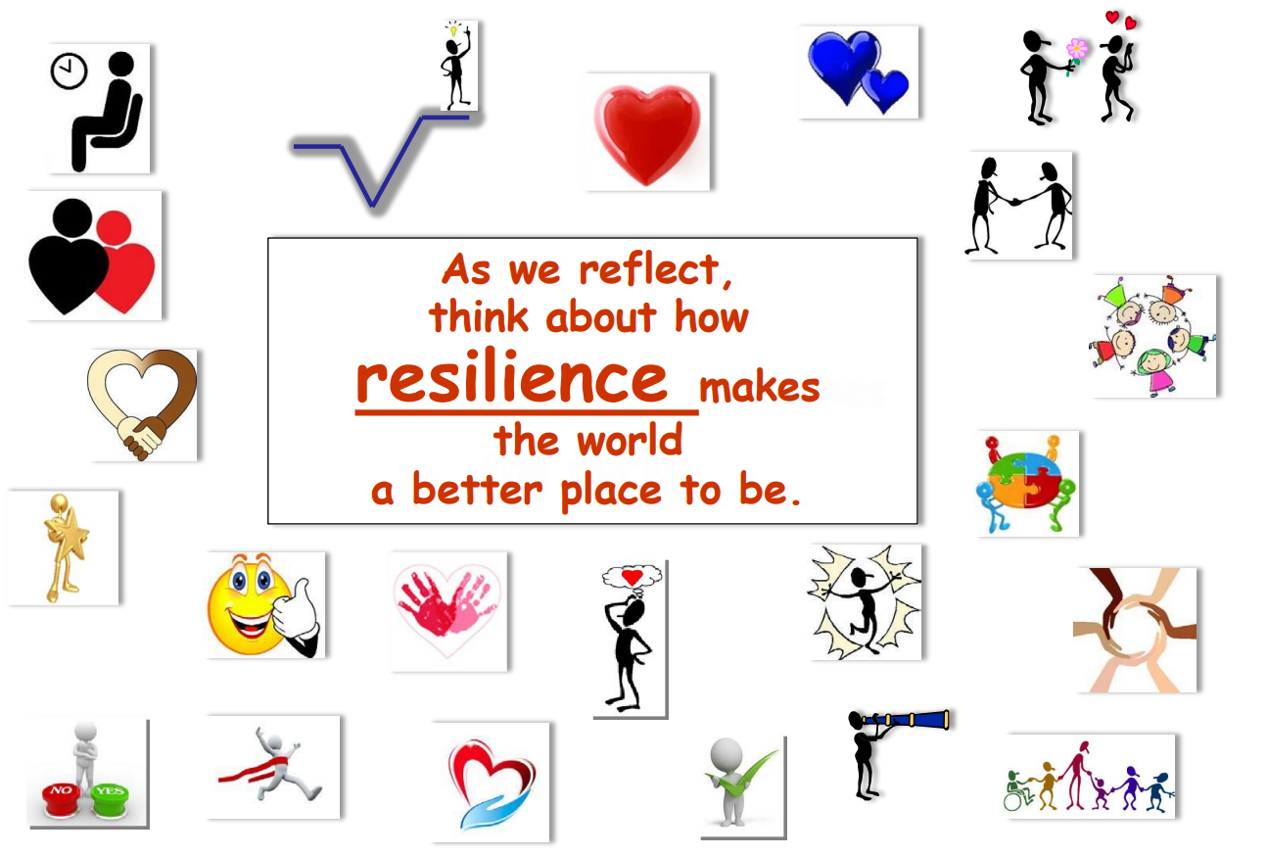
As we reflect think about how showing Empathy makes the world a better place to be.

Slide 11
class Assembly
Discuss these scenarios. How could you show empathy?
A child is not picked for the sports team .
Your friend scores poorly in a maths test.
A child in your class trips and injures themselves as you are playing outside.
Your friend’s grandparents are very ill.
You mum is very tired and still has lot’s of jobs to do before bedtime.

