Slide 1
Empathy
Assembly 3- 08.12.25

Slide 2

Recap
‘Walk a Mile in someone else's shoes’

Slide 3
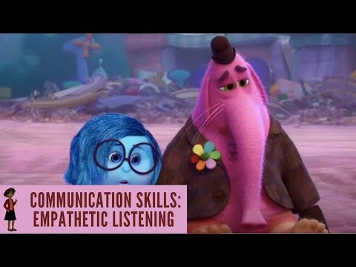
How can we show empathy
Listen to other people- Listening is one of one of the most effective ways you can demonstrate empathy to other people.
Give them your full attention- look at them in the eye and nod to show you are taking in what they are saying!
Open up emotionally- listening isn't going to be enough to build trust
  You might have to tell the other person if you have ever felt the same as them.
  Empathy is a two – way street. It’s about sharing vulnerabilities and building trust in another person.

Slide 4
What is happening in this video?
Notes:
https://www.youtube.com/watch?v=t685WM5R6aM

Slide 5
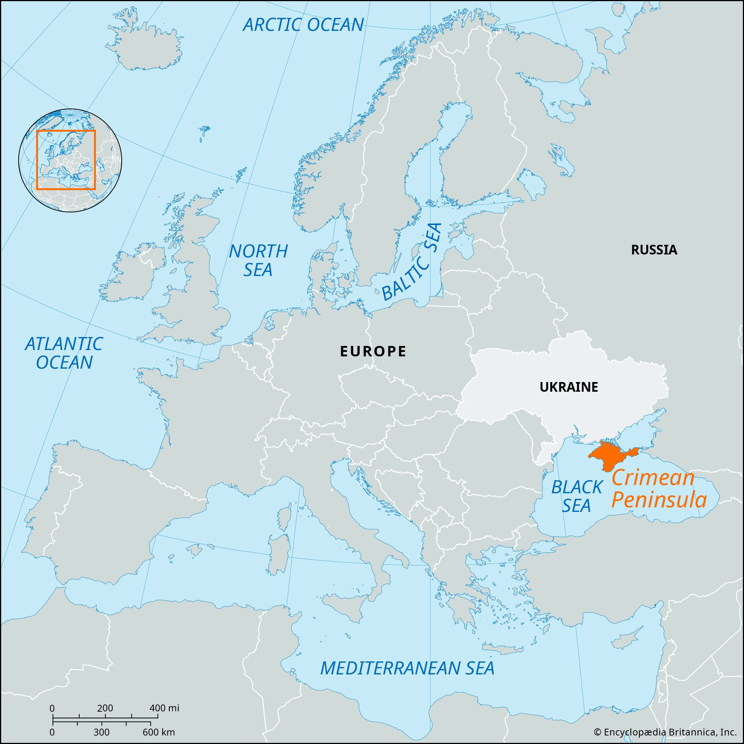
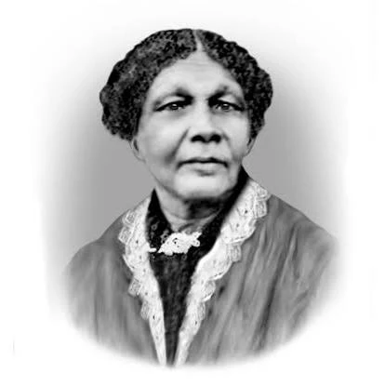

Mary Seacole
Why was she called Mother Seacole?
The Russian Empire on one side and an alliance of the Ottoman Empire, France, the British Empire
23 November 1805 – 14 May 1881

Slide 6

Notes:
https://www.youtube.com/watch?v=ZJ-kGnkUZNA

Slide 7

Notes:
What might this saying mean

Slide 8
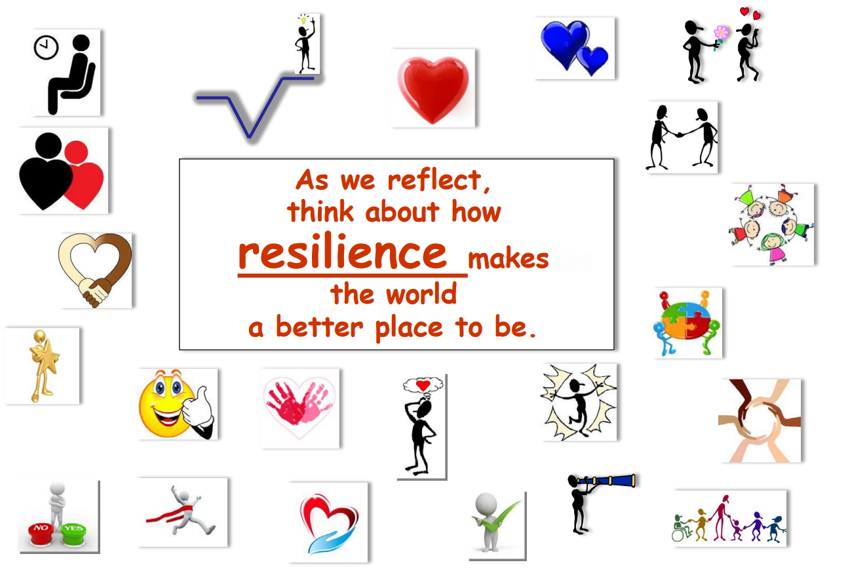
As we reflect think about how showing Empathy makes the world a better place to be.

Slide 9
class Assembly
Mary Seacole –Role Model
KS2 Watch- https://www.youtube.com/watch?v=uavk4N2Nk9s
KS1 Watch -https://www.youtube.com/watch?v=Bs32UDEvUDQ
Why was she called Mother Seacole?
How did Mary Seacole show empathy?
What could others have learnt from her actions
at the time?
What can you learn for her actions?

Slide 10

How does our value of empathy link to life in the UK?

