Slide 1
Respect
Assembly 1 12.01.26
Notes:
https://www.youtube.com/watch?v=EkjJbWBUbUs&list=PLrLt4fBD0JjrHnPALYnCtZFPc1rYEWszS&index=4

Slide 2
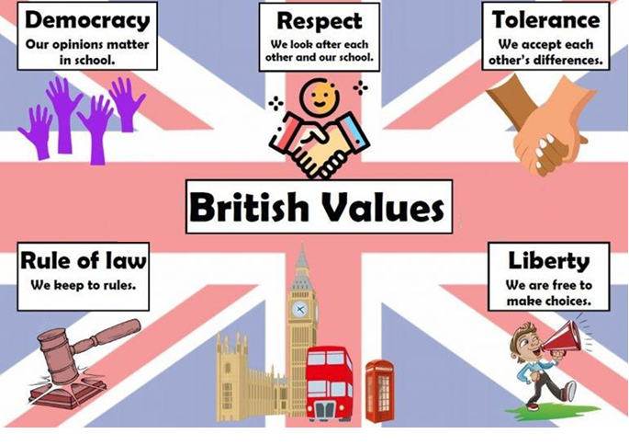

Which School Values link to which
British Values?

Slide 3
What are our 6 school values?

Slide 4
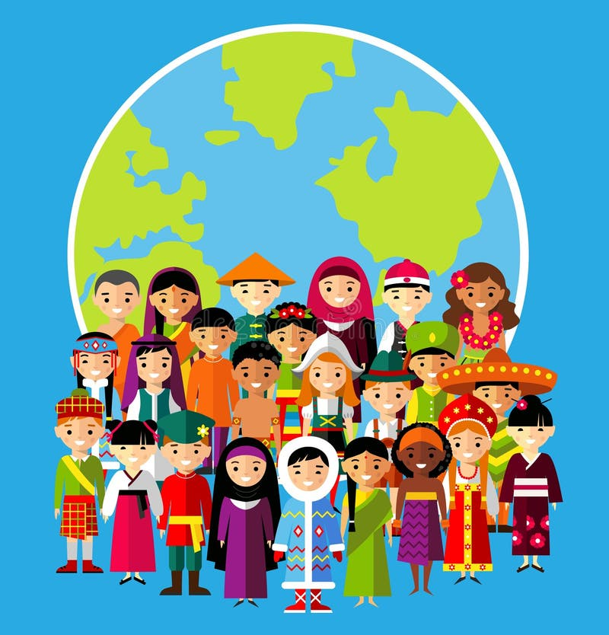
Our Values
Resilient | Empathetic | Respectful
Independent | Courageous | Ambitious

Slide 5
What is the connection
Think about what you can see
Why might these people be behaving that way?

Slide 6
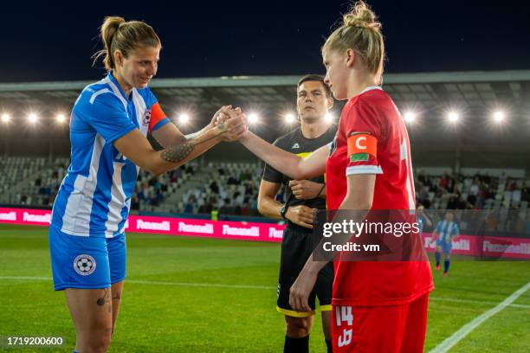
Notes:
Gather the children's opinions. Establish the handshake is a way of showing you intend to play fairly and value your opponents

Slide 7
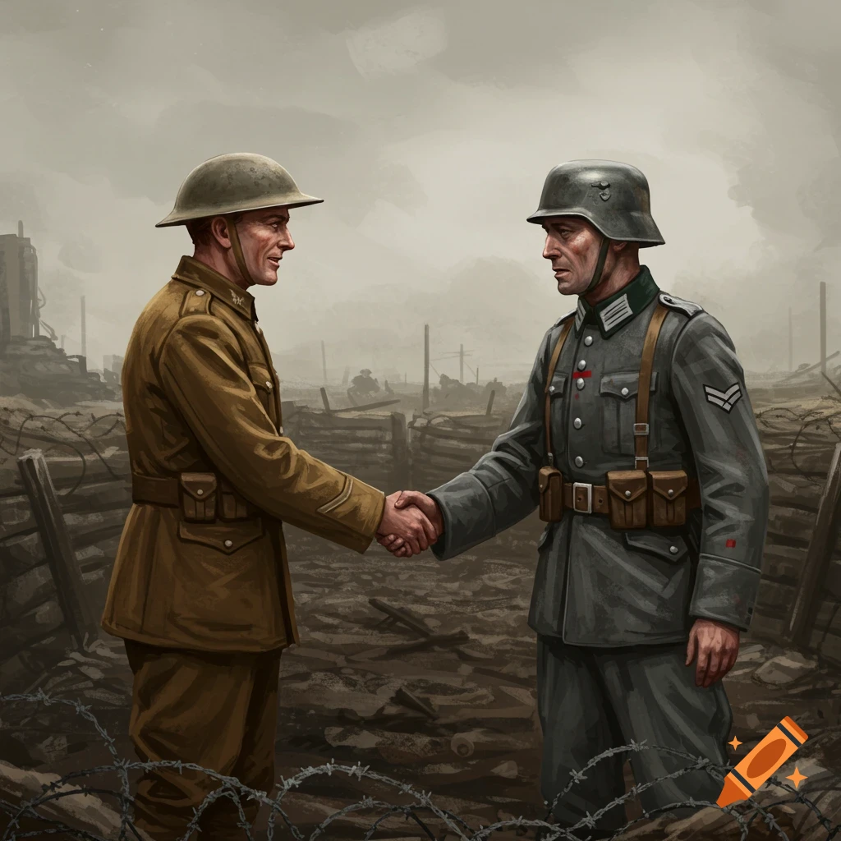

Slide 8
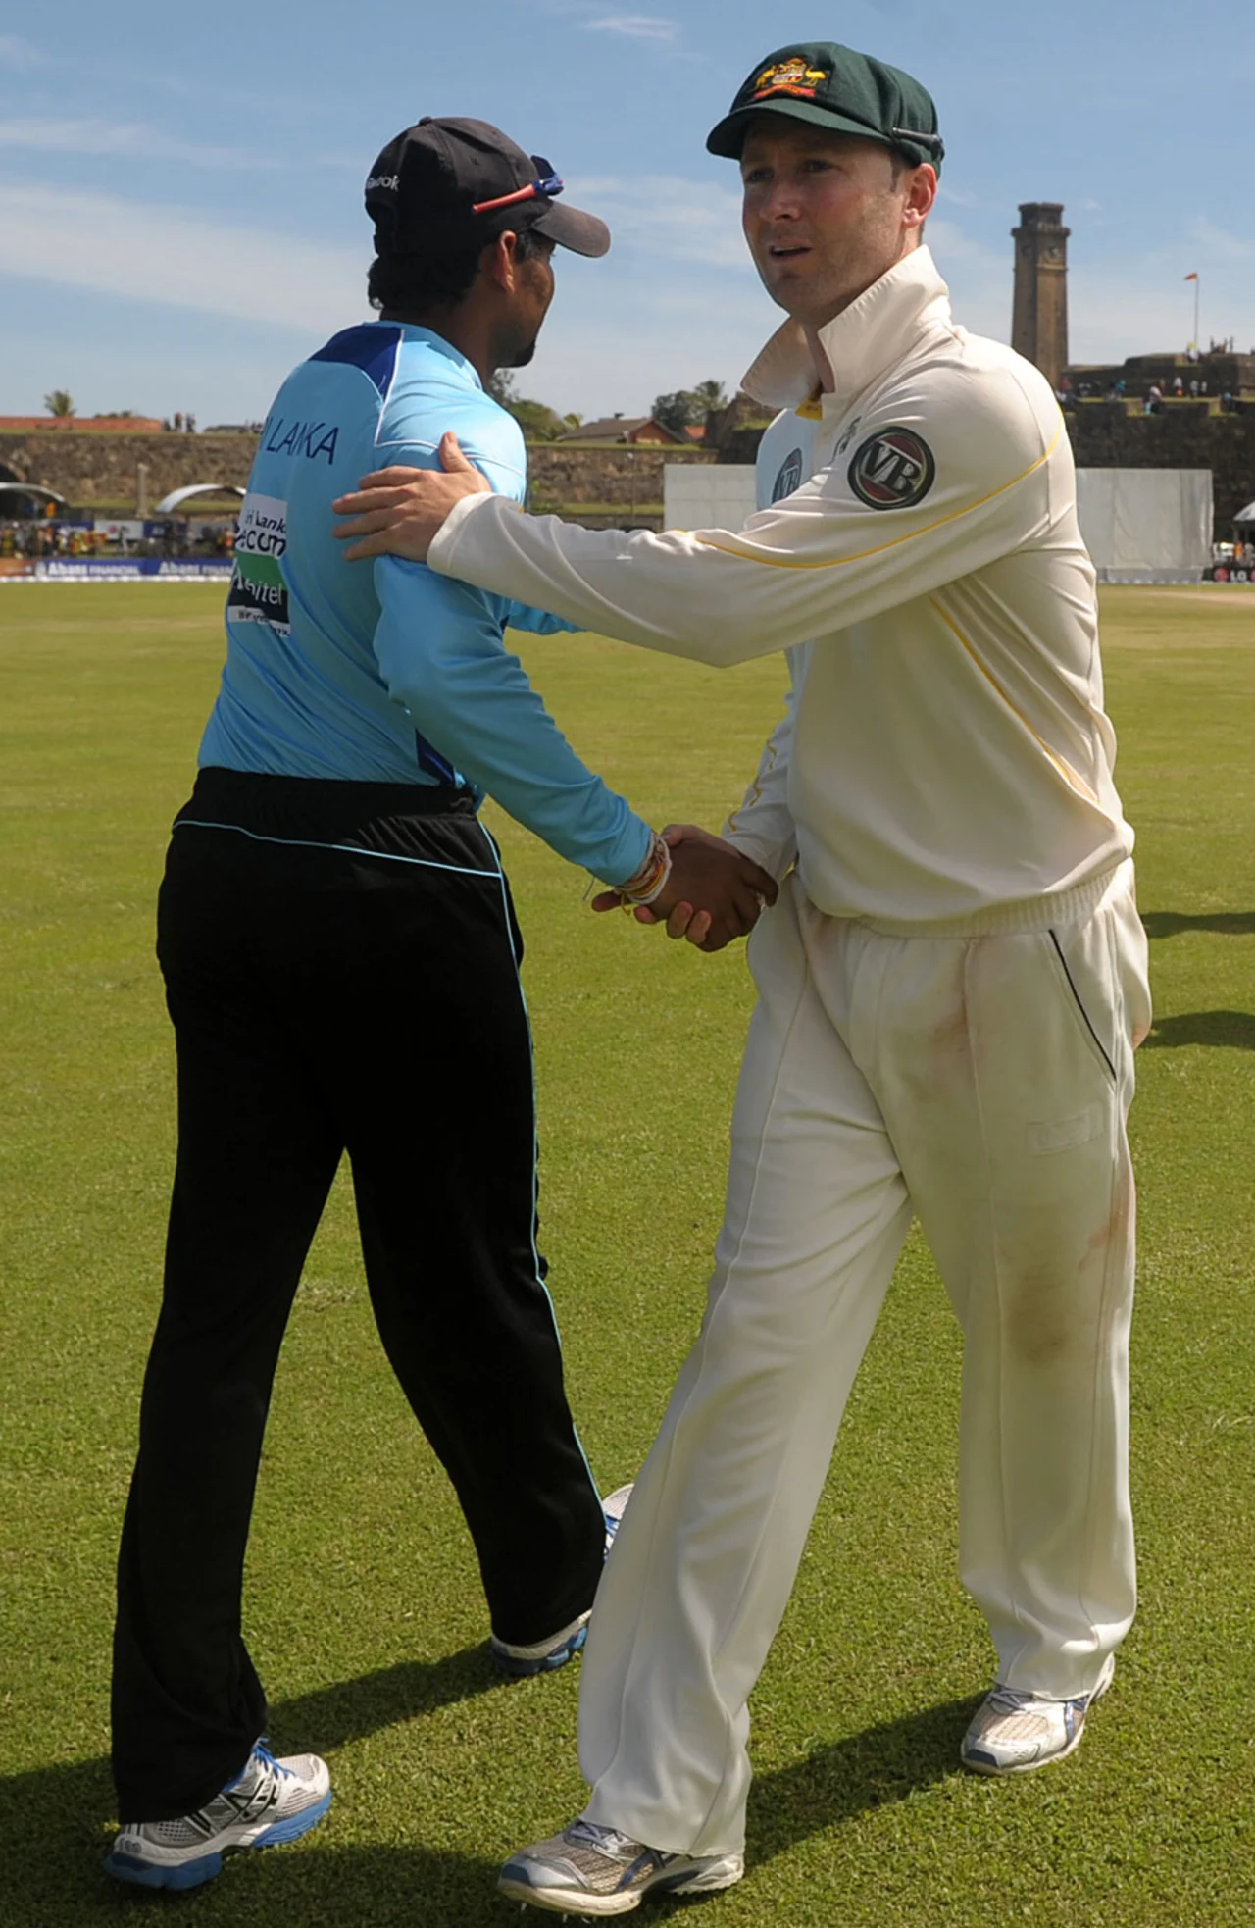

Slide 9
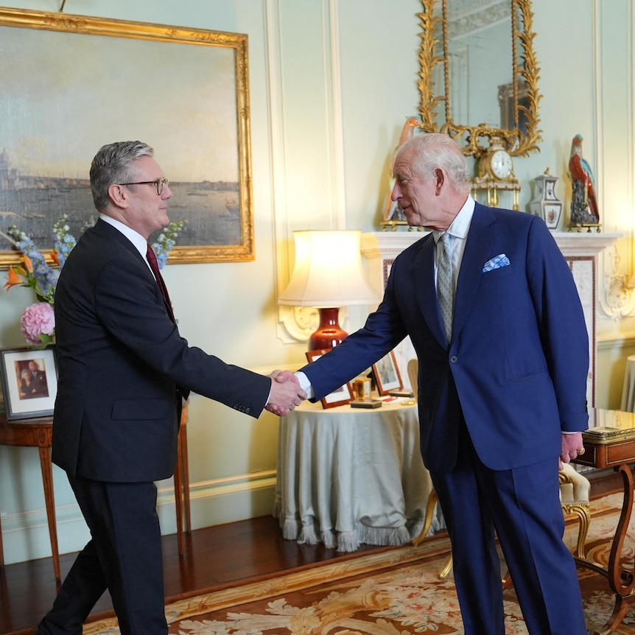

Slide 10
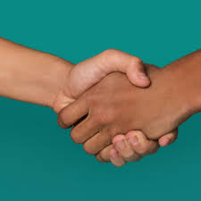
The power of a handshake
A handshake is a way of showing you intend to play fairly and value your opponents.
A handshake is a mark of respect. And mutual respect - respect between one another.
How can a handshake change the world?

Slide 11
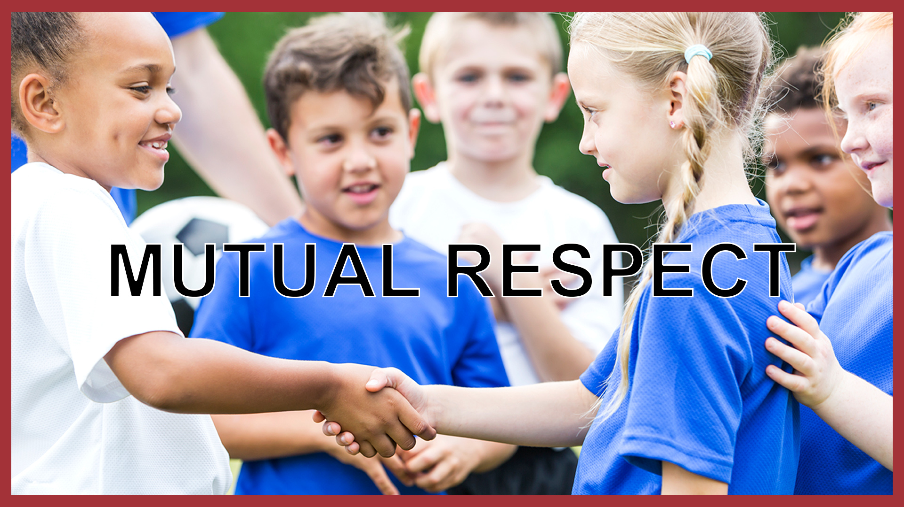
Can you give an example of Mutual respect?
Mutual means shared between people
Respect means to value another (think about someone's feelings, wishes or rights)

Slide 12
How can a handshake change the world?

Slide 13
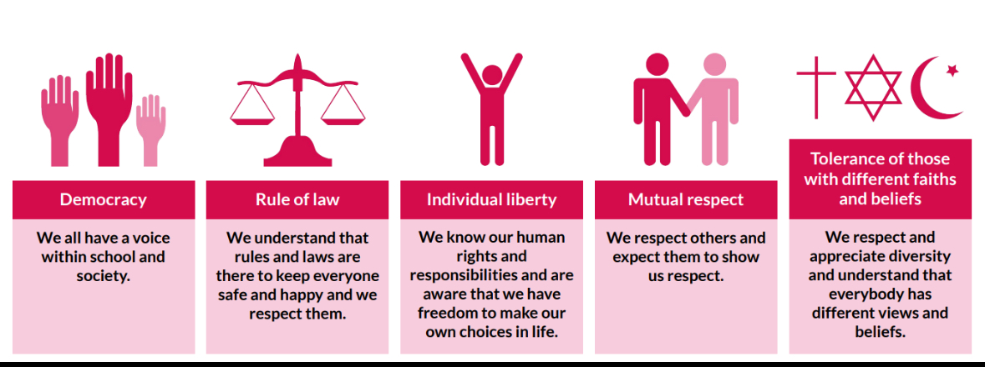
In class follow up:
Recap mutual respect- watch video on: https://www.bbc.co.uk/teach/school-radio/articles/zp8yhcw
Task: As a class think of how you can live our British values in the classroom, create a list to share with student council.
Consider how you can show respect.

