Slide 1
Respect
Assembly 2 19.01.26
Notes:
https://www.youtube.com/watch?v=EkjJbWBUbUs&list=PLrLt4fBD0JjrHnPALYnCtZFPc1rYEWszS&index=4

Slide 2
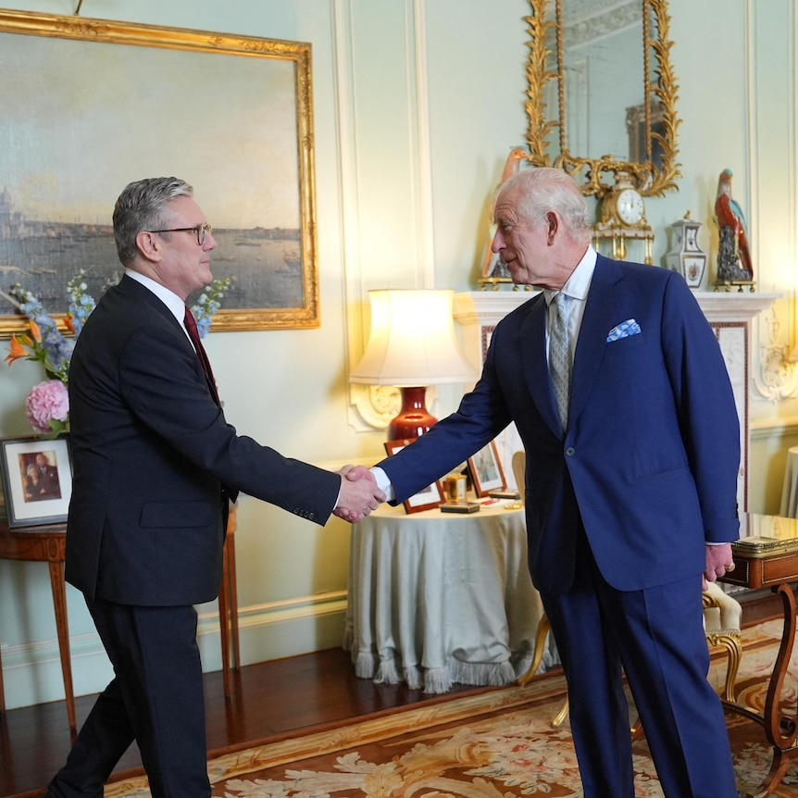
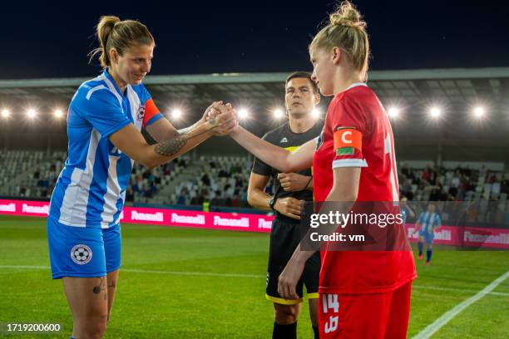
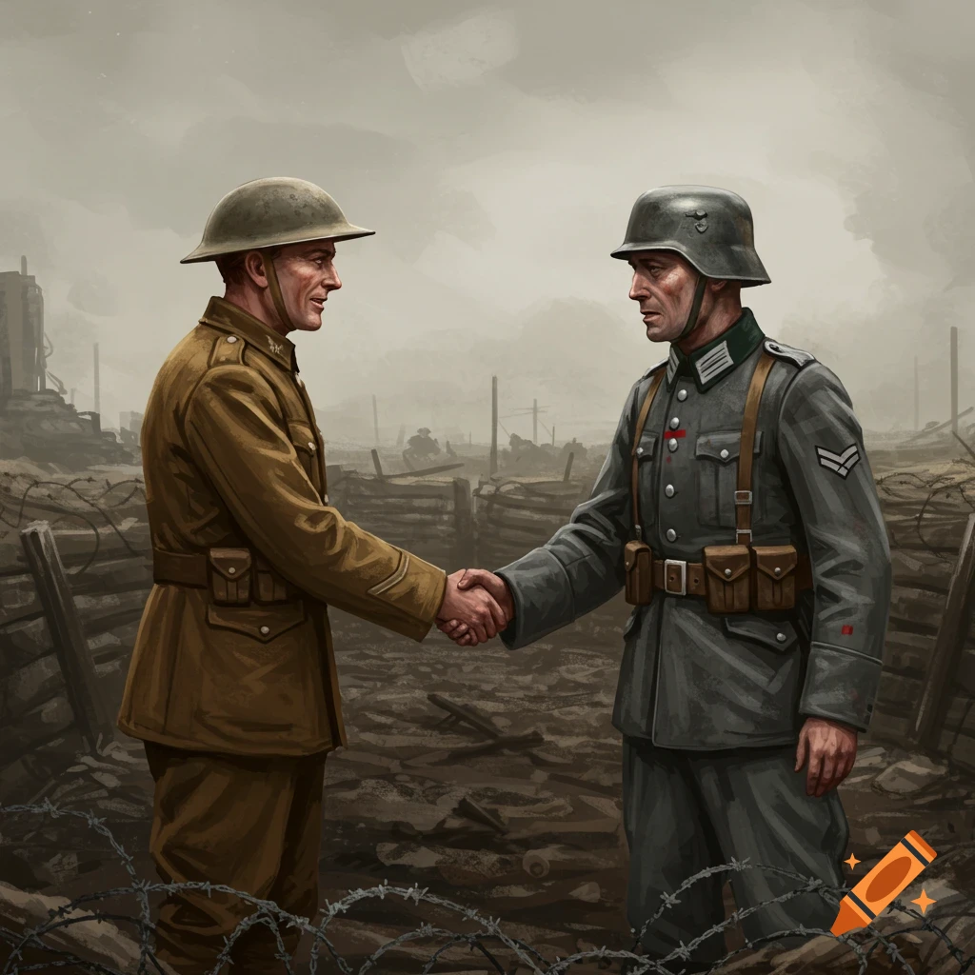
Recap:
A handshake is a way of showing you intend to play fairly and value your opponents.
A handshake is a mark of respect. And mutual respect - respect between one another.

Slide 3

What are our 5 British values?

Slide 4



Slide 5

Mutual means shared between people
Respect means to value another (think about someone's feelings, wishes or rights)

Slide 6
Think:
What does Respect Mean?
How would you show it?
Notes:
https://www.youtube.com/watch?v=2wdYttIm5S8&t=15s

Slide 7
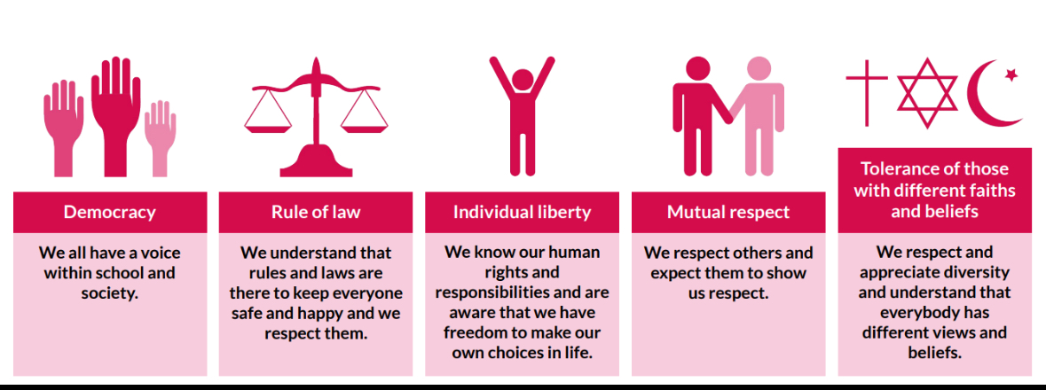
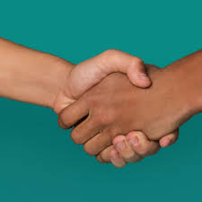
Think: How can a handshake change the world?
In class follow up:

Slide 8

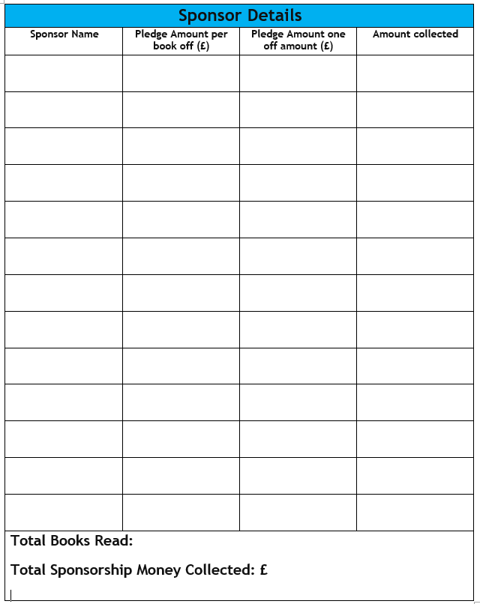
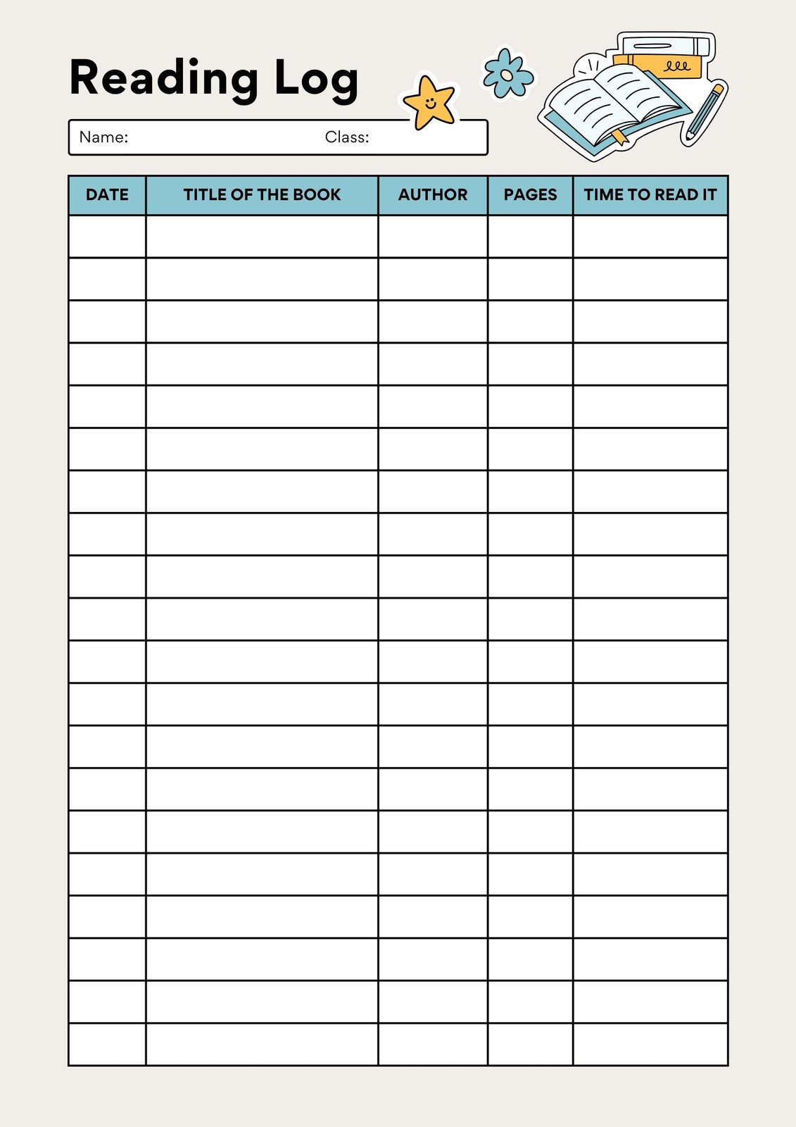

The person in each class who reads the most books by Thursday 12th February will win a special prize!
Return sponsorship money and form to your teacher by Friday 30th January.

Slide 9

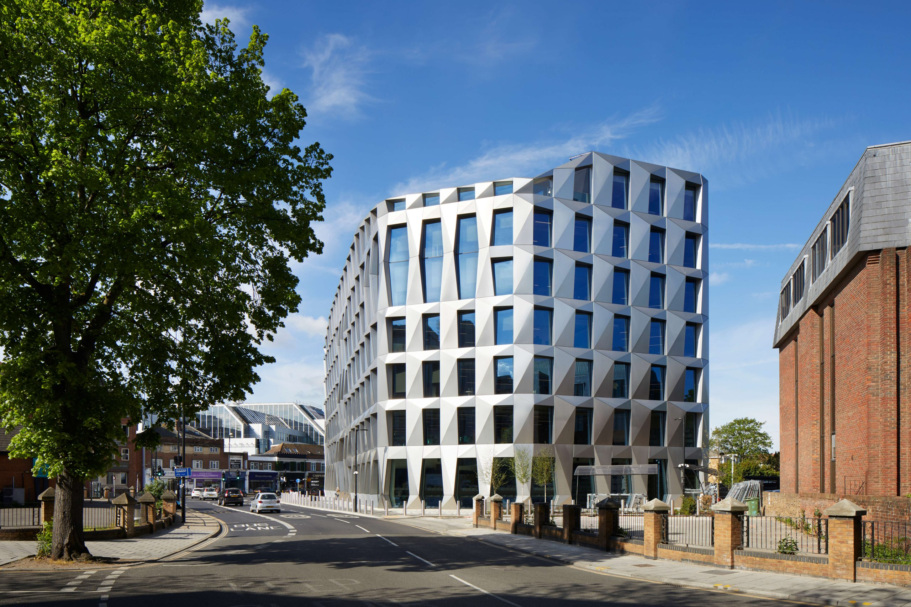

Hounslow Libraries

Slide 10
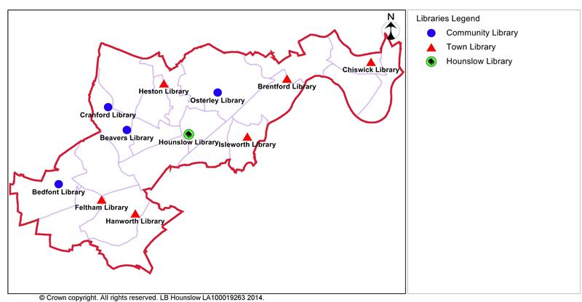
Where are we?
There are 11 libraries in the Hounslow Borough
  Beavers
  Bedfont
  Brentford
  Chiswick
  Cranford
  Feltham
  Hanworth
  Heston
  Hounslow
  Isleworth
  Osterley

Slide 11

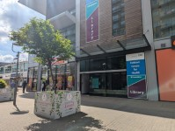
Feltham Library

Slide 12
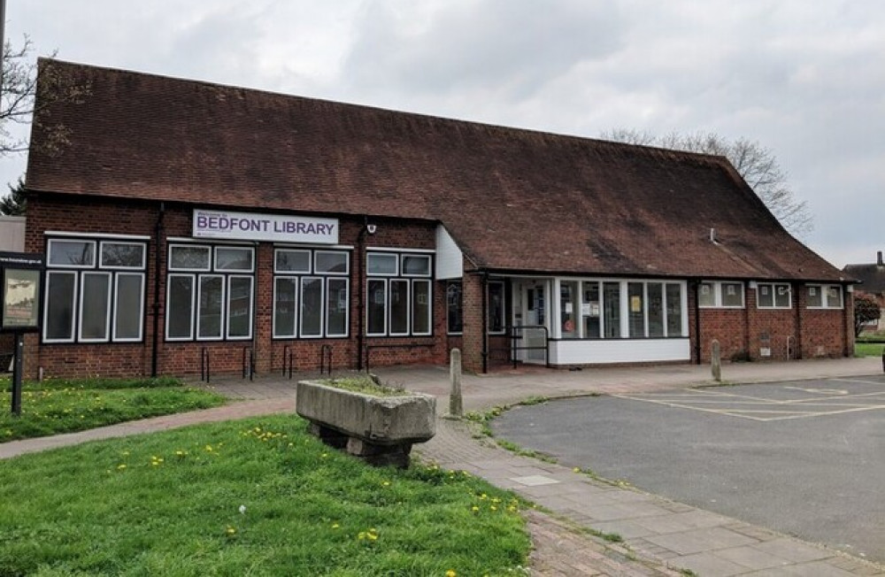
Bedfont Library

Slide 13
Joining the library
IT’S FREE!
ANYONE CAN JOIN
JUST NEED PROOF OF ID
Join online
One card accesses - all Libraries in the Borough

Slide 14
What do we have?
Books
Computers
Activities
Space

Slide 15

Books
Books for all ages. From 0-100
Once joined you can take home up to 10 books and keep them for 3 weeks
Fiction – made up stories
Non-fiction – books to teach and inform you
Books in different languages
Online and audio books

Slide 16

Computers
Free to use
2 hours a day
Printing costs
Free Wifi
Our computers have Microsoft office
Learn My Way – free courses to learn digital skills
Free scanning

Slide 17

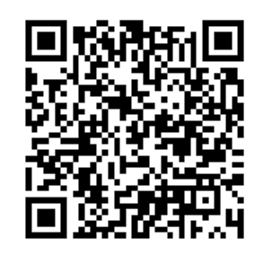
Activities for Children
Storytime for under 5s term time only
Rhyme time for under 5s term time only
Puzzle time and board game sessions for families
Chess club
Crafts for primary school children during the holidays

Slide 18






Ready for the Summer? Keep an eye on our :
Summer Reading Challenge
For 4-11 year olds
To encourage them to read 6 books over the summer holidays
Small prizes for each book read and a medal and certificate when they have read all 6.

Slide 19

Thank you!

