Slide 1
Respect
Assembly 3 26.01.26
Notes:
https://www.youtube.com/watch?v=EkjJbWBUbUs&list=PLrLt4fBD0JjrHnPALYnCtZFPc1rYEWszS&index=4

Slide 2

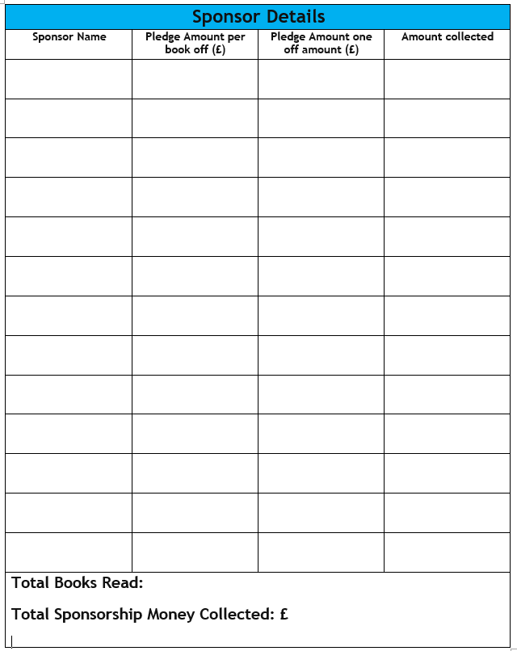
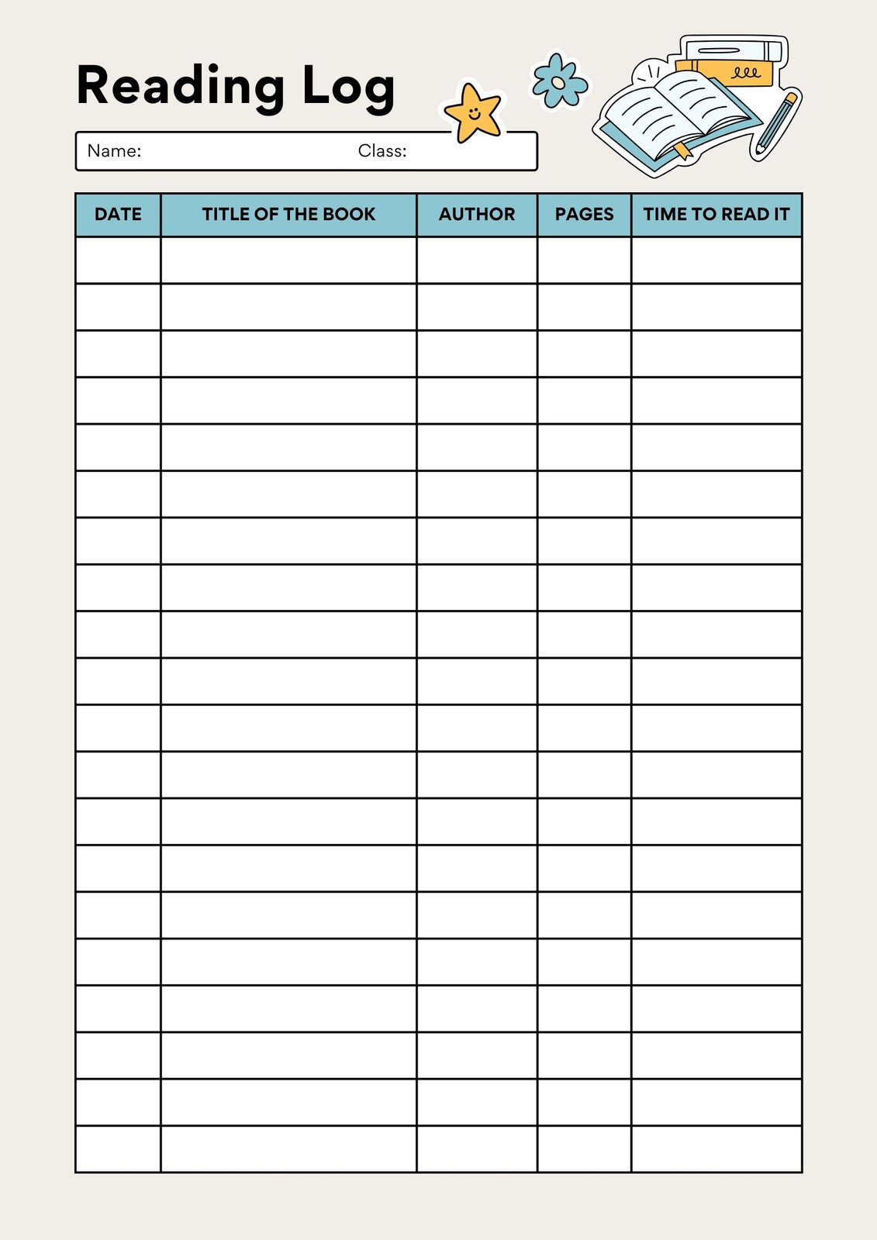

The person in each class who reads the most books by Thursday 12th February will win a special prize!
Return sponsorship money and form to your teacher by Friday 30th January.

Slide 3
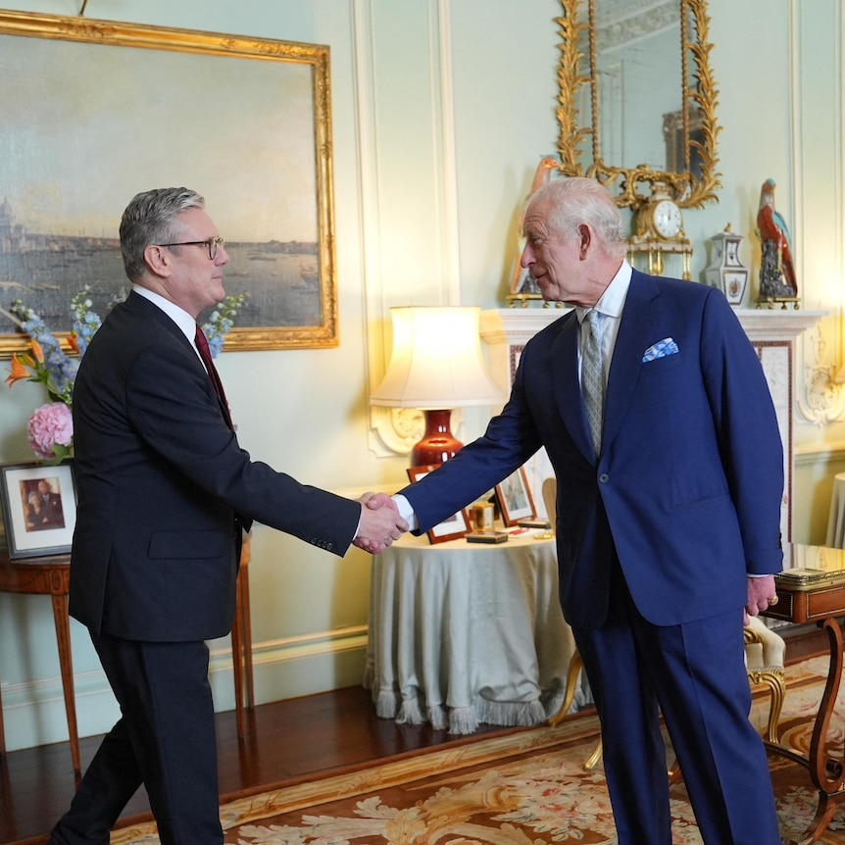
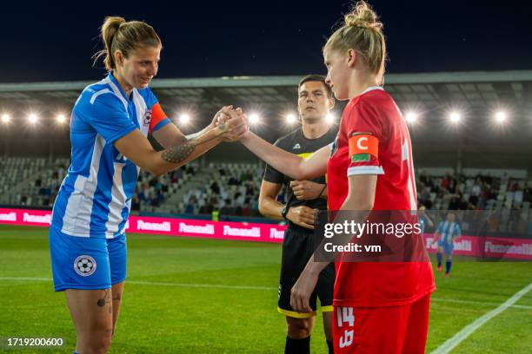
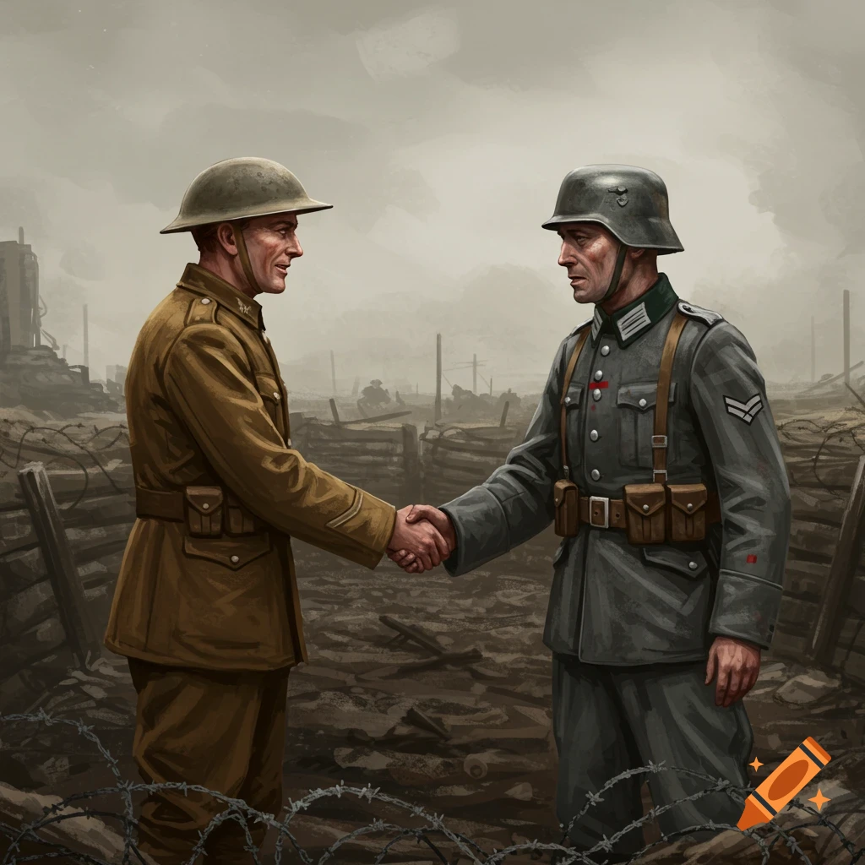
Recap:
A handshake is a way of showing you intend to play fairly and value your opponents.
A handshake is a mark of respect. And mutual respect - respect between one another.

Slide 4
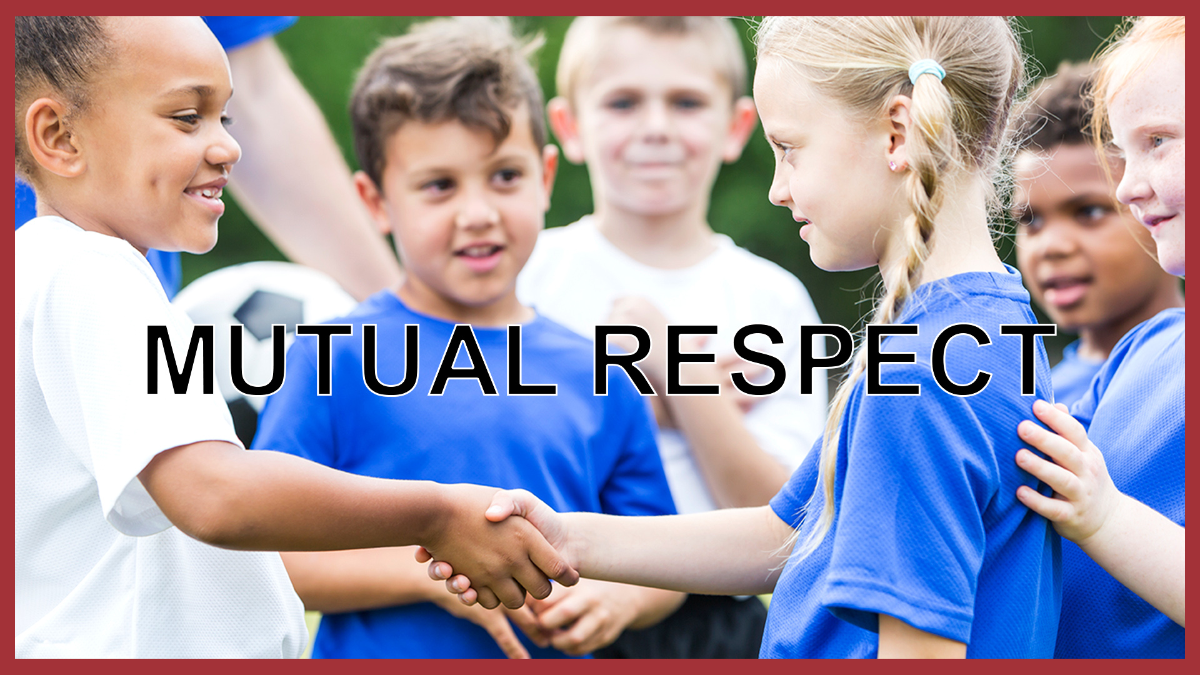
Mutual means shared between people
Respect means to value another (think about someone's feelings, wishes or rights)

Slide 5
Think:
1-What does Respect Mean?
2-How would you show it?
3-Who would you respect?
Notes:
https://www.youtube.com/watch?v=2wdYttIm5S8&t=15s

Slide 6
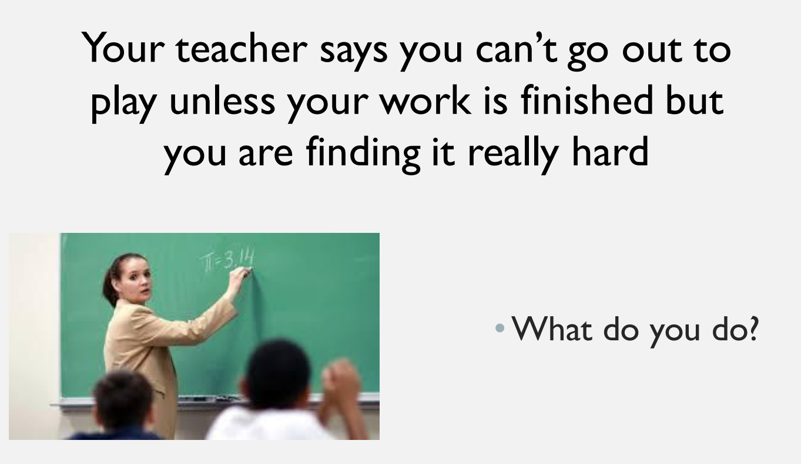

Slide 7
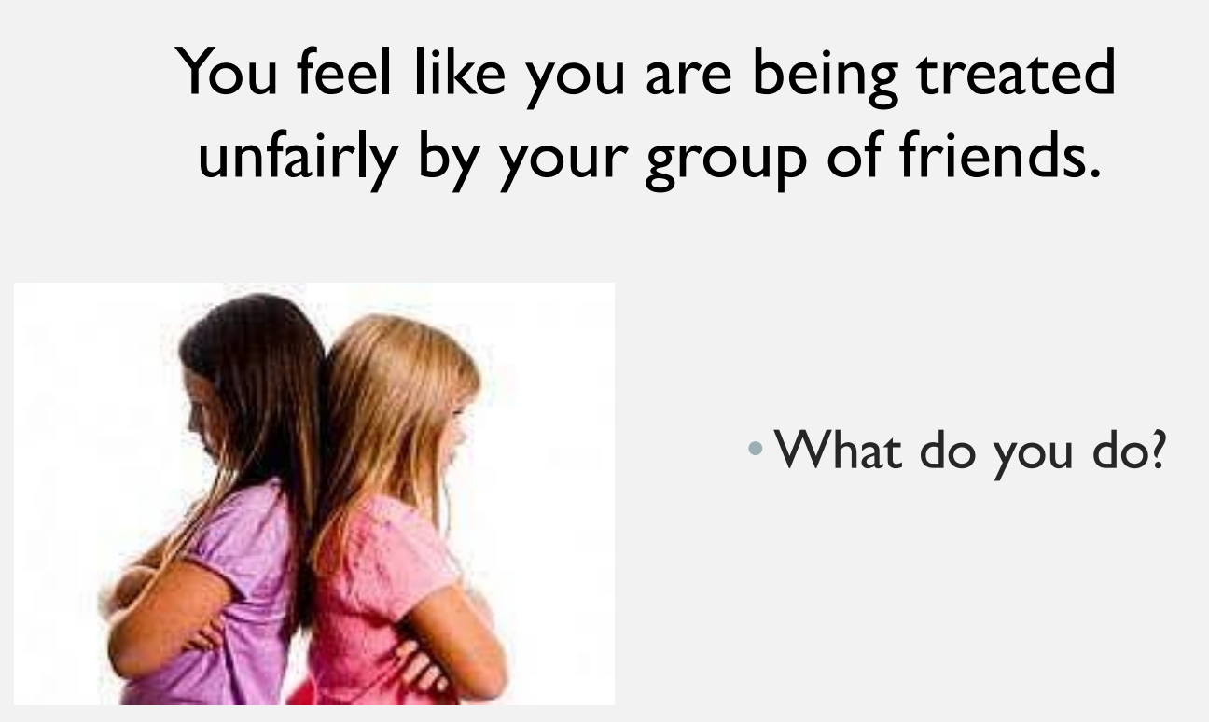

Slide 8
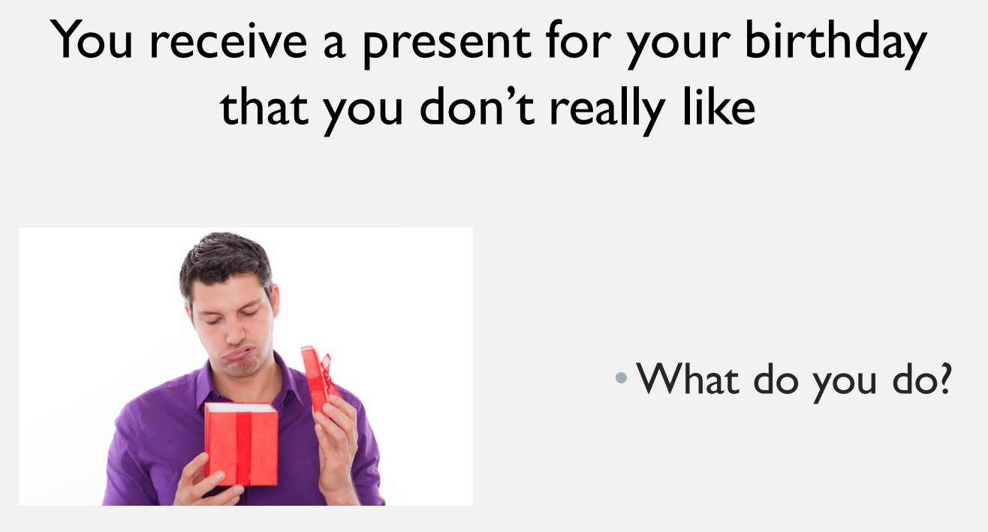

Slide 9
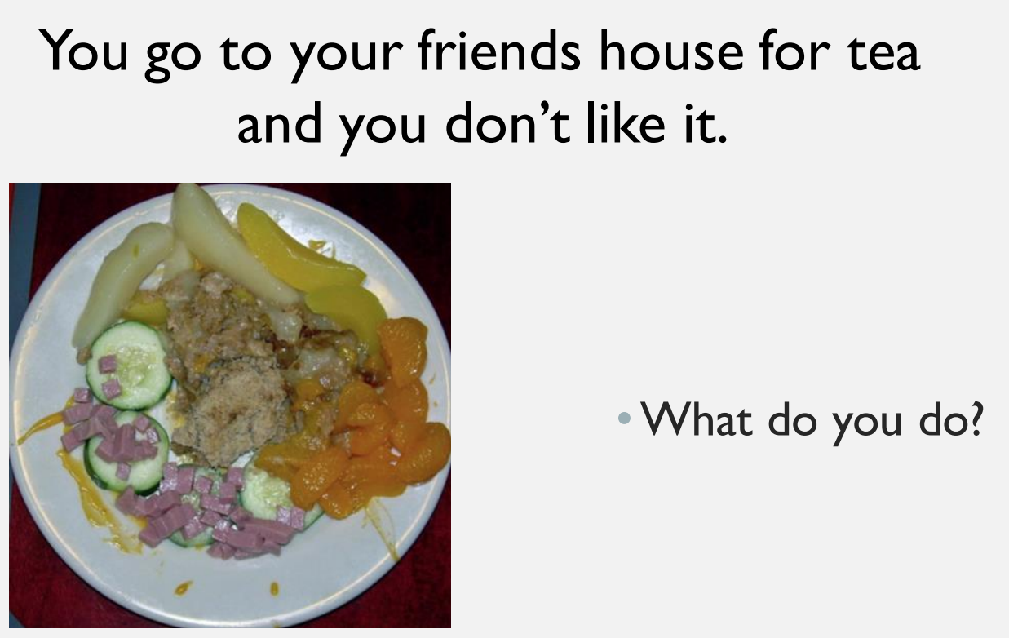

Slide 10
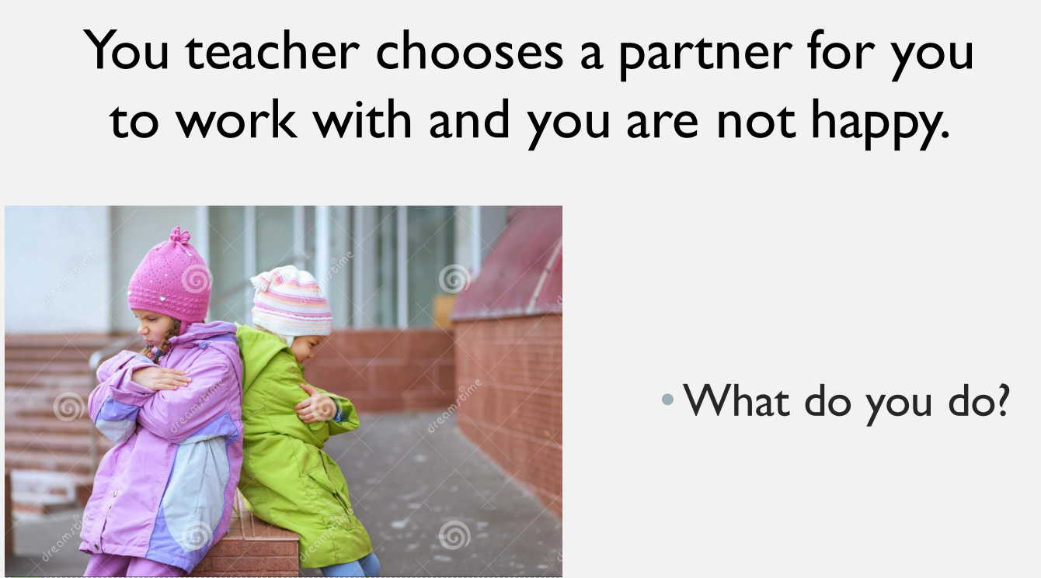

Slide 11
Reflection:
Who would you respect, why?

Slide 12
In class follow up: - 'Delightful the Horse’
Watch: https://www.bbc.co.uk/teach/school-radio/articles/zwc8qyc
Video questions
What was the relationship like between the man and Delightful? (The man loved the horse and the horse worked hard for the man)
Who suggested entering a competition? (Delightful)
Why didn’t the horse win the competition? (He didn’t compete his best because the man spoke unkindly to him)
How did the man feel when the horse did not win the first competition? (He felt ashamed and embarrassed)
How was the second competition different? (The man spoke to Delightful with respect and the horse won the competition)

