Slide 1
Respect
Assembly 4 02.02.26
Notes:
https://www.youtube.com/watch?v=EkjJbWBUbUs&list=PLrLt4fBD0JjrHnPALYnCtZFPc1rYEWszS&index=4

Slide 2

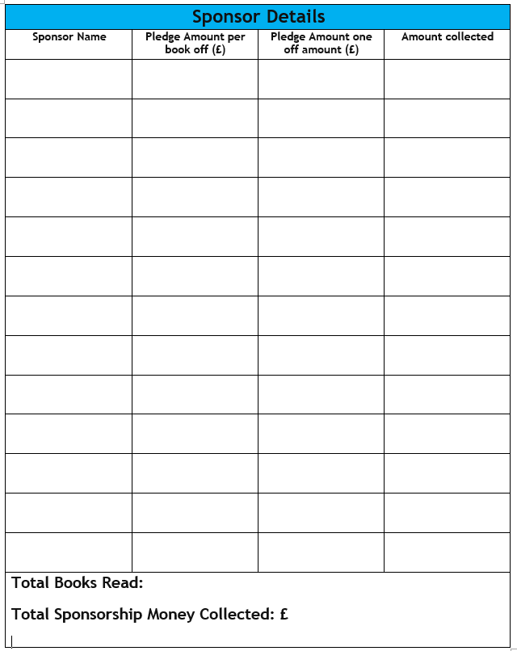
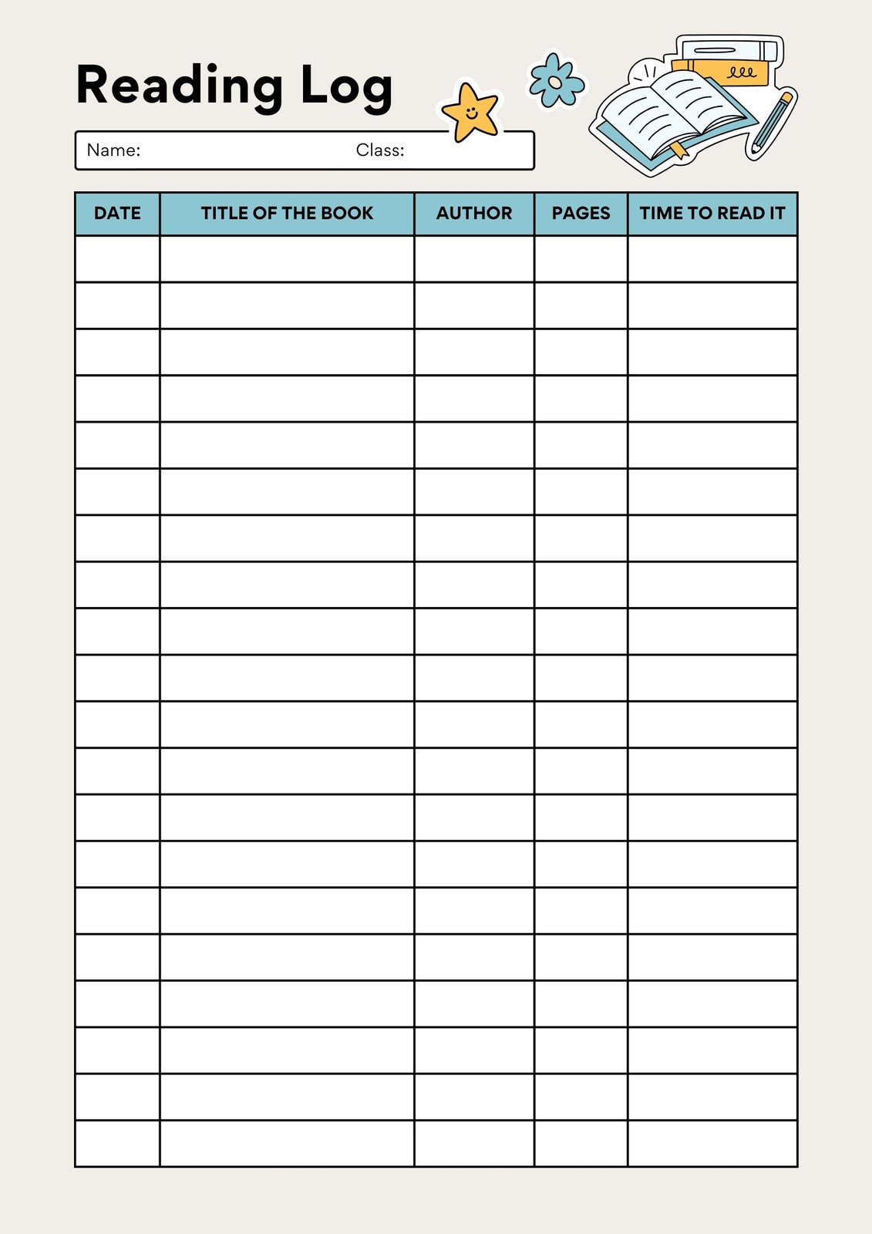

The person in each class who reads the most books by Thursday 12th February will win a special prize!
Return sponsorship money and form to your teacher by Friday 30th January.

Slide 3
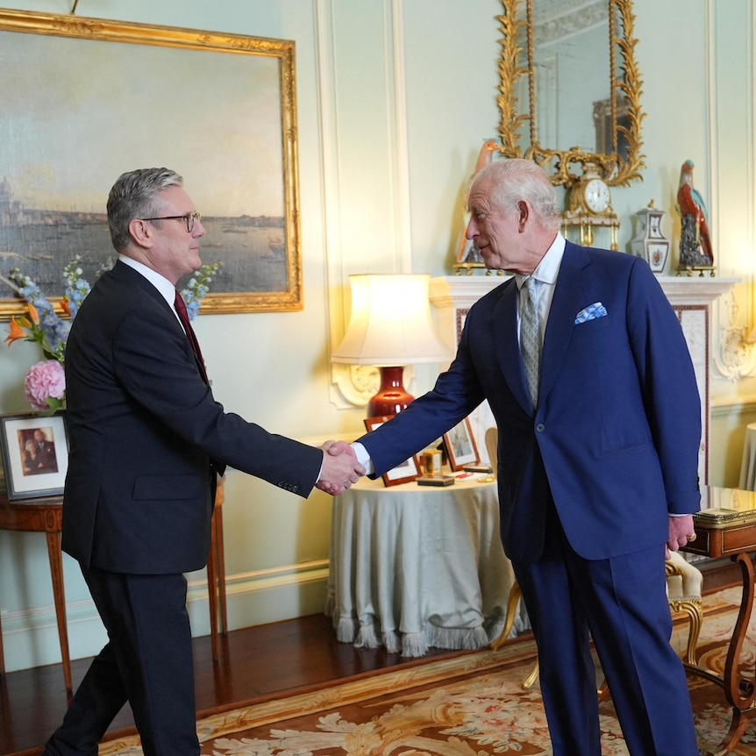
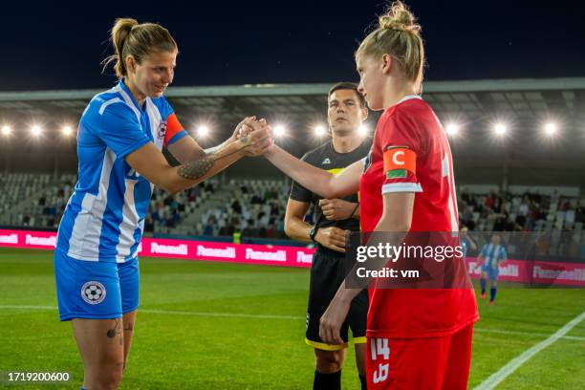
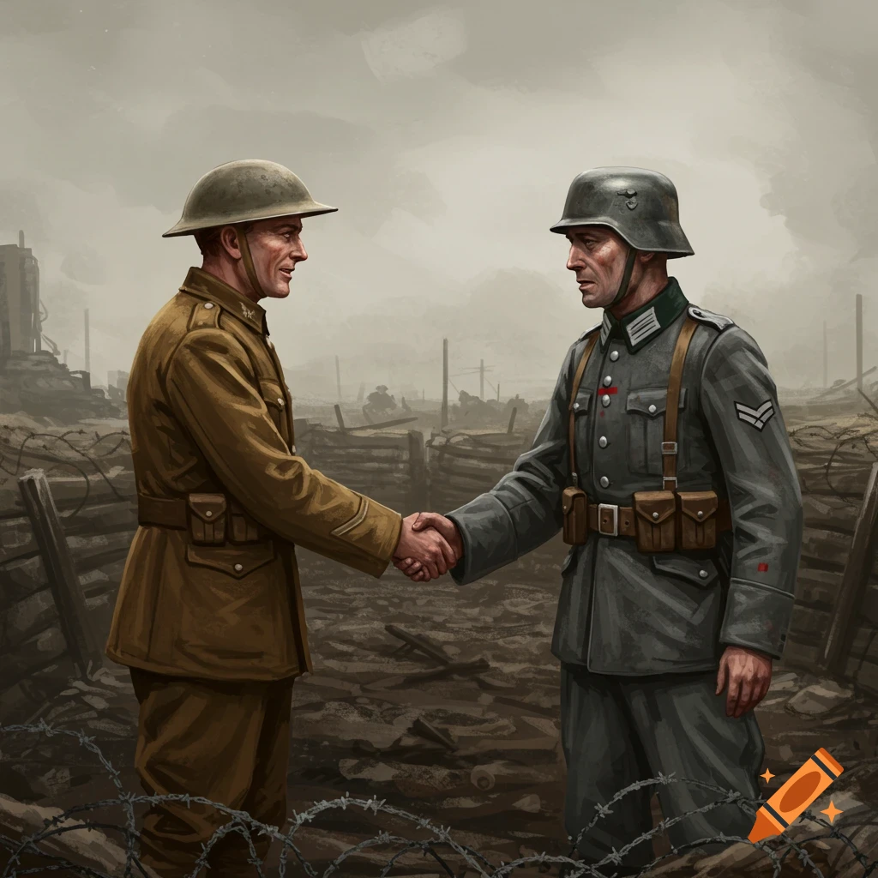
Recap:
A handshake is a way of showing you intend to play fairly and value your opponents.
A handshake is a mark of respect. And mutual respect - respect between one another.

Slide 4
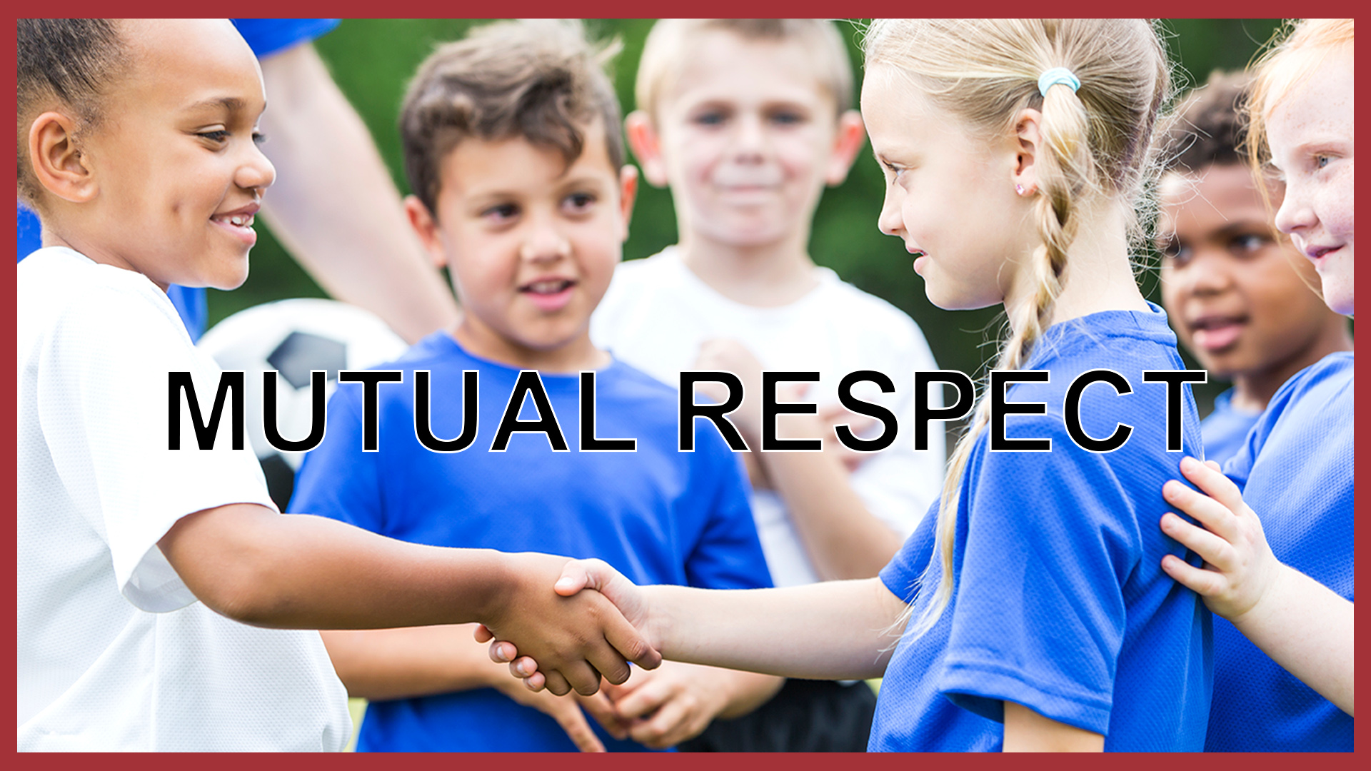
Mutual means shared between people
Respect means to value another (think about someone's feelings, wishes or rights)

Slide 5
Reflection:
Who would you respect, why?
Notes:
https://www.youtube.com/watch?v=omPdemwaNzQ

Slide 6
Think:
What is a Role Model?
Notes:
https://www.youtube.com/watch?v=2wdYttIm5S8&t=15s

Slide 7
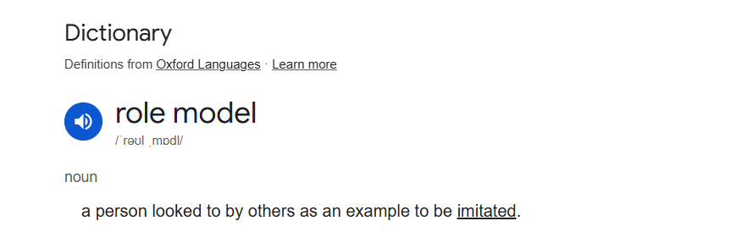

Slide 8
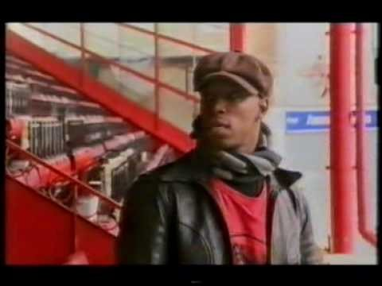
What effect does a role model have on someone?

Slide 9
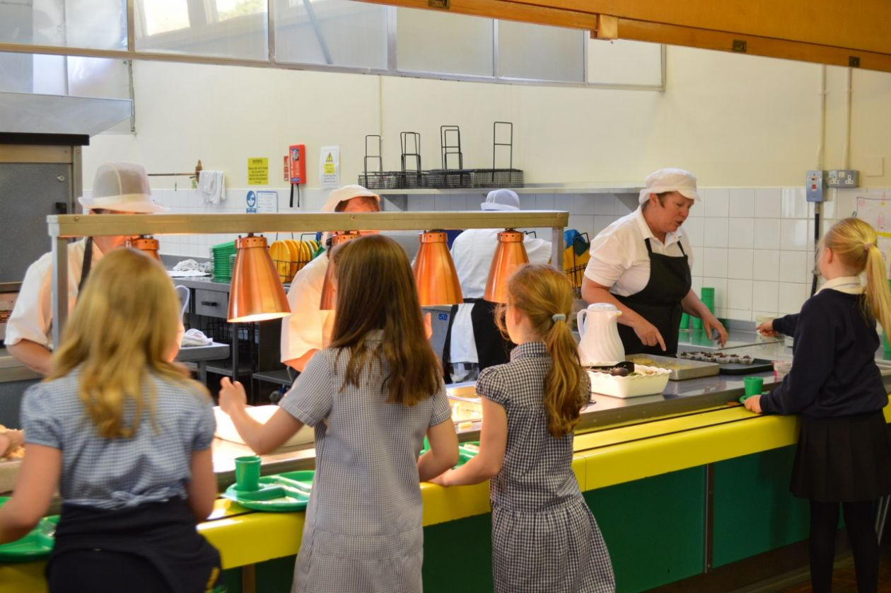
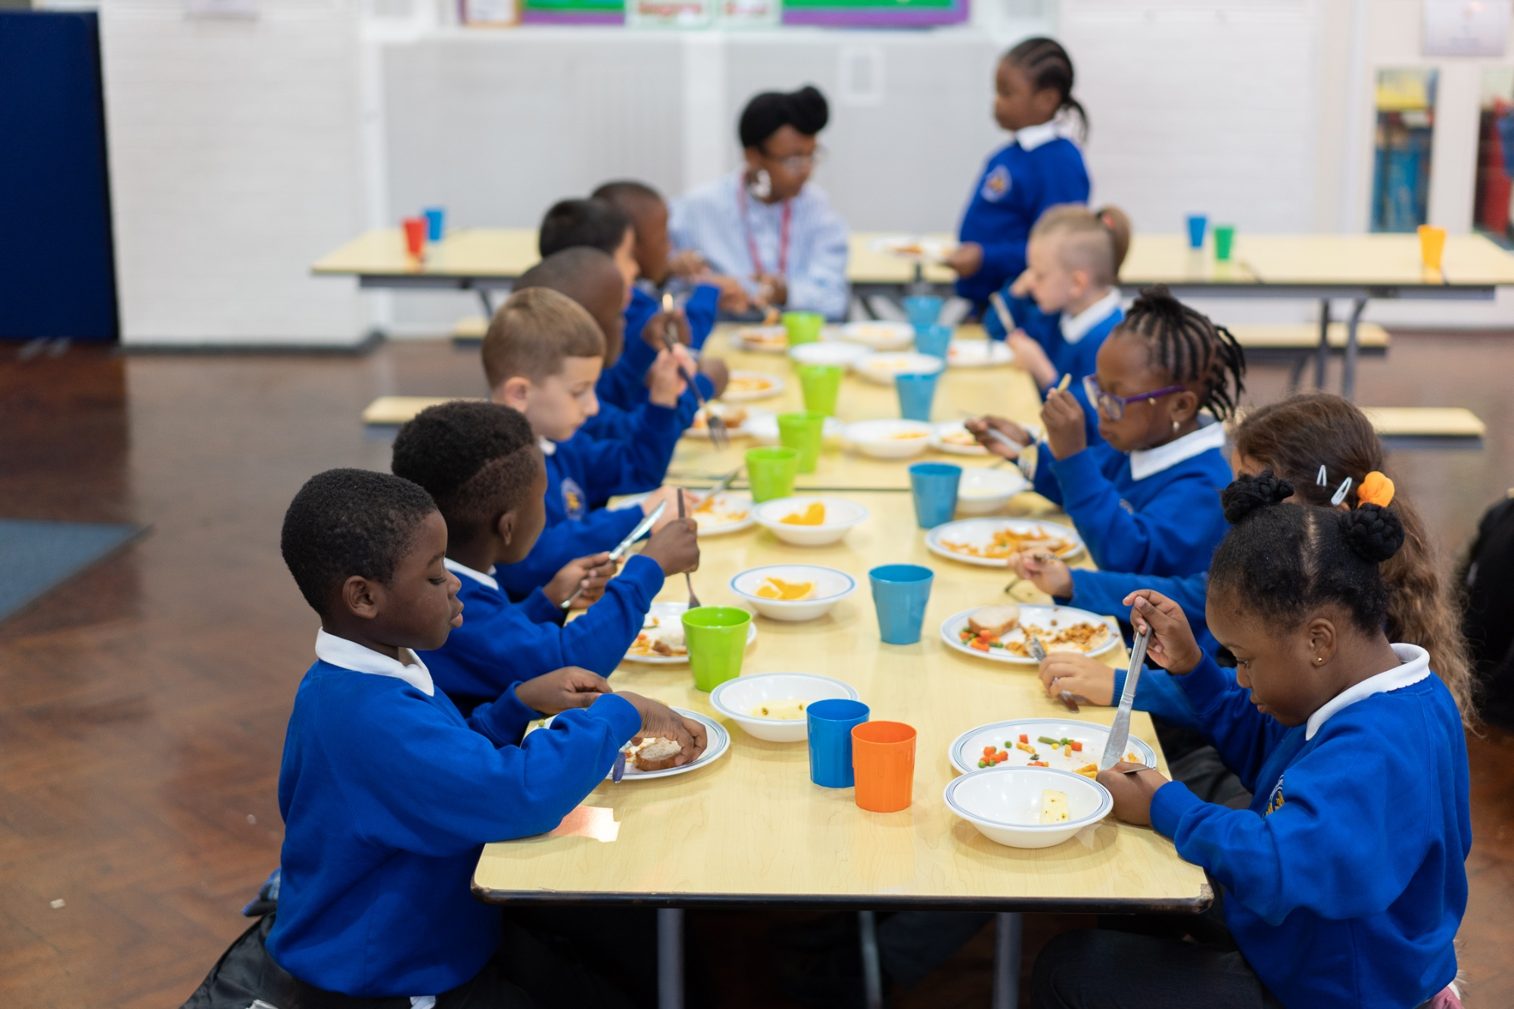
How would you show respect in the lunch hall?

Slide 10
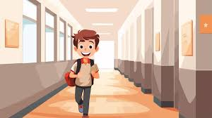
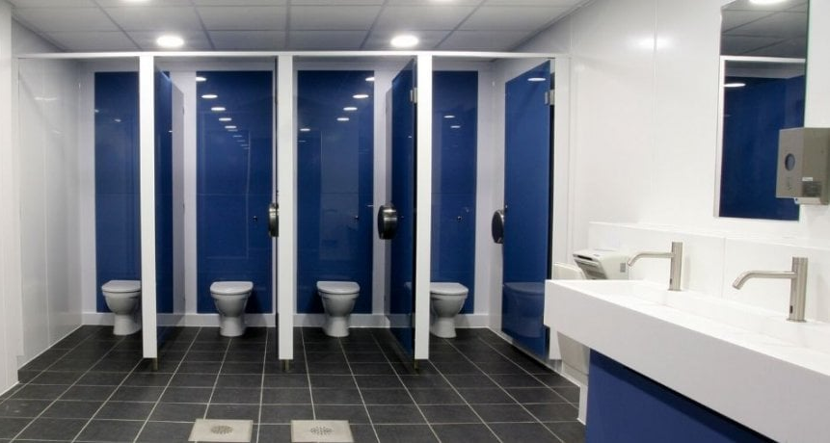
How would you show respect around the school?

Slide 11
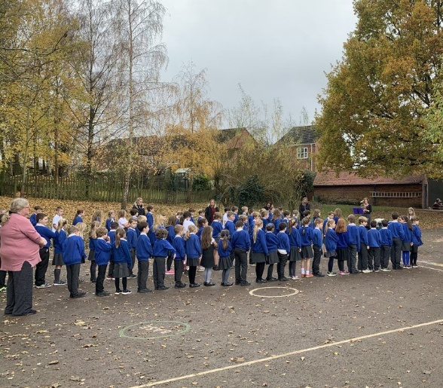
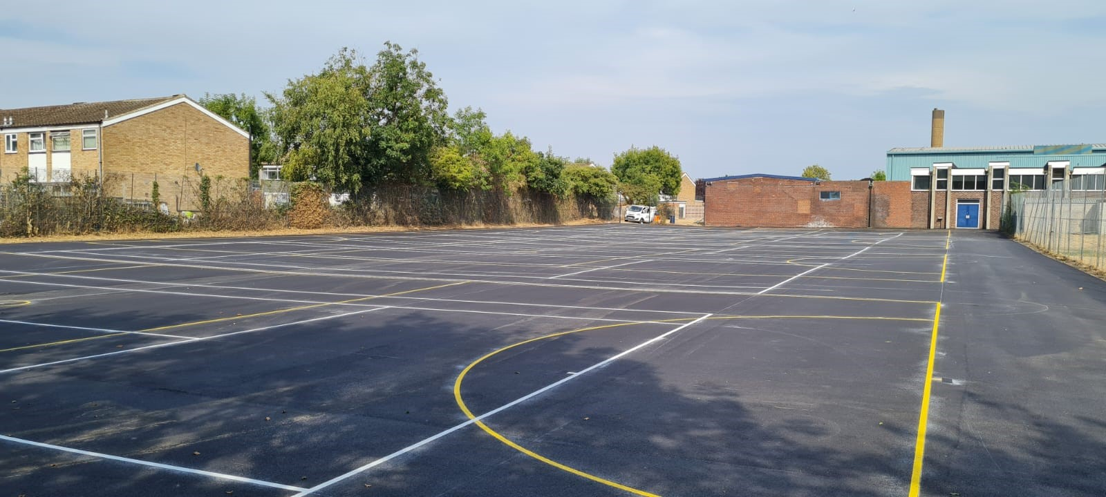

How would you show respect in the playground?

Slide 12
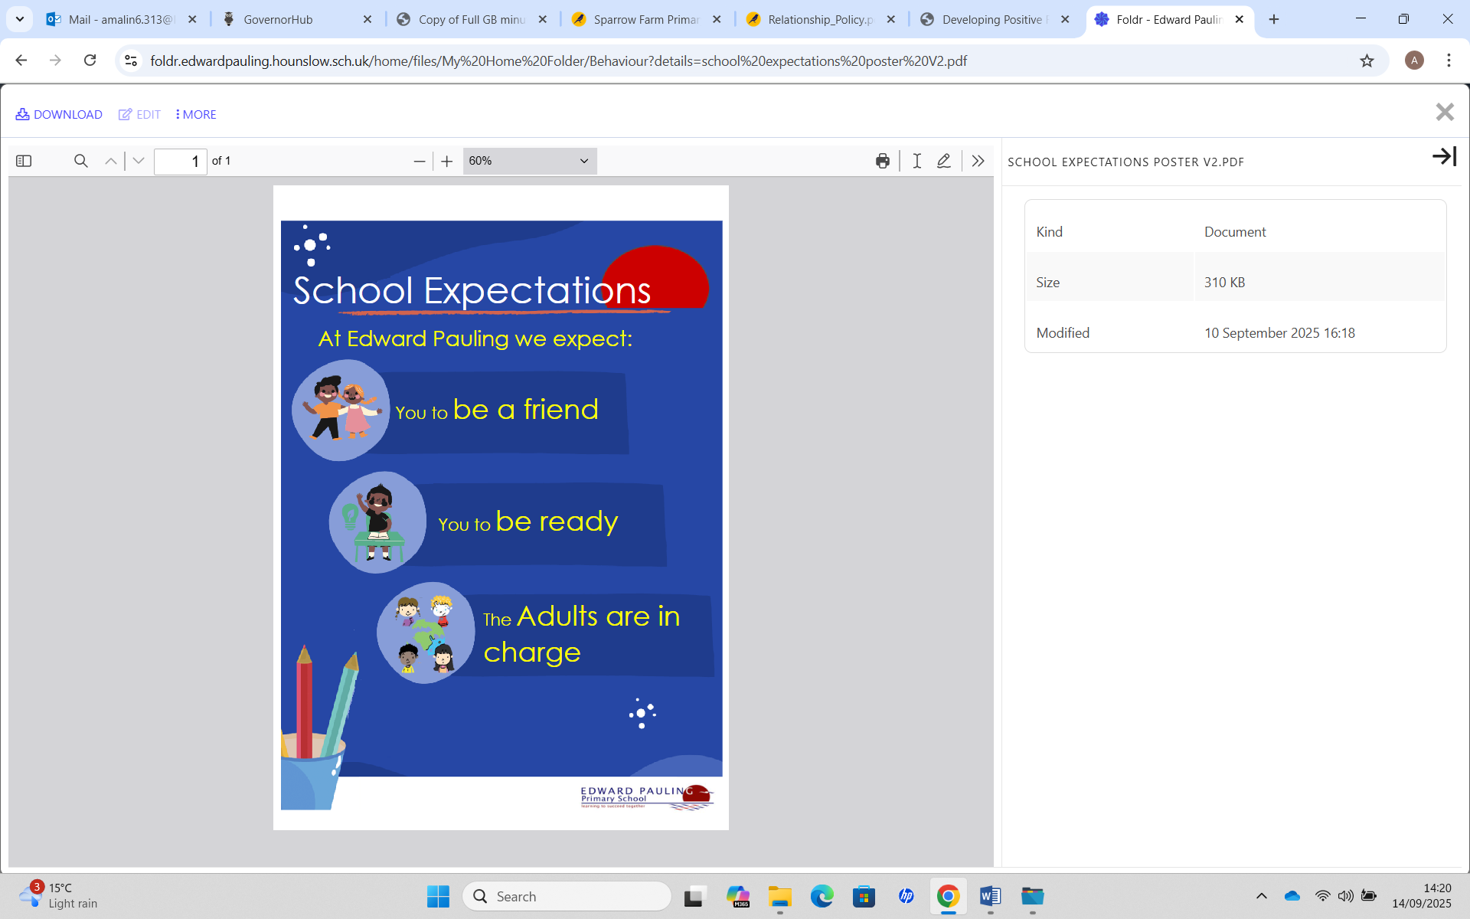
In class follow up:
KS1- Think and share:
*What can you learn from a role model?
*Can you be a role model?
KS2- Think and share:
*Who would you respect, why?
*As a role model, which school expectation is the most important?
*What responsibilities would be expected of a role model in our school?

