Slide 1
Independence
Assembly 1 23.02.26

Slide 2



£1,300
What else are we doing for the National Year of Reading?

Slide 3
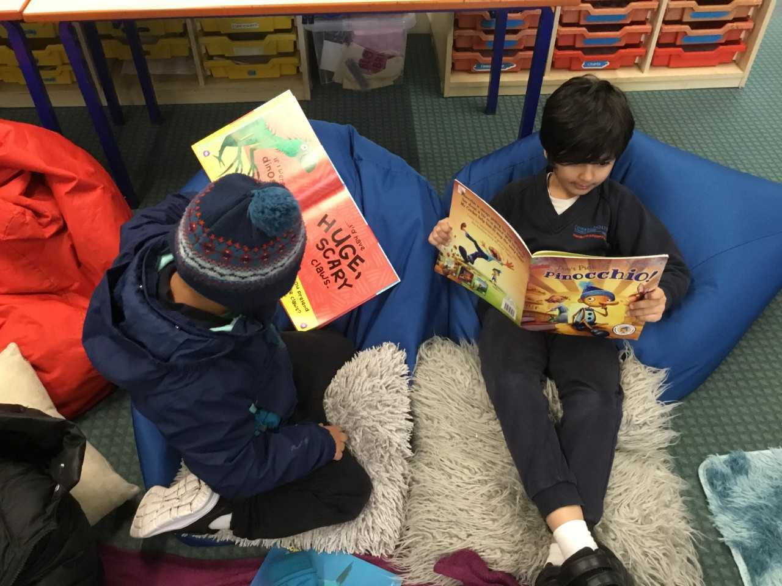


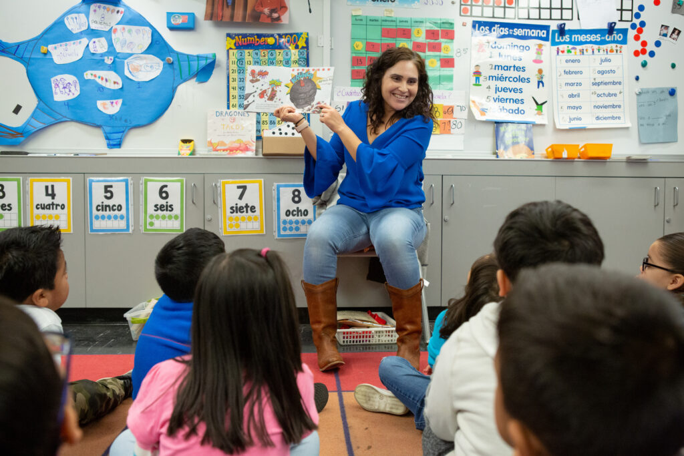
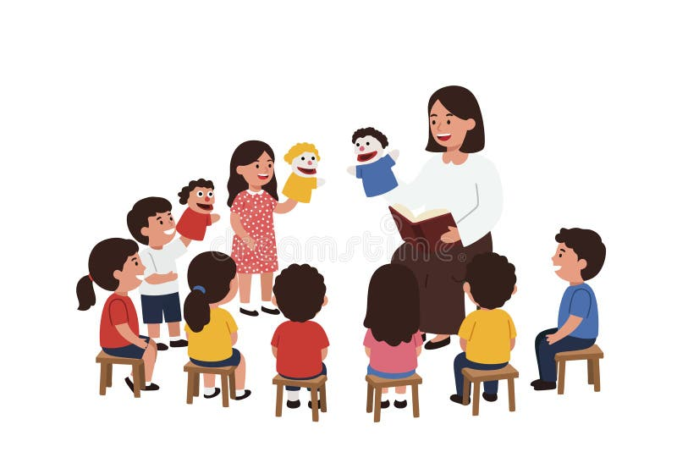
Lunchtime reading club
Daily story telling
Teacher read alouds

Slide 4
What are our 6 school values?

Slide 5
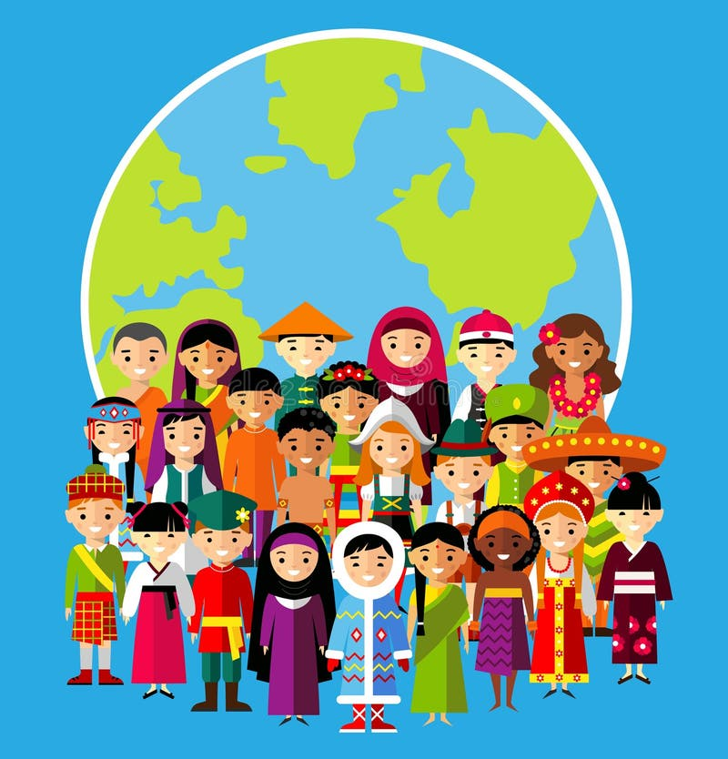
Our Values
Resilient | Empathetic | Respectful
Independent | Courageous | Ambitious

Slide 6
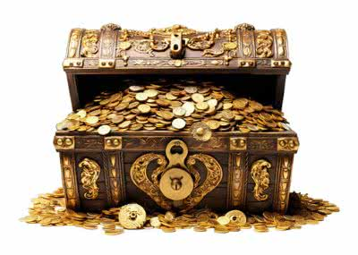
Our values help to prepare us for life and should be treasured
Resilient
Empathy
Respect
Independence
Courage
Ambition

Slide 7
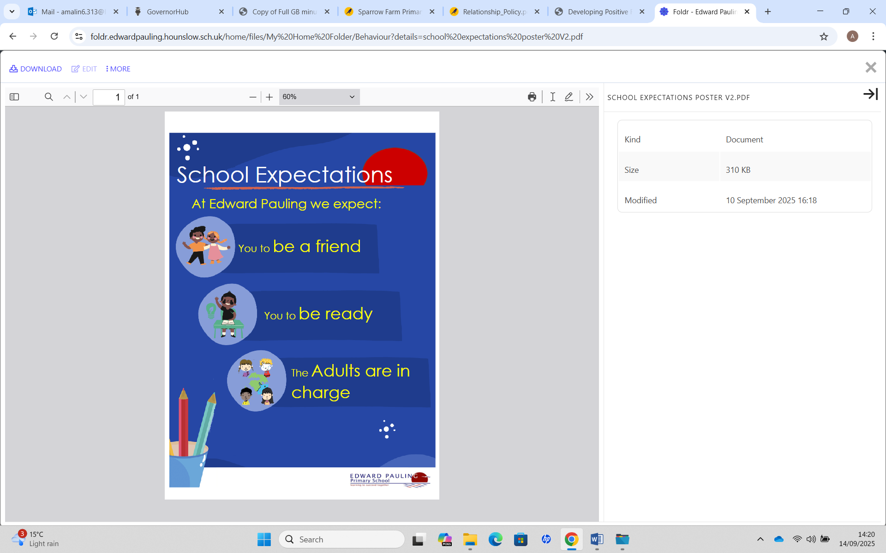

Last Week class follow up- Role Model
KS1- Think and share:
*What can you learn from a role model?
*Can you be a role model?
KS2- Think and share:
*Who would you respect, why?
*As a role model, which school expectation is the most important?
*What responsibilities would be expected of a role model in our school?

Slide 8
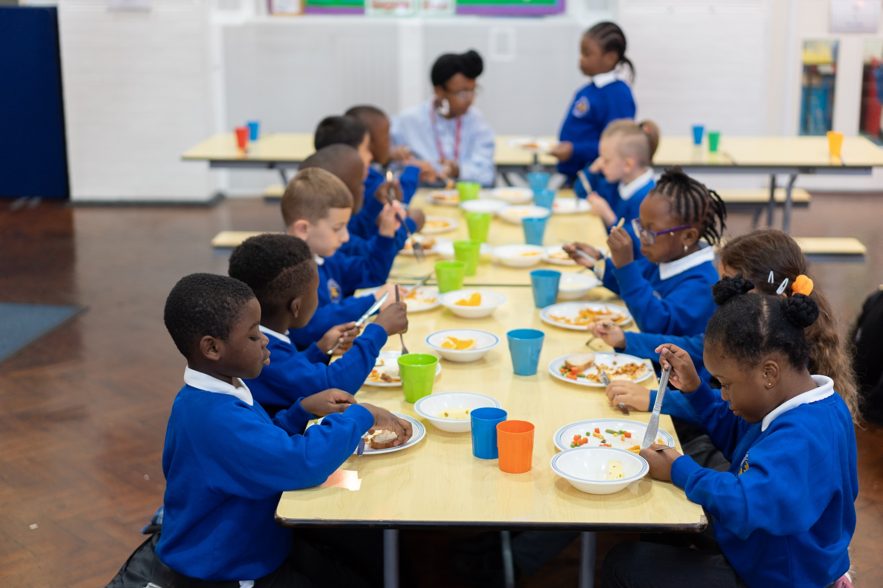
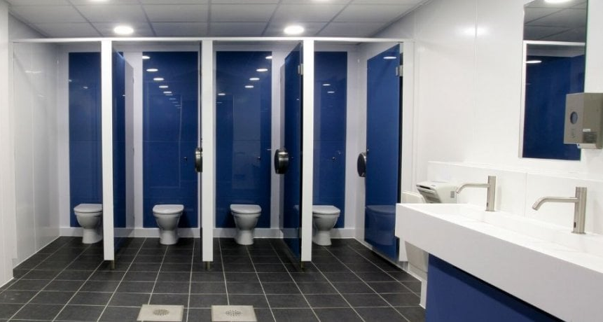
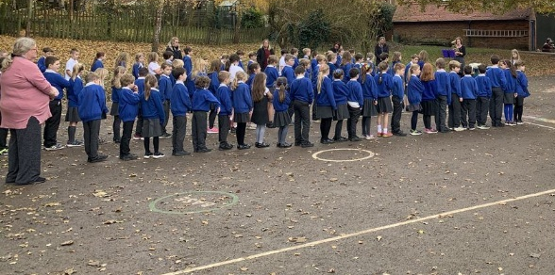
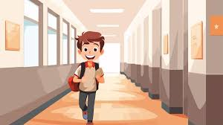
How can you be a Role Model

Slide 9
Class Follow up:
Stuedent Council will present about British Values.
Can each class create a small display to display the British values posters that student council have created
For each british value to recap how in your classroom/ in our school we develop. Eg voting for class a class book. On your mini class display please add details.
Send a photograph of your display to Mr Malin and Mrs Evans as we will be creating a page on our school website and student council will be updating the British value display in the ICT room.

Slide 10

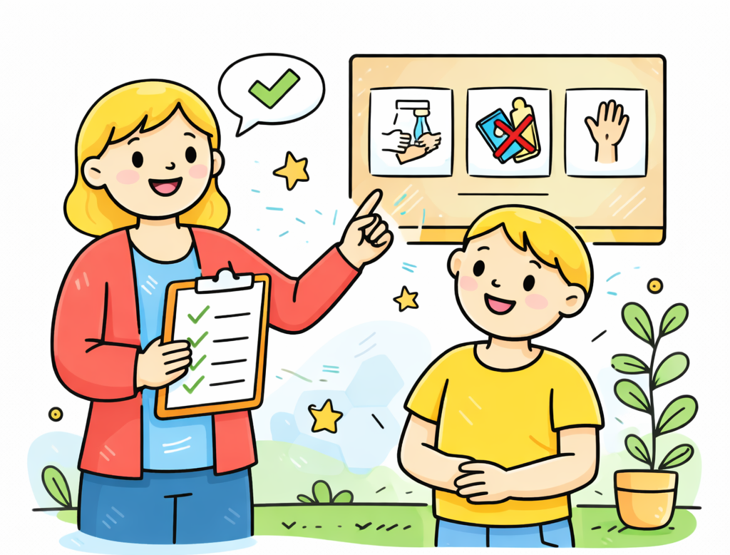


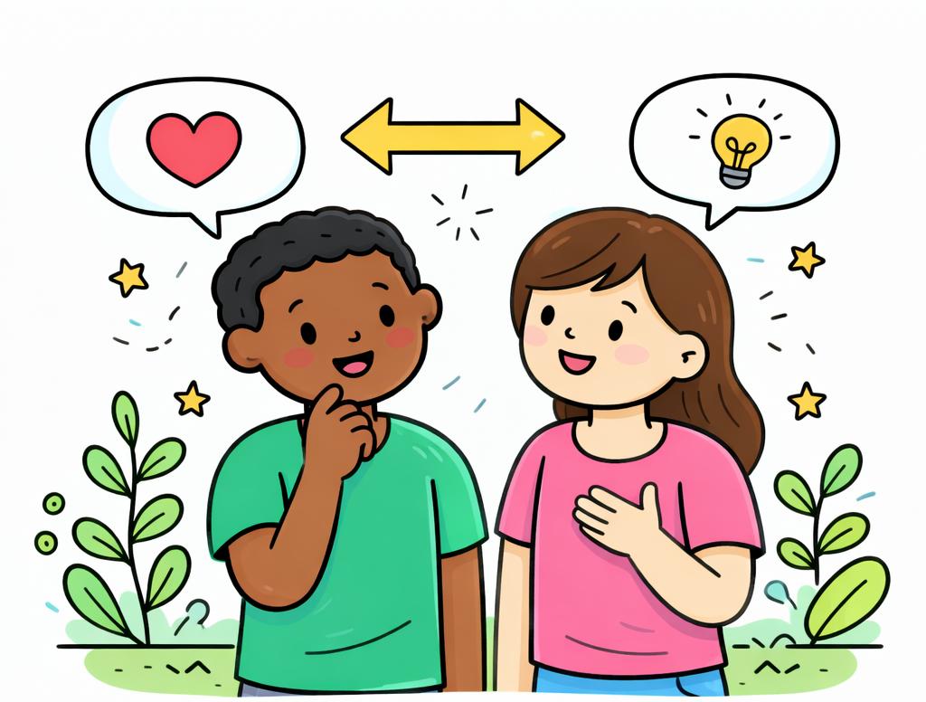
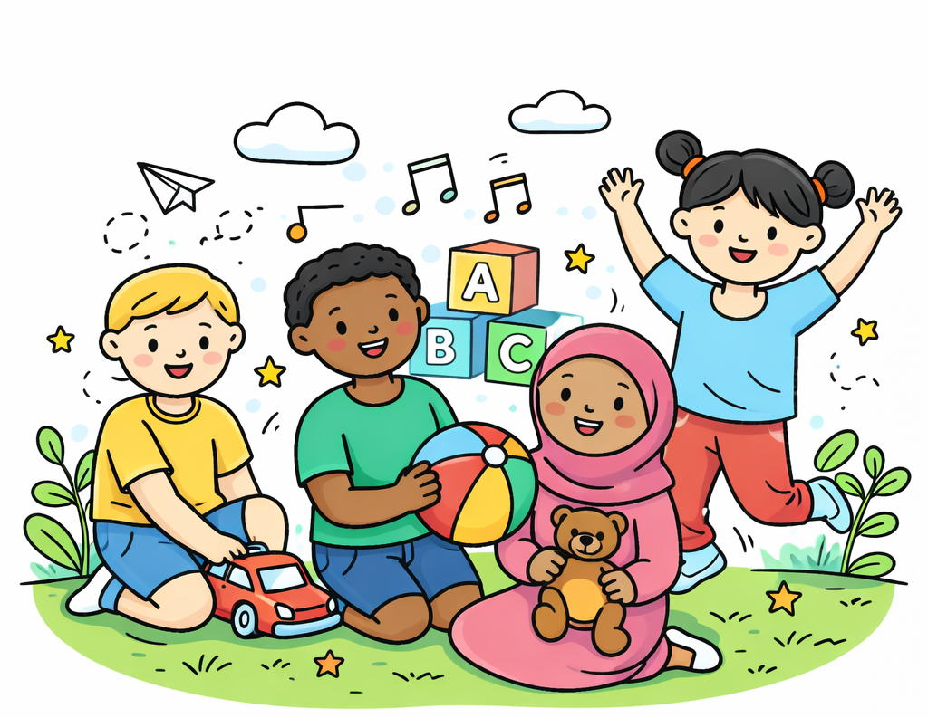

Rule of Law
Democracy
follow instructions
justice
do the right thing
voting
listen
prefects
be ready
listened to
safety
take turns
wellbeing
my voice
respect
choice
rules
fairness
debate
Mutual Respect
school expectations
school council
Tolerance
empathy
listen
respect
friends
British values
open-minded
listen
talk
celebrate our differences
teach
learn
help
honest
care
comfort
respect
feeling valued
trust
kind
listened to
thoughtful
special
listen
love
take turns
ambitious
understanding
kind hands
freedom
empathy
considerate
share opinions
fair
courage
acceptance
support
confidence
my rights
different
equality
unique
my choice
Individual Liberty
appreciated

Slide 11





Rule of Law
Democracy
wellbeing
safety
follow instructions
school expectations
rules
be ready
do the right thing
listen
respect
listened to
prefects
my voice
Tolerance
Mutual Respect
listen
debate
take turns
school council
choice
justice
fairness
care
voting
empathy
friends
British values
thoughtful
considerate
listen
respect
kind hands
honest
take turns
talk
support
listened to
comfort
help
understanding
empathy
listen
respect
fair
celebrate our differences
special
open-minded
teach
my choice
my rights
learn
trust
kind
confidence
freedom
acceptance
ambitious
feeling valued
unique
different
love
equality
appreciated
share opinions
courage
Individual Liberty

Slide 12





Rule of Law
Democracy
listened to
be ready
take turns
do the right thing
rules
listen
wellbeing
safety
fairness
my voice
follow instructions
choice
prefects
respect
voting
listen
justice
Tolerance
school expectations
school council
Mutual Respect
debate
British values
celebrate our differences
kind
support
love
comfort
help
talk
trust
take turns
listen
care
friends
empathy
learn
thoughtful
listen
empathy
respect
teach
open-minded
understanding
listened to
respect
fair
freedom
acceptance
considerate
my choice
confidence
honest
special
courage
ambitious
kind hands
my rights
unique
equality
appreciated
different
feeling valued
share opinions
Individual Liberty

