Slide 1
Independence
Assembly 3 24.03.26
Notes:
https://www.youtube.com/watch?v=KFbYFHaigSk

Slide 2
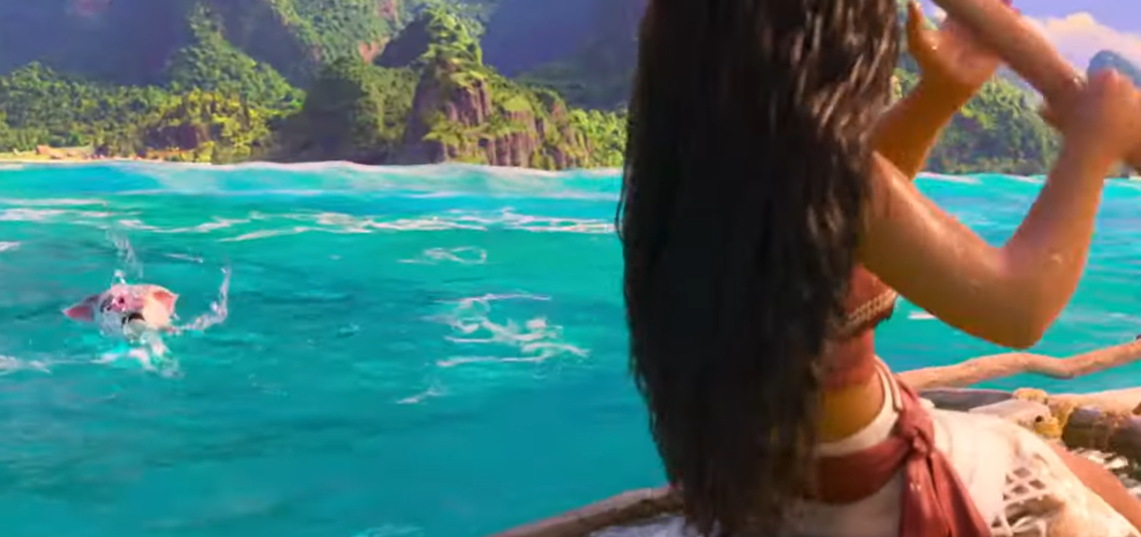
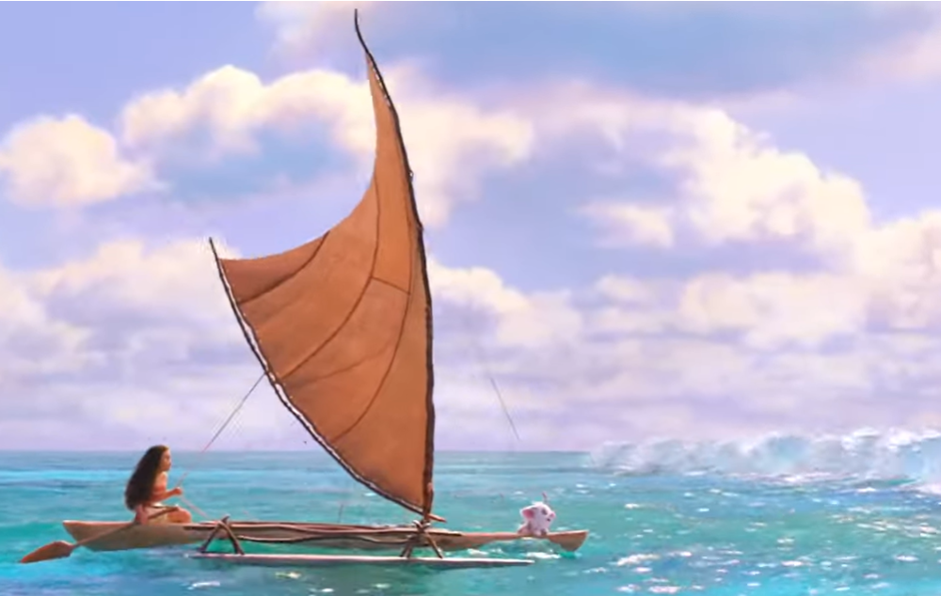
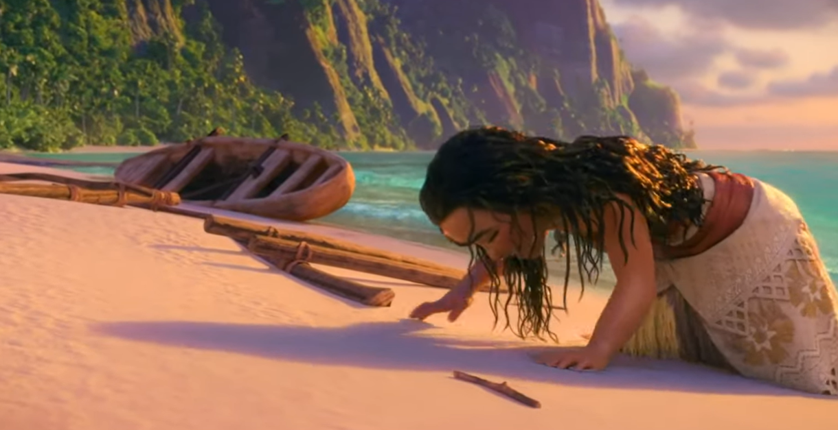
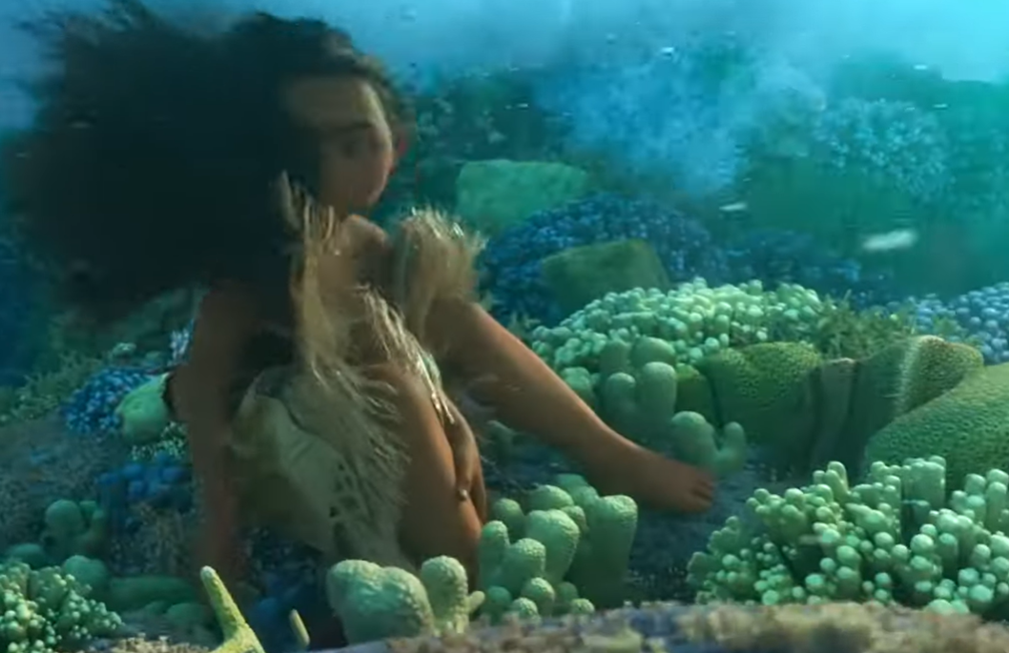
Recap-
Failure as an opportunity to learn.

Slide 3
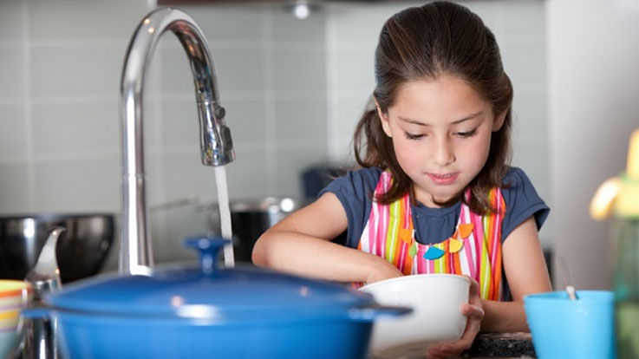



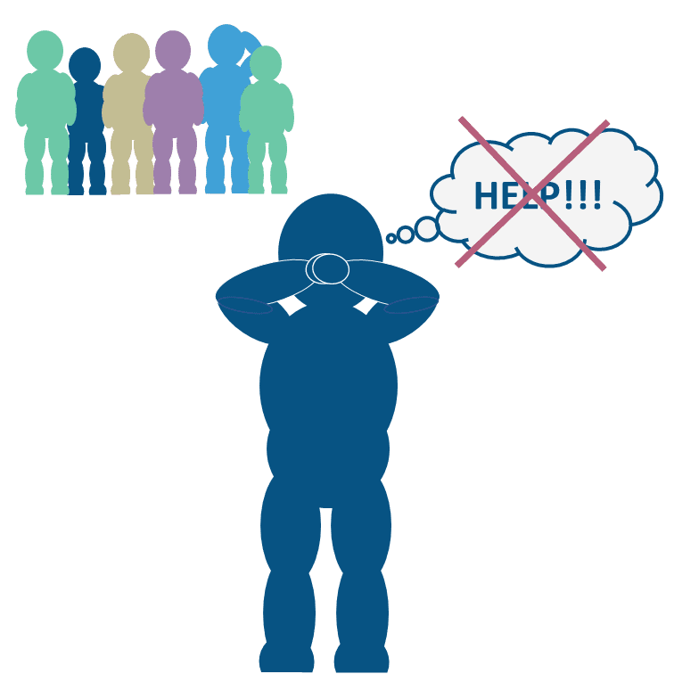
Being independent is…
Being able to do things for yourself
Taking responsibility for your own actions
Taking care of your own needs
Not following the rules
Not asking for help

Slide 4
A role model inspires others to be the best version of themselves
Notes:
What are the key words

Slide 5

Watch: Top 3 takeways
Notes:
https://www.youtube.com/watch?v=esIppyBGf_c

Slide 6
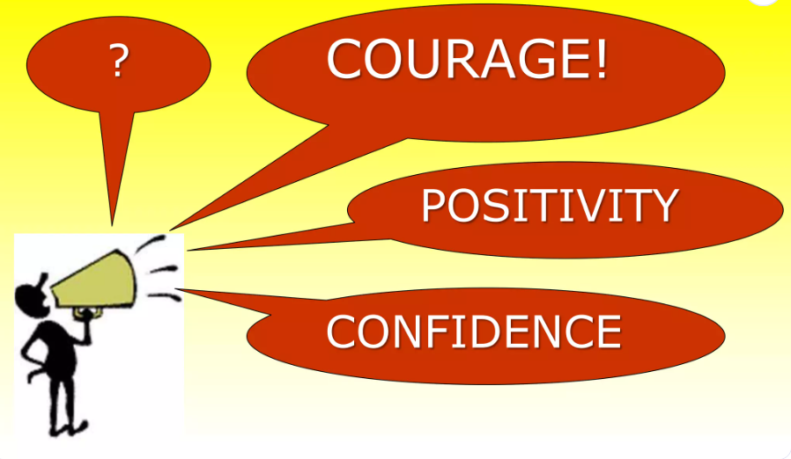
Recap
What values will help you to be more independent?

Slide 7
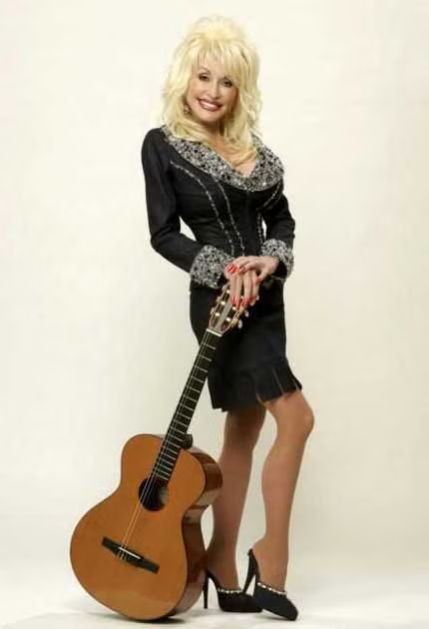
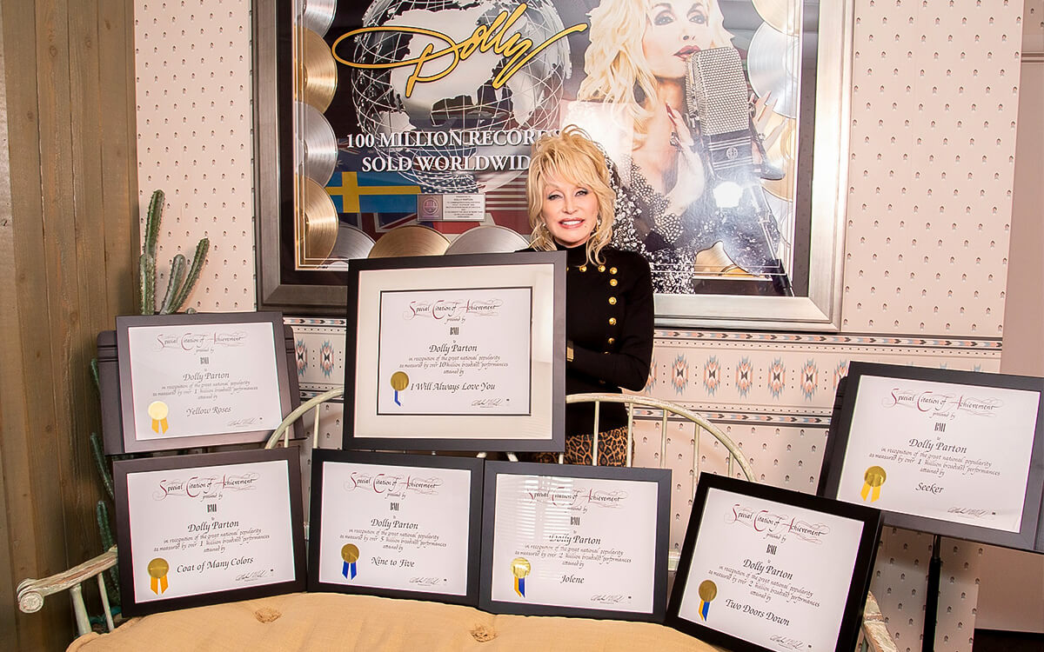
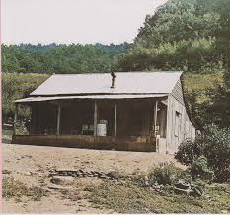



Slide 8

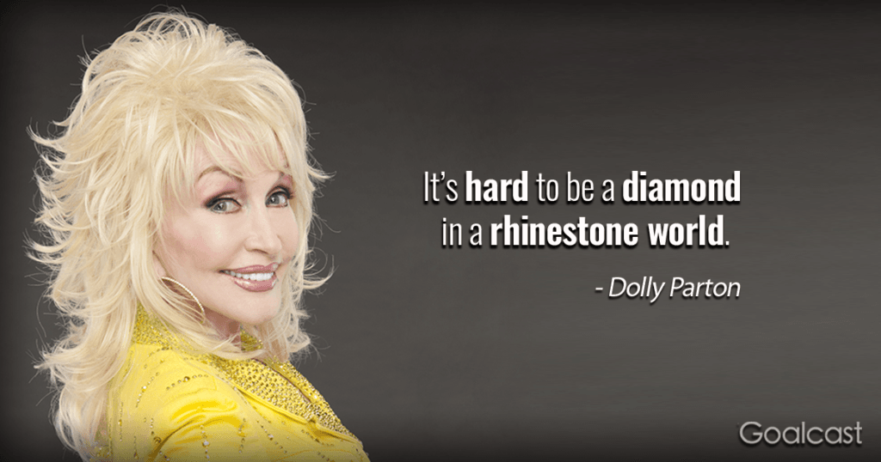


Rhinestone
Diamond
Notes:
Reflection: stand out by being your true self

Slide 9
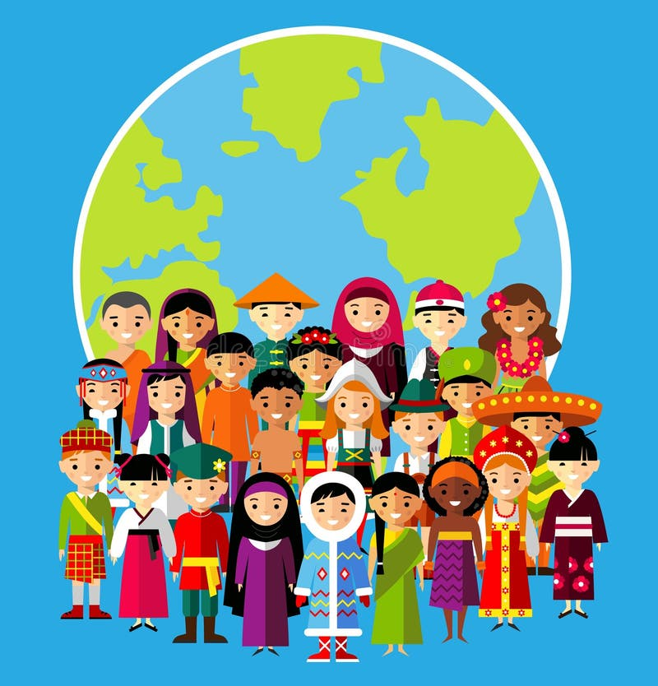
Our Values
Resilient | Empathetic | Respectful
Independent | Courageous | Ambitious

