Slide 1
Courage
Assembly 2 27.04.26
Notes:
https://www.youtube.com/watch?v=EkjJbWBUbUs&list=PLrLt4fBD0JjrHnPALYnCtZFPc1rYEWszS&index=4

Slide 2
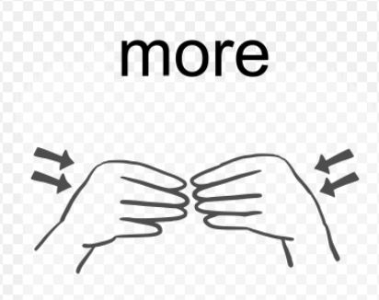
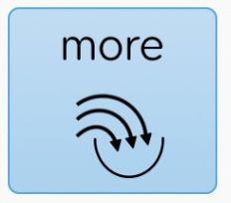

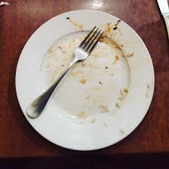
Sign and symbol of the week
Notes:
https://www.tiktok.com/@lets.make_a_difference/video/7559349147824950550

Slide 3

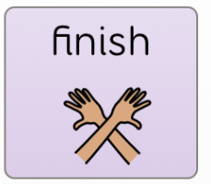
Sign and symbol of the week
Notes:
https://www.tiktok.com/@lets.make_a_difference/video/7559349147824950550

Slide 4
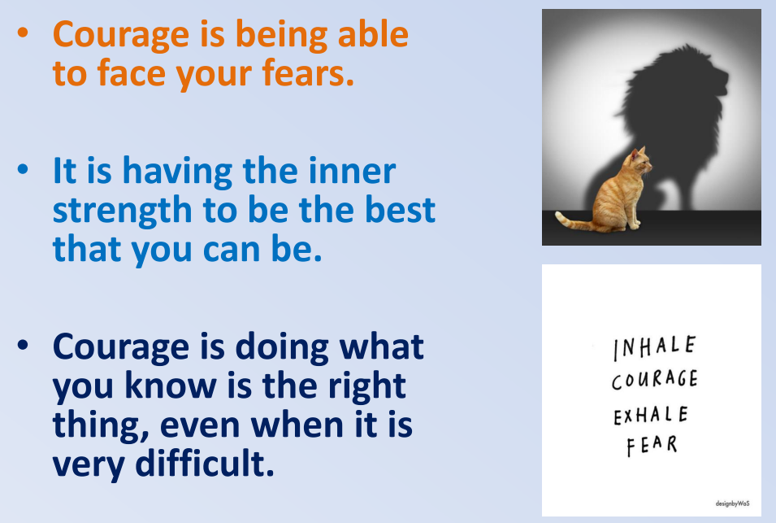
What is Courage?

Slide 5


How did Gerald show courage?

Slide 6
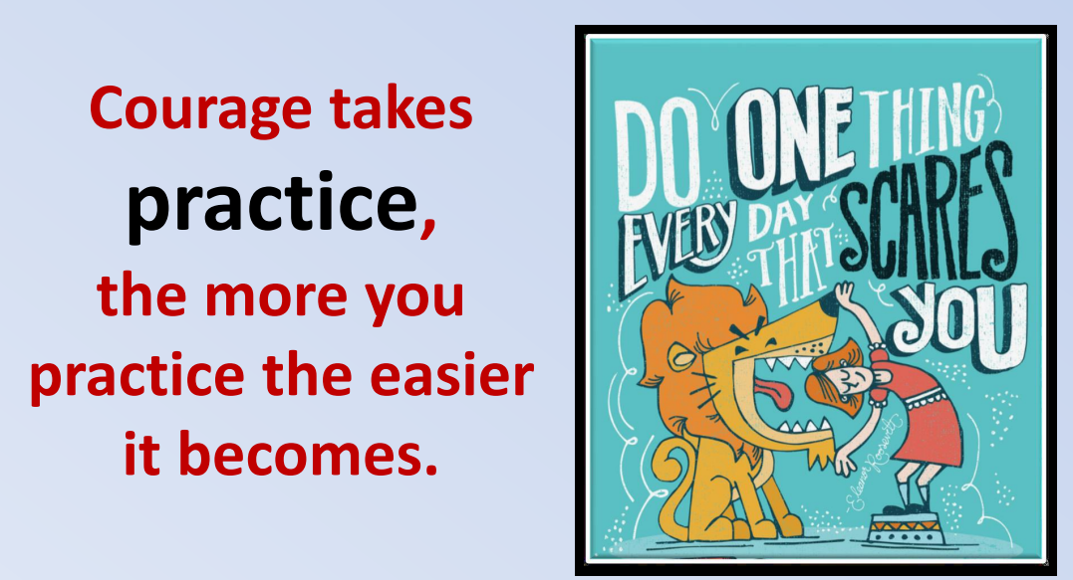

Slide 7
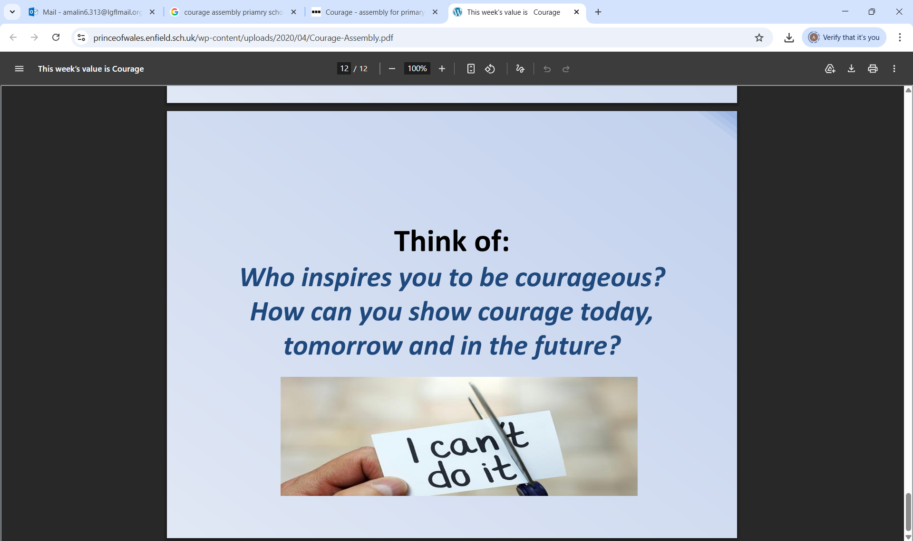

Slide 8

What quality did Piper show?
Notes:
https://www.youtube.com/watch?v=WIPV1iwzrzg

Slide 9
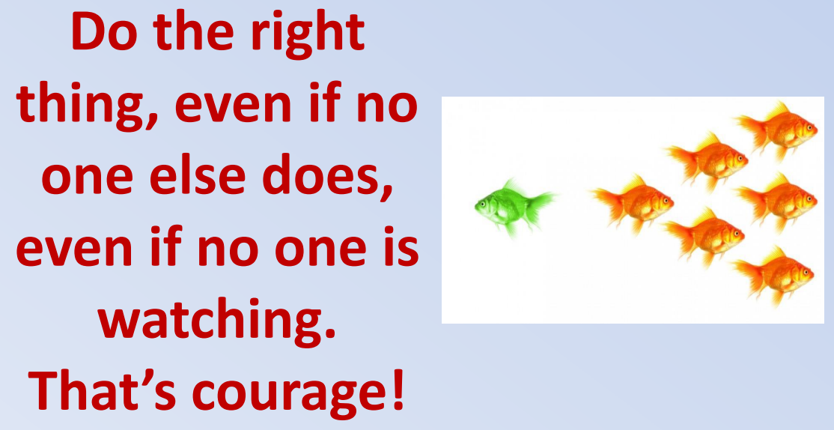
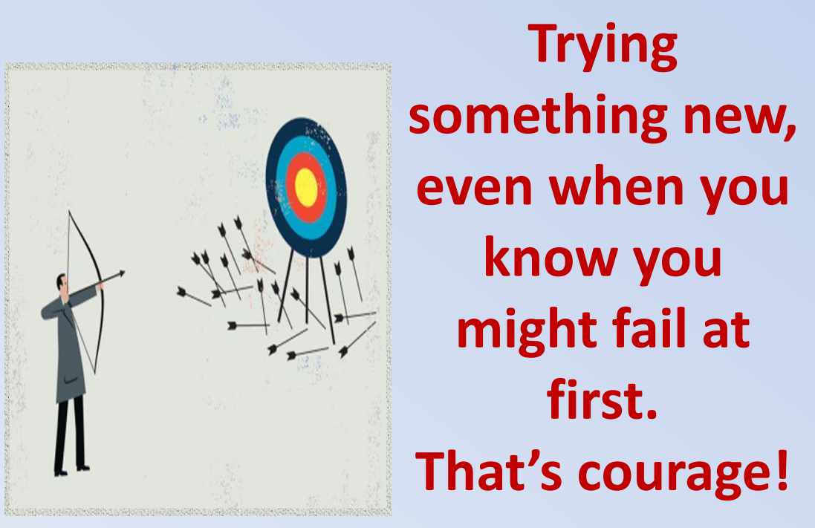

Slide 10

Courage is……….
I can show courage by………

