Slide 1

EYFS & KS1 Maths Parent Workshop
Friday 20th March 2026
What we focus on in Maths
How we teach
How children learn
How can you help at home
Mr Chambers (Maths Lead)

Slide 2
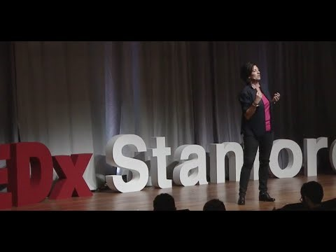
How do you feel about Maths?
Notes:
TED talk clip
Jo Boaler- Professor at Stanford

Slide 3
What We Focus On in Maths
At our school we help children to:
• Understand Maths deeply
• Become confident problem solvers
• Explain their thinking
• Build strong number skills
Maths is about understanding, not just getting answers.

Slide 4
How We Teach (I Do – We Do – You Do)
I Do
The teacher models the learning clearly.
We Do
Children practise together with support.
You Do
Children practise independently to show understanding.
This helps children build confidence step by step.

Slide 5
How Children Learn Maths
Concrete → Pictorial → Abstract
Concrete
Using real objects (counters, cubes)
Pictorial
Using pictures and diagrams
Abstract
Using numbers and symbols
Children may use resources to help their understanding.

Slide 6








T | O
H | T | O
100
40 | 60

Slide 7


Slide 9
1) What is missing?
1, 2, 3, __ , 5 , 6 , 7, __
2) Write the number 2 in words.
3) What is missing?
10, 11, ___, 13, ___
4) You have only 1 nose and 1 mouth.
What do you have 2 of?

Slide 10

1) What is missing?
1, 2, 3, __ , 5 , 6 , 7, __
2) Write the number 2 in words.
3) What is missing?
10, 11, ___, 13, ___
4) You have only 1 nose and 1 mouth.
What do you have 2 of?
4
8
two
12
14

Slide 12



How many strawberries?
Now I can count in 2s.
There are 8 strawberries.

Slide 13
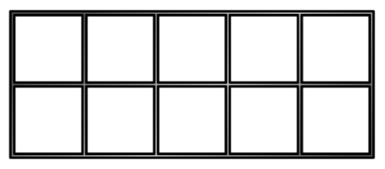
How many counters?
0
2
4
6
8
10

Slide 14

How many gloves?
0
1
2
3
4
5
6
7
8
9
10
11
12
13
14
15
16
17
18
19
20

Slide 15




How many socks?
Have a think
There are __ equal groups of 2
There are __ socks altogether.
12
24

Slide 16
Continue colouring in 2s on the grid.
1 | 2 | 3 | 4 | 5 | 6 | 7 | 8 | 9 | 10
11 | 12 | 13 | 14 | 15 | 16 | 17 | 18 | 19 | 20
21 | 22 | 23 | 24 | 25 | 26 | 27 | 28 | 29 | 30
31 | 32 | 33 | 34 | 35 | 36 | 37 | 38 | 39 | 40
41 | 42 | 43 | 44 | 45 | 46 | 47 | 48 | 49 | 50
Have a think
What do you notice?

Slide 17
What number is missing?
Have a think
1 | 2 | 3 | 4 | 5 | 6 | 7 | 8 | 9 | 10
11 | 12 | 13 | 14 | 15 | 16 | 17 | 18 | 19 | 20
21 | 22 | 23 | 24 | 25 | 26 | 27 | 28 | 29 | 30
31 | 32 | 33 | 34 | 35 | 36 | 37 | 38 | 39 | 40
41 | 42 | 43 | 44 | 45 | 46 | 47 | 48 | 49 | 50
22 | 24 | 26 | 28 | 30 | 32 | 34
36

Slide 18
What number is missing?
Have a think
1 | 2 | 3 | 4 | 5 | 6 | 7 | 8 | 9 | 10
11 | 12 | 13 | 14 | 15 | 16 | 17 | 18 | 19 | 20
21 | 22 | 23 | 24 | 25 | 26 | 27 | 28 | 29 | 30
31 | 32 | 33 | 34 | 35 | 36 | 37 | 38 | 39 | 40
41 | 42 | 43 | 44 | 45 | 46 | 47 | 48 | 49 | 50
36 | 38 | 40 |  | 44 | 46 | 48 | 50
42

Slide 19

Tiny is counting backwards in 2s.
36, 34, 32, 30, 27, 26
Have a think
36
34
32
30
28
26
What mistake has Tiny made?
Tiny has said an odd number, 27

Slide 20


Ron counts back from 50 in 2s.
Sam counts up from 12 in 2s.
50
48
46
44
42
40
38
36
34
32
12
14
16
18
20
22
24
26
28
30
They say their numbers at
the same time.
Who will say the number 30 first?
Sam
Have a think

Slide 21
How You Can Help at Home
• Count everyday objects (toys, steps, food)
• Practise number bonds to 10 and 20
• Ask your child to explain their thinking
• Use maths in real life (shopping, cooking, time)
• Encourage confidence — mistakes help learning.
Understanding is more important than speed.

Slide 22
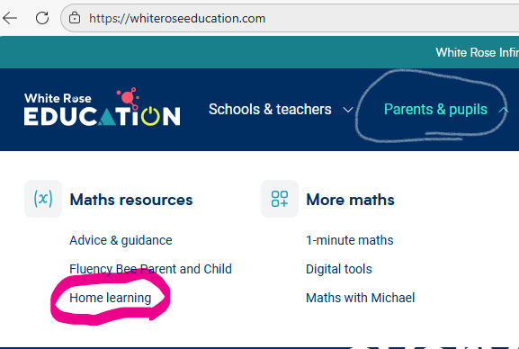
White Rose at home
Notes:
Maths home learning | Home learning | White Rose Education

Slide 23
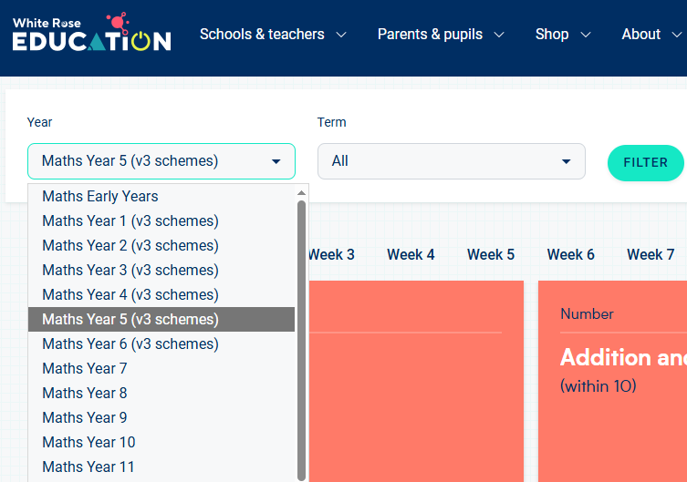
White Rose at home
Select year group and current topic- check with your child, ask their teacher or look on the website.

Slide 24
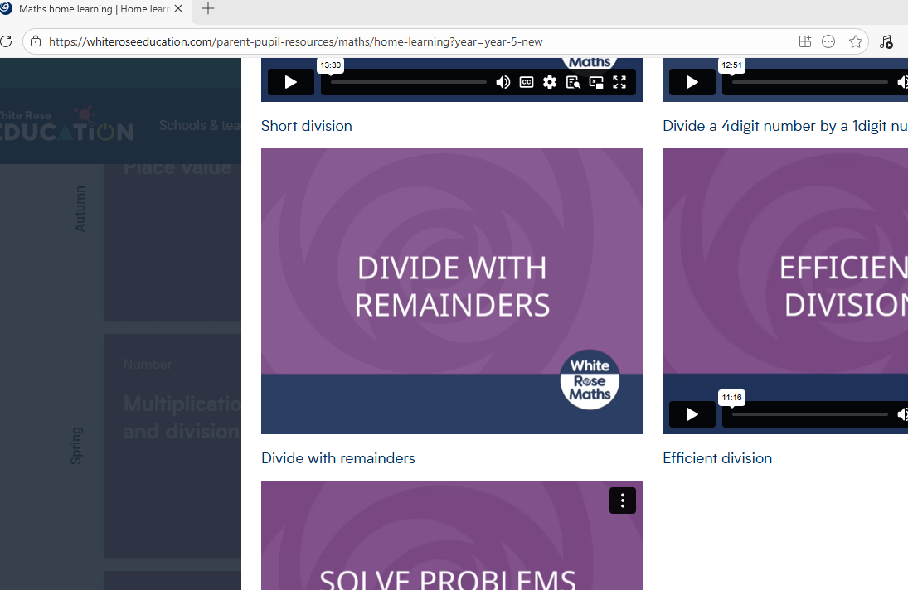
Find the lesson you want to revisit with your child.

