Slide 1

KS2 Maths Parent Workshop
Friday 13th March 2026
What we focus on in Maths
How we teach
How children learn
How can you help at home
Mr Chambers (Maths Lead)

Slide 2
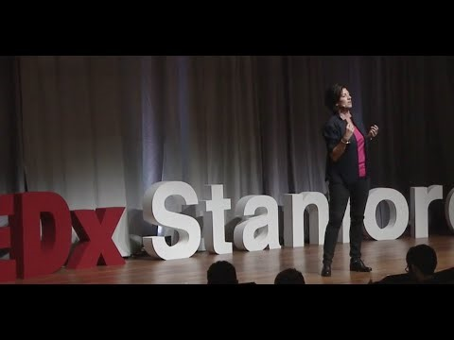
How do you feel about Maths?
Notes:
TED talk clip - YouTube

Slide 3
What We Focus On in Maths
At our school we help children to:
• Understand Maths deeply
• Become confident problem solvers
• Explain their thinking
• Build strong number skills
Maths is about understanding, not just getting answers.

Slide 4
How We Teach (I Do – We Do – You Do)
I Do
The teacher models the learning clearly.
We Do
Children practise together with support.
You Do
Children practise independently to show understanding.
This helps children build confidence step by step.

Slide 5
How Children Learn Maths
Concrete → Pictorial → Abstract
Concrete
Using real objects (counters, cubes)
Pictorial
Using pictures and diagrams
Abstract
Using numbers and symbols
Children may use resources to help their understanding.

Slide 6









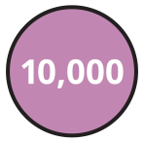


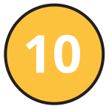


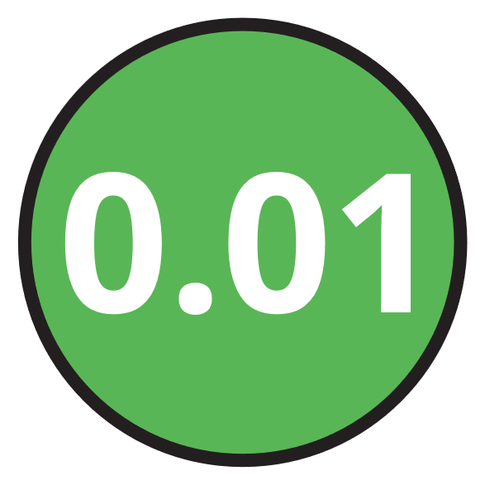

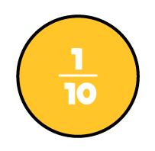




M | HTh | TTh | Th | H | T | O | Tth | Hth | Thth
100
40 | 60
Millions | Thousands |  |  | Ones
O | H | T | O | H | T | O
Notes:
Examples of concrete and pictorials.

Slide 7

Notes:
Lets look at a typical lesson.

Slide 9
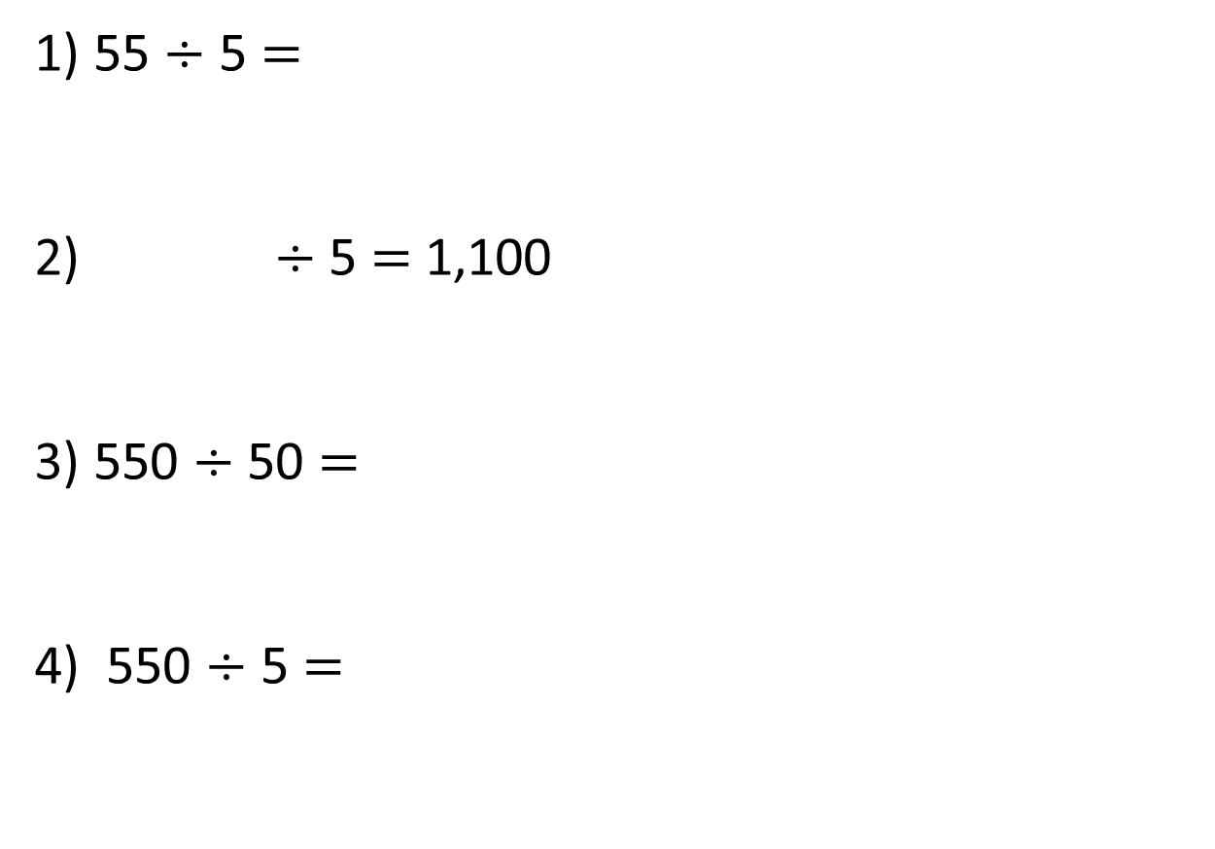
1) 55 $÷$ 5 $=$
2) $÷$ 5 $=$ 1,100
3) 550 $÷$ 50 $=$
4) 550 $÷$ 5 $=$

Slide 10
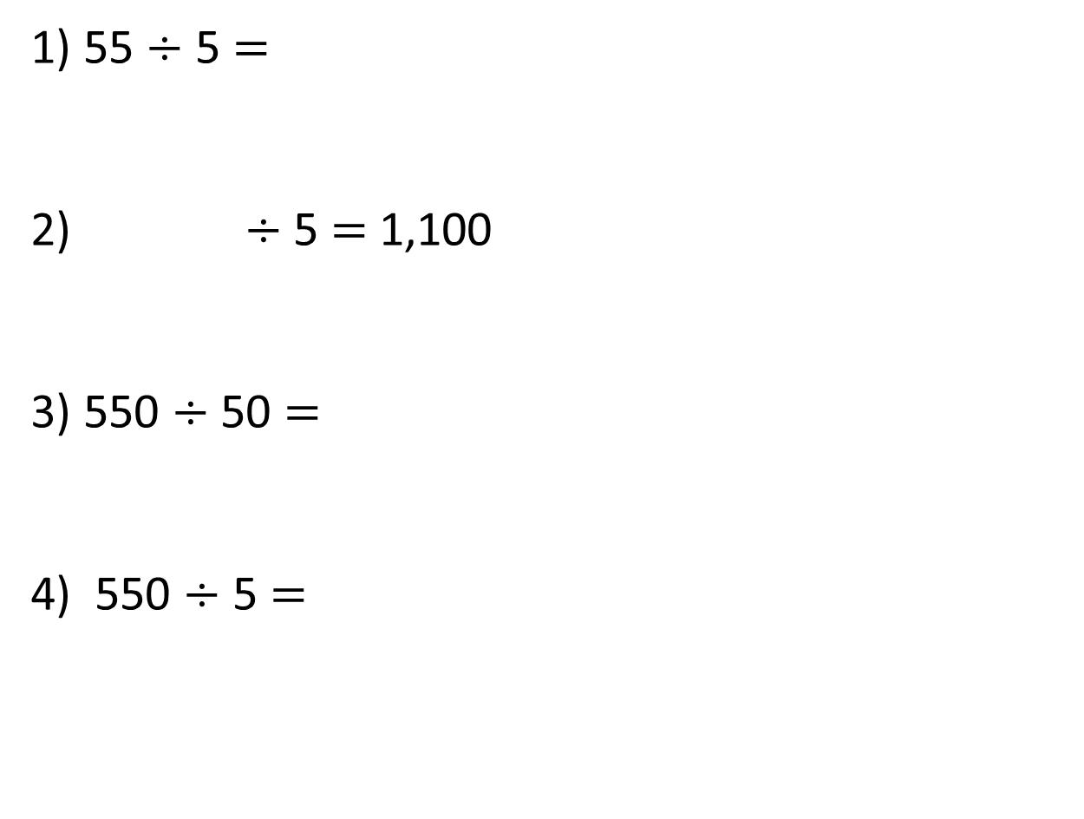
1) 55 $÷$ 5 $=$
2) $÷$ 5 $=$ 1,100
3) 550 $÷$ 50 $=$
4) 550 $÷$ 5 $=$
11
5,500
11
110

Slide 12
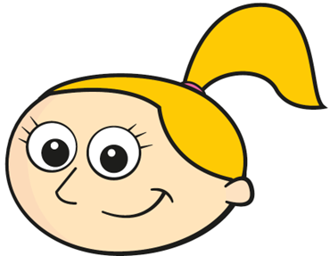

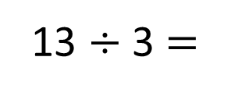
Eva has 13 straws. She wants to make them into triangles. How many triangles can she make?
What do we mean by “remainder”?
13 $÷$ 3 $=$
4 r1

Slide 13
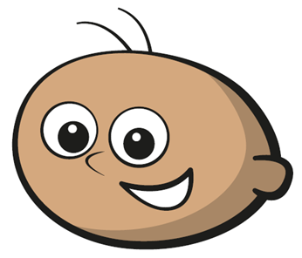
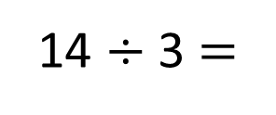
Tommy has 14 straws. He wants to make them into triangles. How many triangles can he make?
14 $÷$ 3 $=$
4 r2

Slide 14
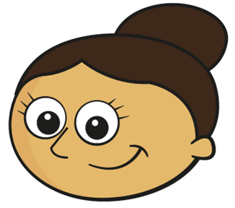
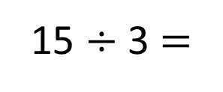
Dora has 15 straws. She wants to make them into triangles. How many triangles can she make?
15 $÷$ 3 $=$
5

Slide 15





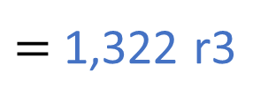
5,291 $÷$ 4
$=$ 1,322 r3
Thousands | Hundreds | Tens | Ones
4 | 5 | 2 | 9 | 1
1
3
2
2
r3
1
1

Slide 16

Complete the divisions.
Have a think
 | 4 | 9 | 6 | 5 | 8
 | 7 | 9 | 6 | 5 | 8
2
4
1
4
r2
1
3
7
9
r5
1
1
2
5
6
What do you notice about the size of the remainders

Slide 17
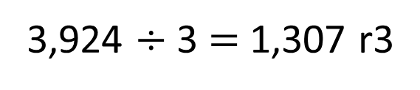
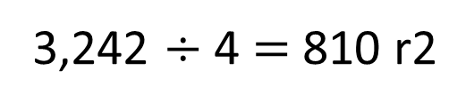
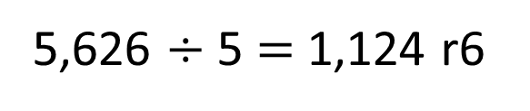
Have a think
Could these calculations be correct?
3,924 $÷$ 3 $=$ 1,307 r3
3,242 $÷$ 4 $=$ 810 r2
5,626 $÷$ 5 $=$ 1,124 r6
Could be correct | Definitely incorrect

Slide 18
Complete the sentences.
Have a think
When dividing by 2, the greatest remainder you can have is ____
1
When dividing by 3, the greatest remainder you can have is ____
2
When dividing by 7, the greatest remainder you can have is ____
6
When dividing by 9, the greatest remainder you can have is ____
8

Slide 19
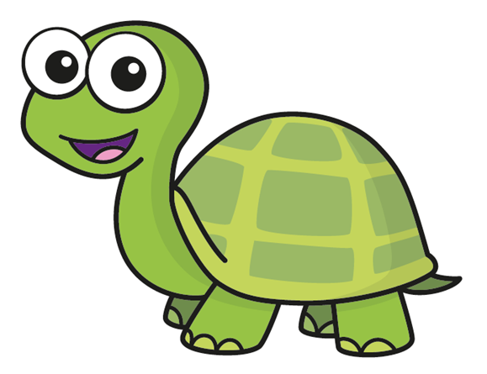
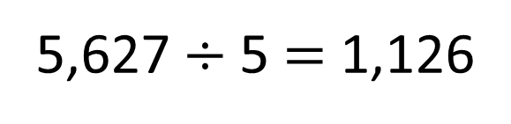
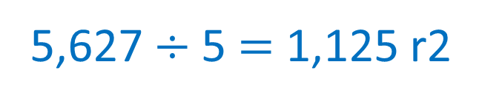
Tiny has worked out this division.
Have a think
5,627 $÷$5 $=$ 1,126
How do you know Tiny is incorrect?
The 5 times table is in a pattern: 5, 10, 15, 20 ..
5,627 is a whole number but it does not have 5 ones or 0 ones so the answer must have a remainder.
5,627 $÷$5 $=$ 1,125 r2

Slide 20
There are 349 people at a wedding.
They are sitting at tables in groups of 8
How many tables are needed?
 | 8 | 3 | 4 | 9
0
4
3
r5
3
2
44 tables are needed.
43 tables are needed.
Have a think

Slide 21

Ron is thinking of a number between 500 and 550
His number has 1 one.
He divides it by 8 and there is a remainder of 1
2
5
1
8 | 5 | 0 | 1
8 | 5 | 1 | 1
8 | 5 | 2 | 1
0
6
2
r5
0
6
3
r7
0
6
5
r1
5
2
5
3
5
4
Have a think

Slide 22
How You Can Help at Home
• Practise number facts and times tables
• Ask your child to explain their thinking
• Use maths in everyday life:
-cooking
-shopping
-telling the time
Understanding is more important than speed.

Slide 23
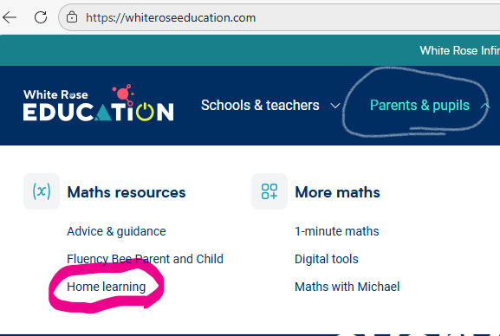
White Rose at home
Notes:
Maths home learning | Home learning | White Rose Education

Slide 24
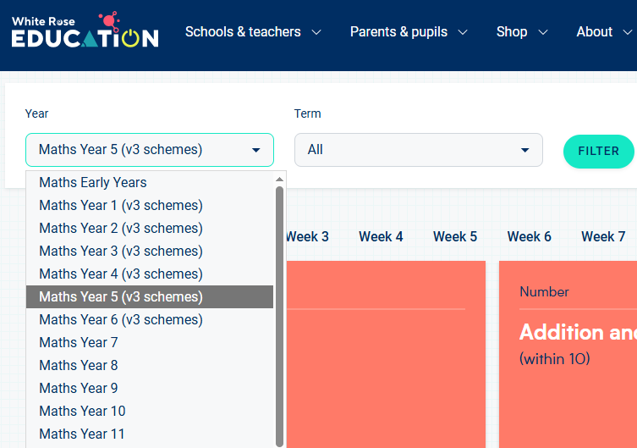
White Rose at home
Select year group and current topic- check with your child, ask their teacher or look on the website.

Slide 25
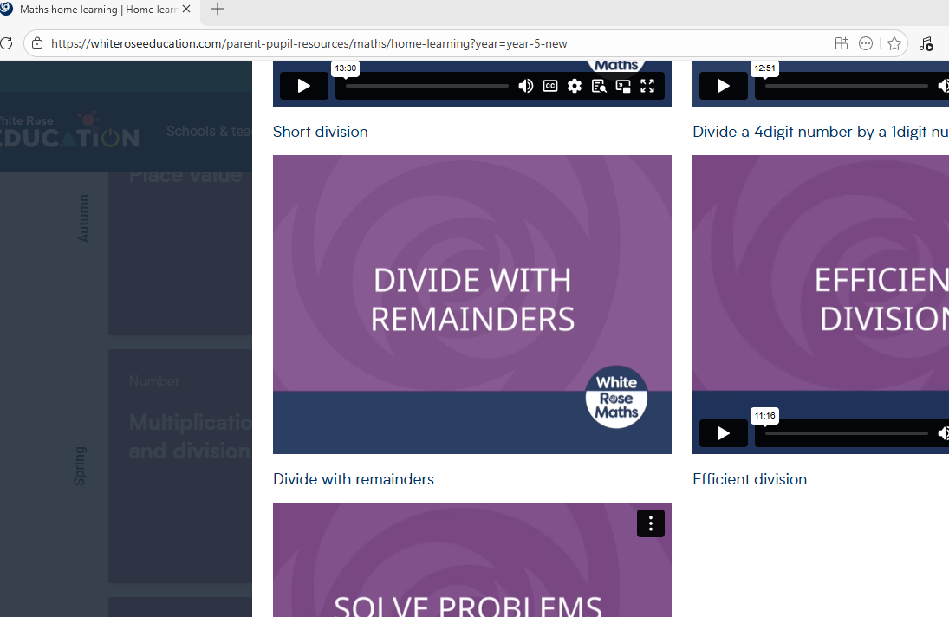
Find the lesson you want to revisit with your child.

Slide 26
Year 4 Multiplication Tables Check (MTC)
All Year 4 pupils complete the Multiplication Tables Check in June.
What is it?
• An online check of times tables knowledge
• 25 questions
• 6 seconds per question
• Focuses on recall up to 12 × 12
Why is it important?
• Helps build fluency and confidence
• Supports learning in all areas of maths
• Prepares children for upper Key Stage 2 maths
How you can help at home:
• Practise little and often (5 minutes daily)
• Focus on quick recall, not written methods
• Use games, apps or quick-fire questioning
• Encourage confidence and a positive attitude.
Notes:
Multiplication Tables Check - 2026 - Timestables.co.uk

