Slide 1
Courage
Assembly 3 11.05.26
Notes:
https://www.youtube.com/watch?v=EkjJbWBUbUs&list=PLrLt4fBD0JjrHnPALYnCtZFPc1rYEWszS&index=4

Slide 2

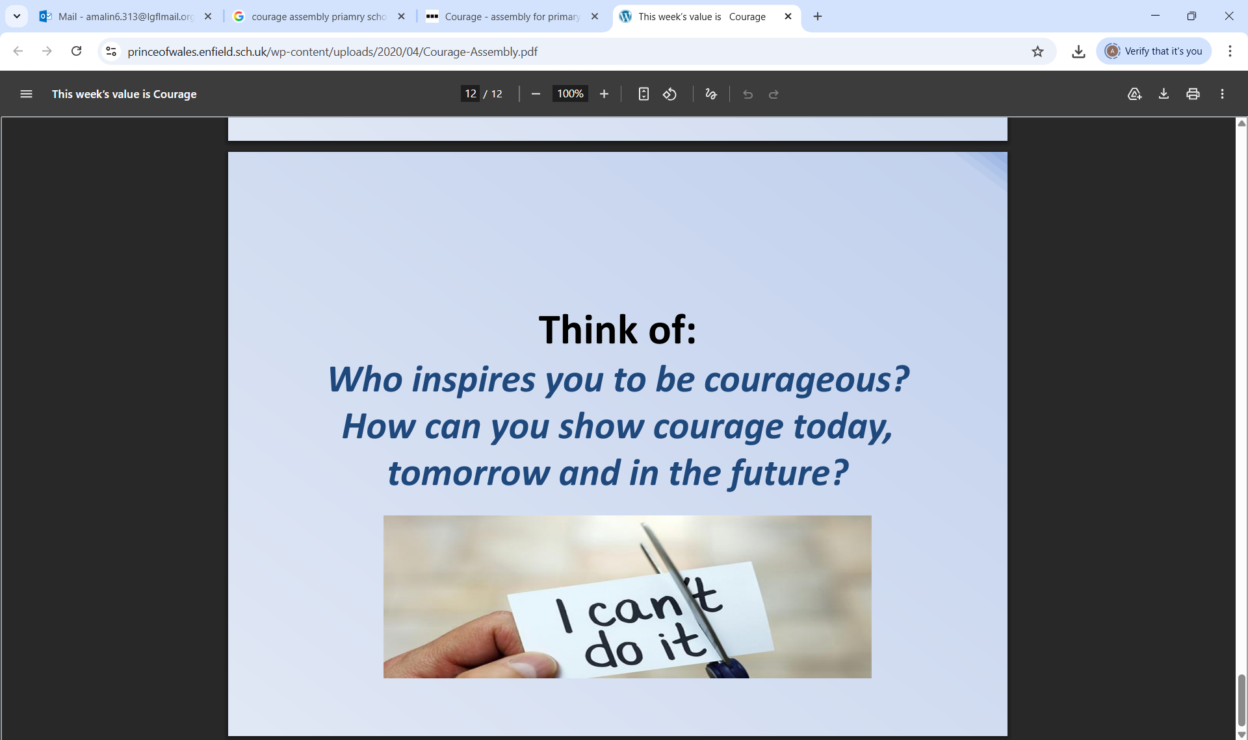
Courage is……….
I can show courage by………

Slide 3
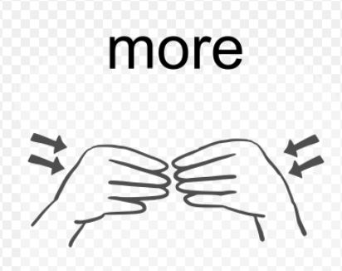
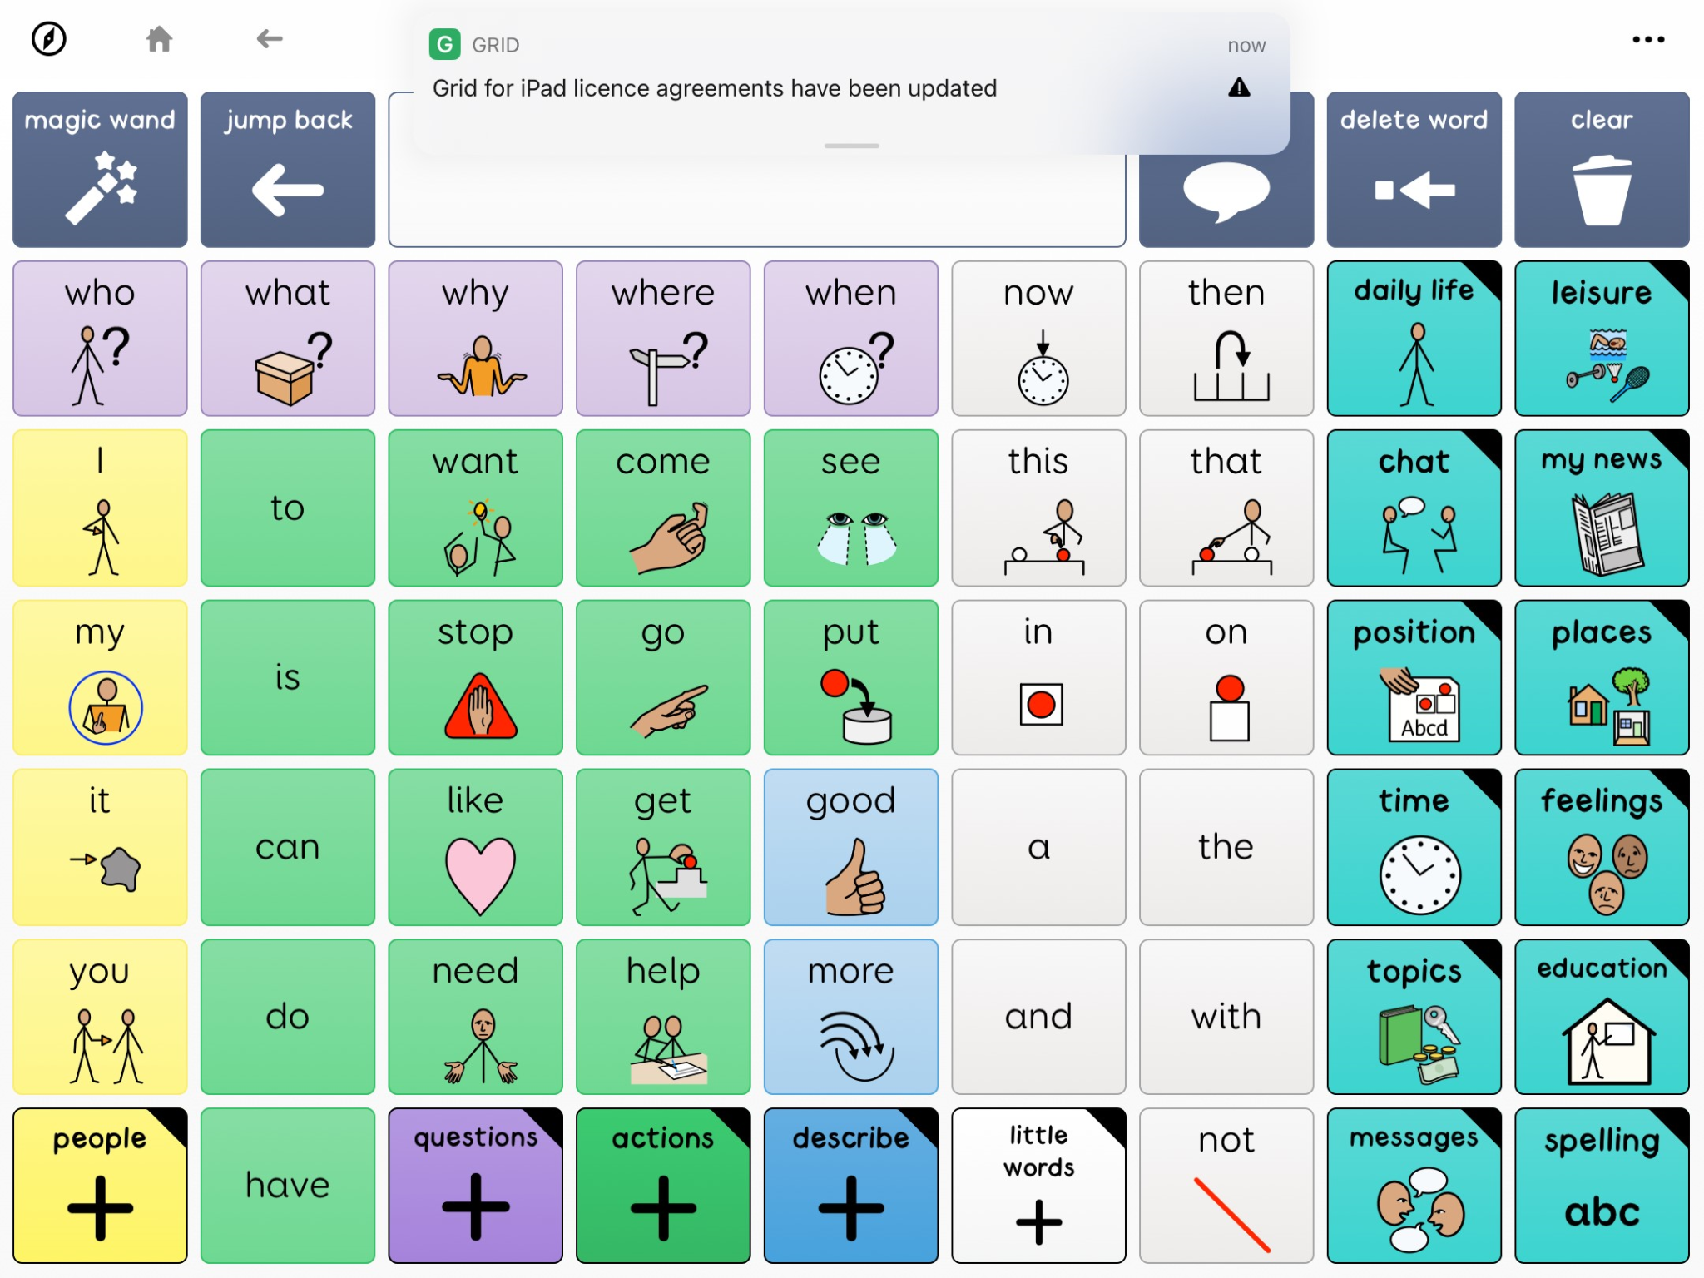

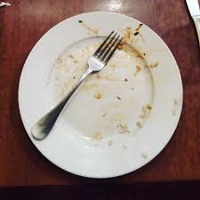
Sign and symbol of the week
Notes:
https://www.tiktok.com/@lets.make_a_difference/video/7559349147824950550

Slide 4
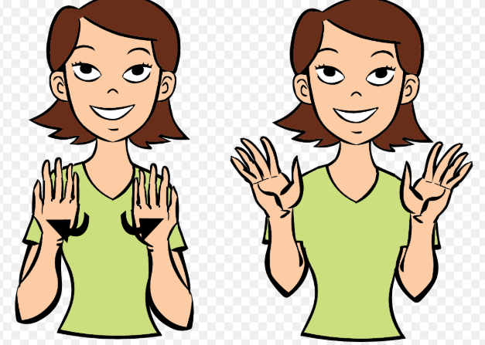
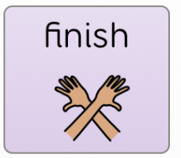
Sign and symbol of the week
Notes:
https://www.tiktok.com/@lets.make_a_difference/video/7559349147824950550

Slide 5

Sign and symbol of the week

Slide 6
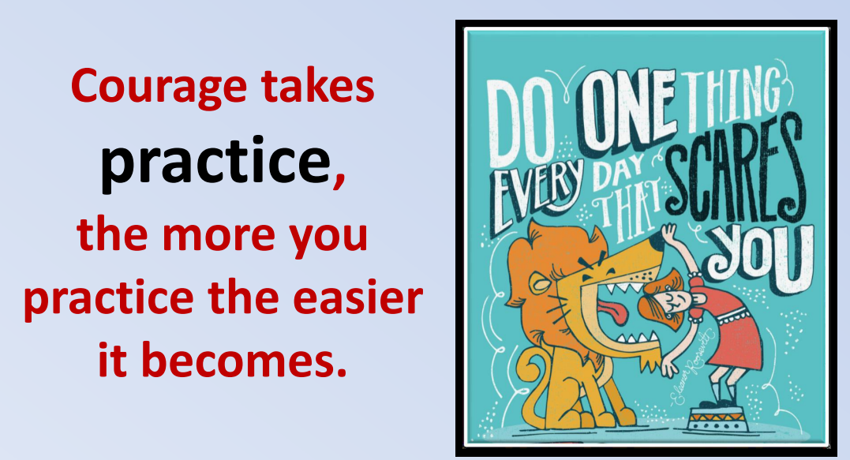
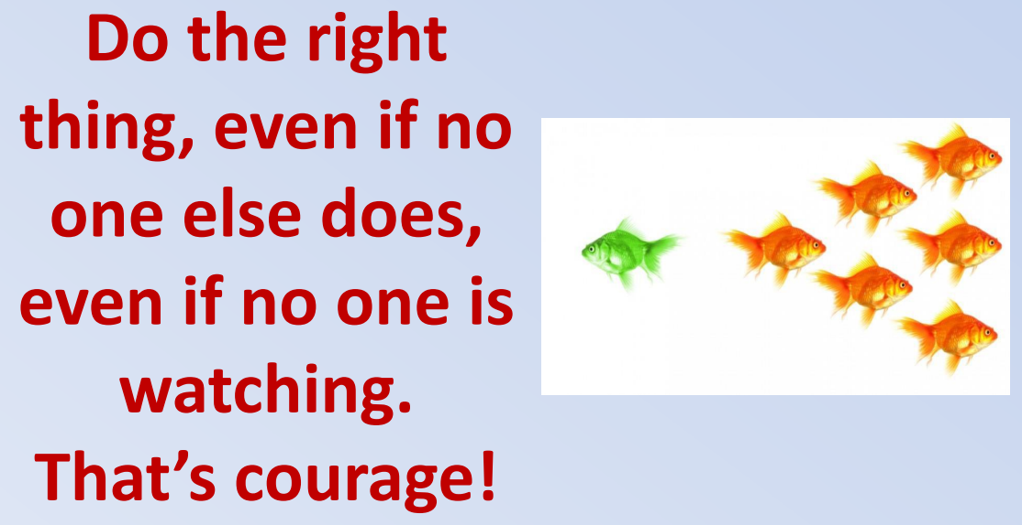
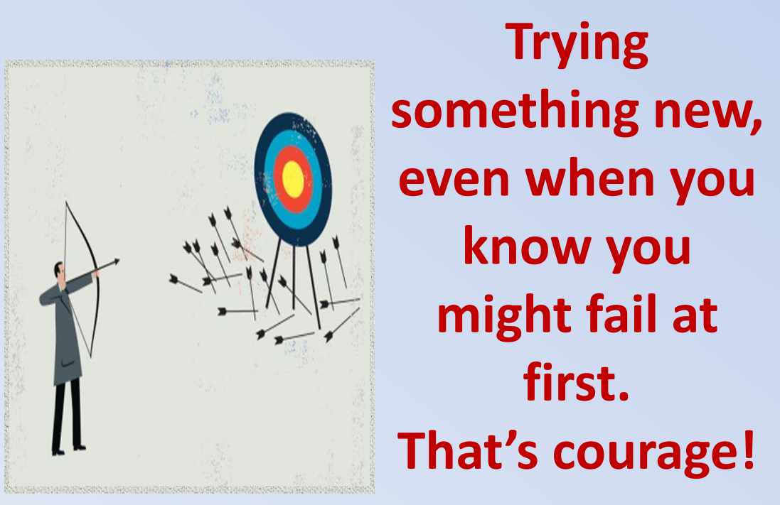
What is Courage?

Slide 7
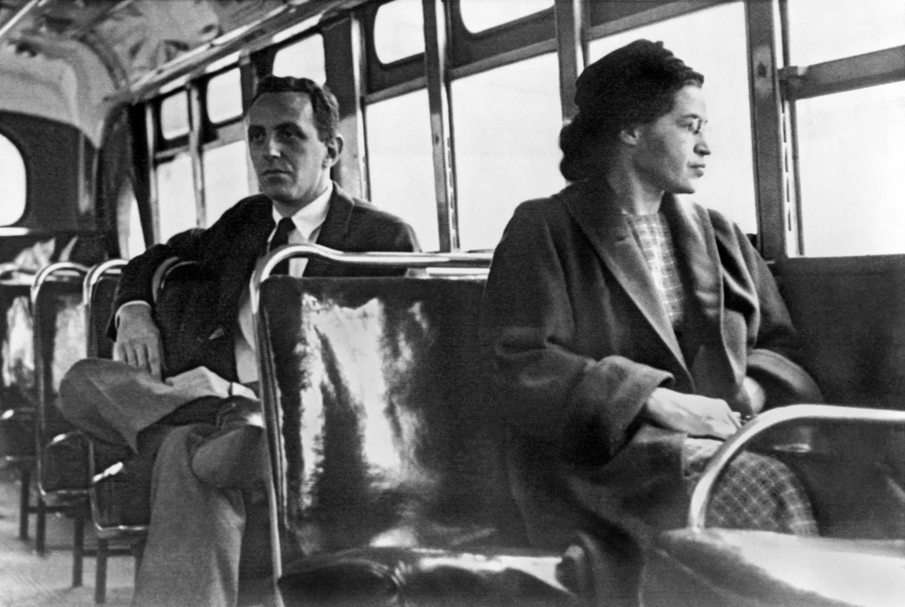
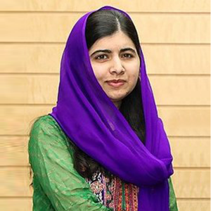
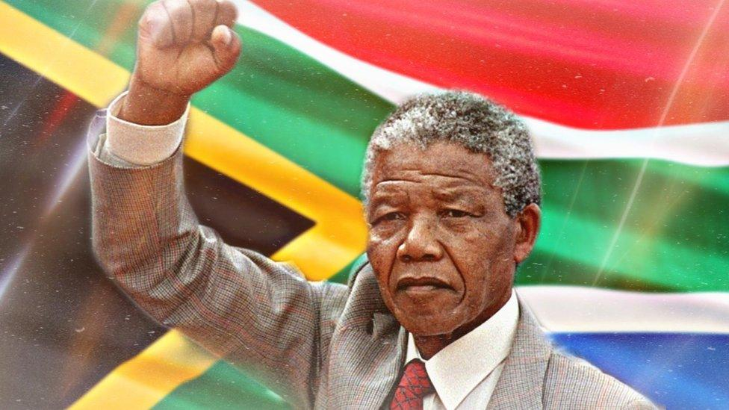
What have these three people in common?
Rosa Parks
Nelson Mandela
Malala Yousafzai

Slide 8
After being shot by the Taliban in 2012 for advocating for girls' education in Pakistan, Malala did not stop her activism. She showed immense bravery by continuing to fight for educational rights, becoming the youngest Nobel Peace Prize laureate and a global symbol for the fight against oppression
Malala Yousafzai

Slide 9
Mandela showed, "unwavering courage for the well-being and rights of others" by spending 27 years in prison for his anti-apartheid activism. Upon his release, he chose reconciliation over retribution, steering South Africa toward a united future
Nelson Mandela

Slide 10
In 1955, Rosa Parks refused to give up her seat to a white passenger on a bus in Montgomery, Alabama. Her simple act of defiance helped ignite the U.S. civil rights movement.
Rosa Parks

Slide 11
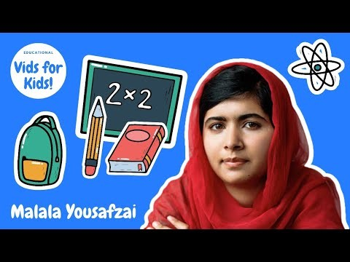
Notes:
https://www.youtube.com/watch?v=Q2d7b0x72Ok

Slide 12



