Slide 1
Aspirations
Assembly 1 01.06.2026
Notes:
https://www.youtube.com/watch?v=EkjJbWBUbUs&list=PLrLt4fBD0JjrHnPALYnCtZFPc1rYEWszS&index=4

Slide 2
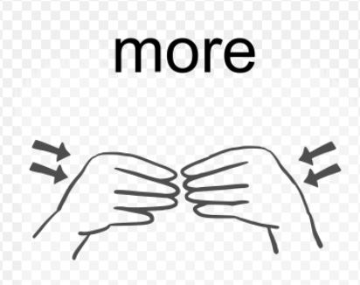
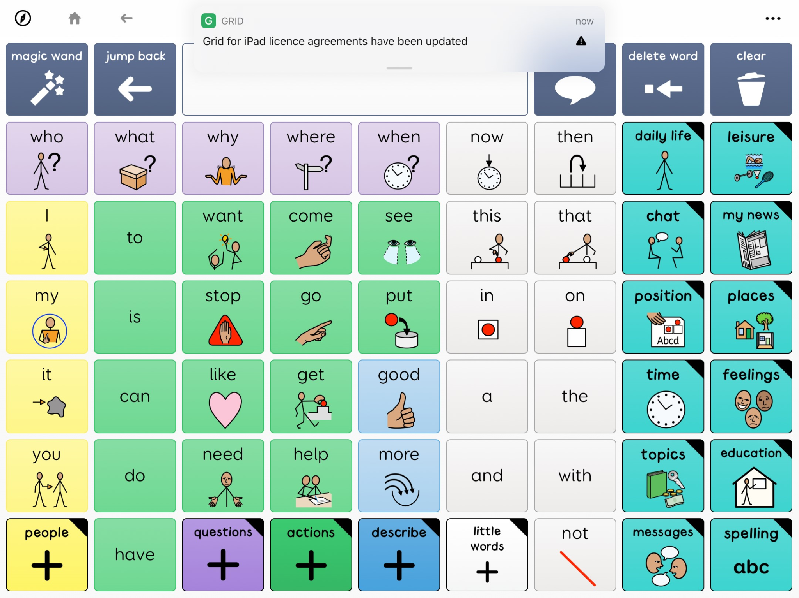
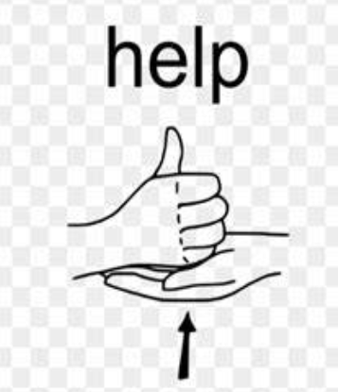
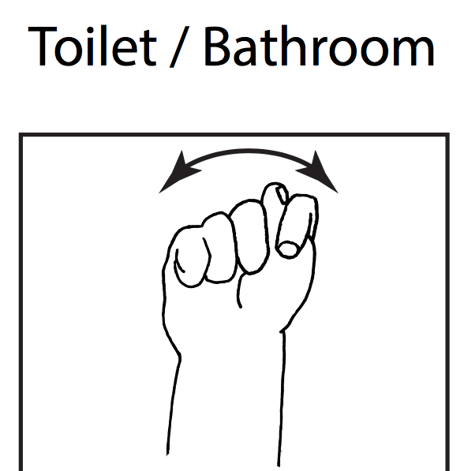
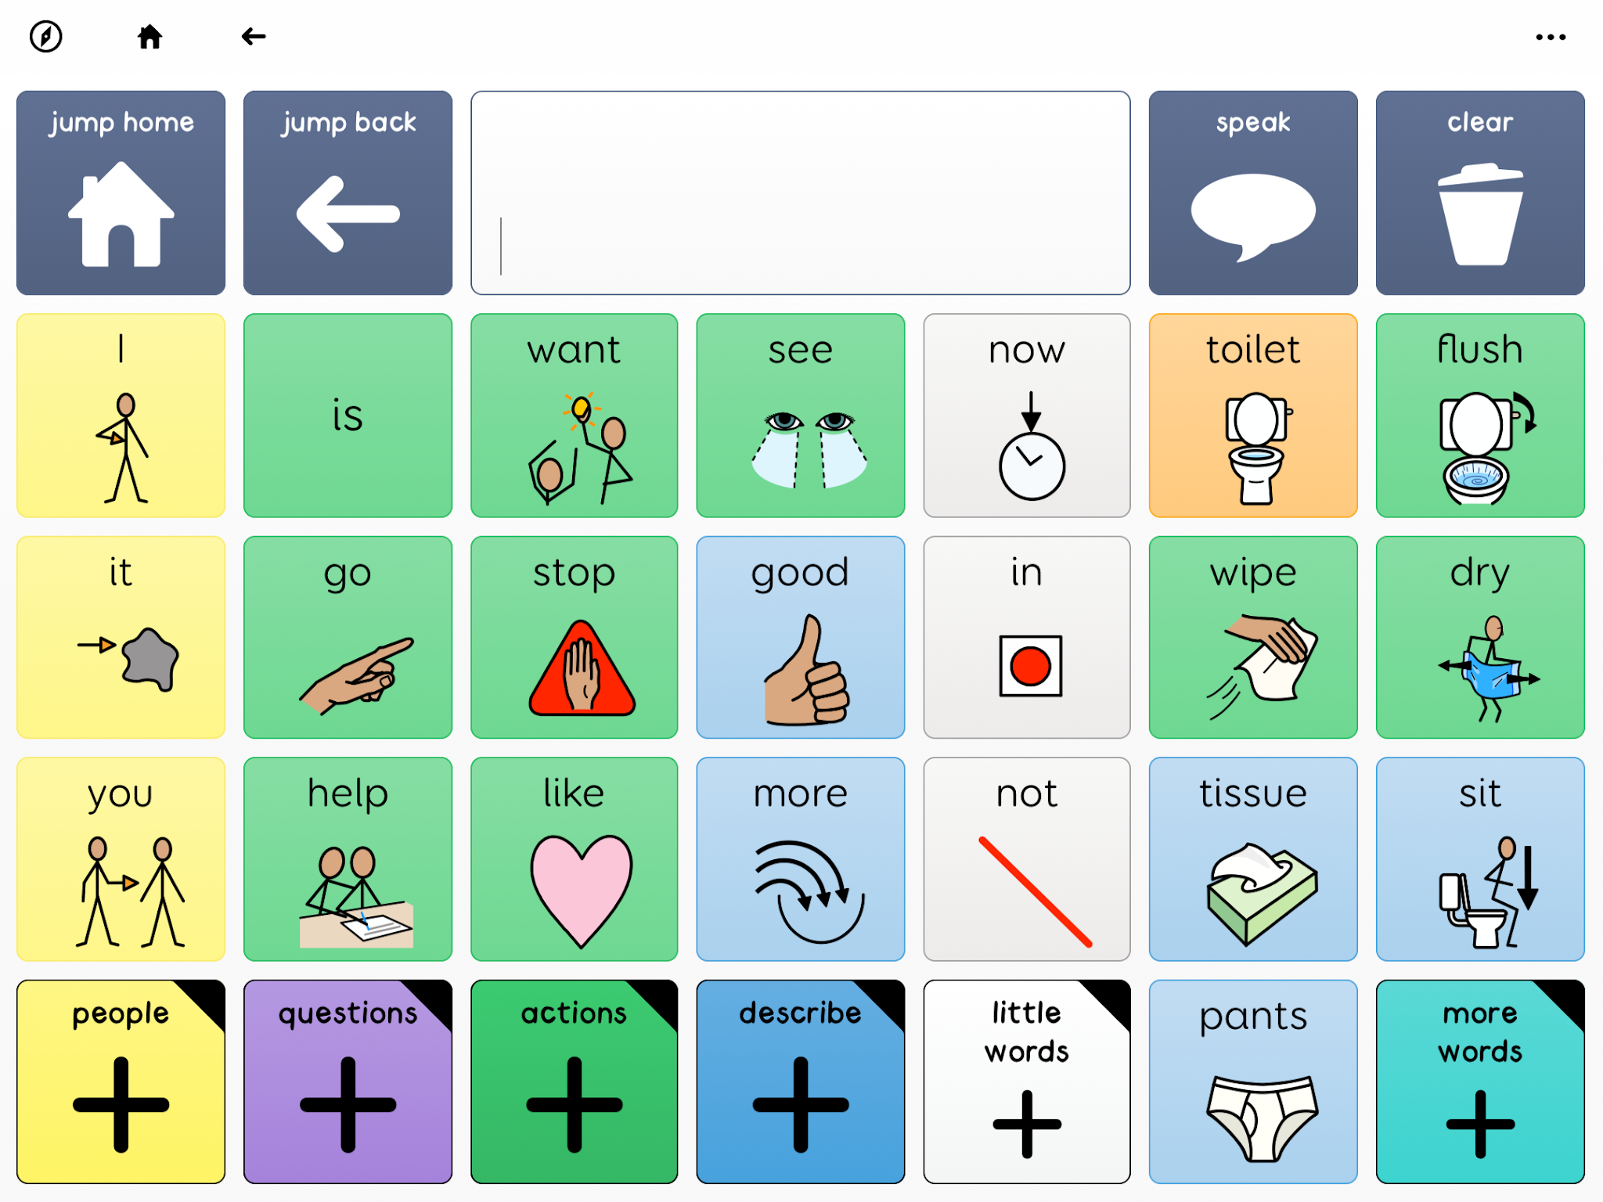
Recap Sign and symbol of the week
Notes:
https://www.tiktok.com/@lets.make_a_difference/video/7559349147824950550

Slide 3

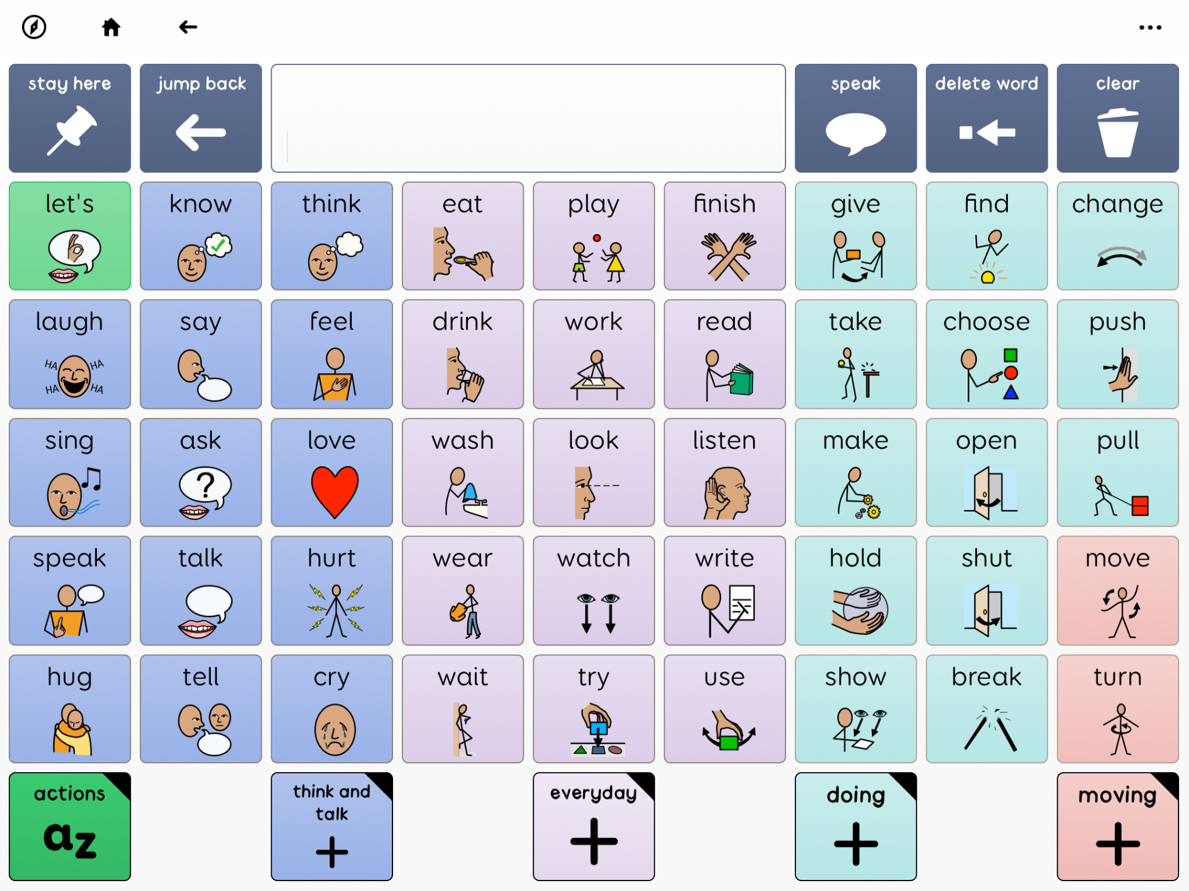

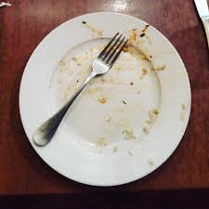
Last Sign and symbol of the week
Notes:
https://www.tiktok.com/@lets.make_a_difference/video/7559349147824950550

Slide 4
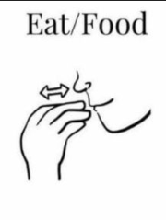
Sign and symbol of the week

Slide 5
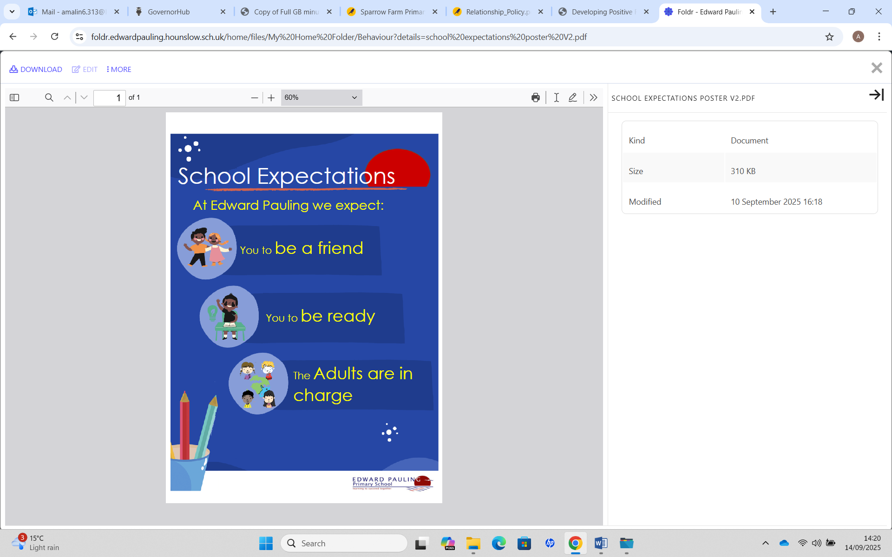
Which of our values link to our expectations?
Can you give an example.
Resilient | Empathetic | Respectful
Independent | Courageous | Ambitious

Slide 6
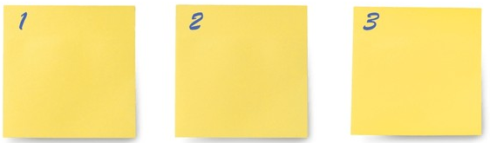
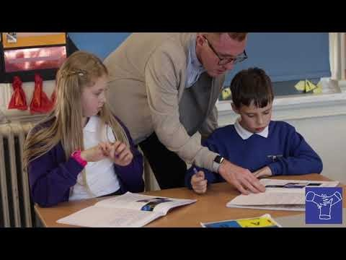
ambition is…..

Slide 7


Slide 8

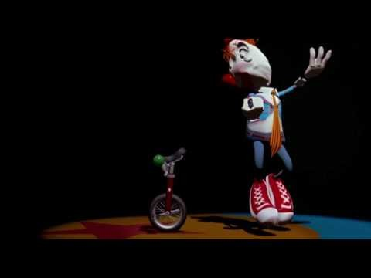
Notes:
https://www.youtube.com/watch?v=96xGUa1a_zs
Advice to give

