Slide 1






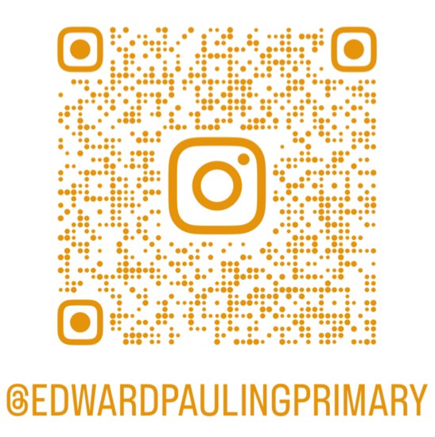
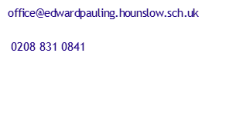

Edward Pauling Primary School
Newsletter
Learning to Succeed
Together
At Edward Pauling Primary School, every child deserves access to a broad and balanced curriculum that challenges and inspires. We are committed to building a community where every child is seen, heard, and valued.
Headteacher’s Message
​This week, our Year Six children sat the Key Stage 2 SATs and they showed great determination and resilience- we are so incredibly proud of them all! This morning, I stood beside the photocopier and had the privilege to have a sneaky peak at the planned end of year production.. we are all in for a real treat!
Punctuality and Attendance
As you are aware this term there has been much focus on improving our children’s attendance and punctuality. Whilst there has been a slight improvement in our children’s attendance, I’m becoming greatly concerned by many children’s punctuality. For many of our younger children they are missing key learning, such as phonics. Sessions start promptly at 9am and every minute that a child is late is a minute less that they are able to develop fundamental reading skills, which directly affects your child’s independence and attainment in all areas of the curriculum. We expect all children to be in the classroom before 8.50am.
Next week, a number of parents will be invited to attend attendance and punctuality meetings so we can work together to overcome any challenges there may be. I’ve also adjusted our end of year school report templates, that you will receive next half term, to share your child’s punctuality, there are a number of children who have missed over 600 minutes of education- which equates to over 10 hours of lost education or nearly 2 full days this academic year!
Term Time Leave
There have been a number of requests for term- time leave, we understand that families sometimes face difficult situations. However, by law, children should attend school during term time unless there are exceptional circumstances. Only the headteacher can approve these requests. To request term time leave please complete your request at least 4 weeks before the planned event. Further details can be found on our school website- https://www.edwardpauling.hounslow.sch.uk/page/?title=Attendance&pid=344
Transition
There have been a number of parents enquiring about next year’s teaching structure. Next half term, we will publish the staffing structure for 2026/2027. I will also be sharing further details about our transition plans.
Mr Adam Malin
Headteacher
15th May 2026 Issue 14
We are proud of our children who consistently go over and above, embodying our school values of resilience, empathy, respect, independence, courage, and ambition as they rise to challenges and make outstanding progress.
Well done to the following children who have gone Over and Above last week.
Blue – Hana
Year 1 – Darcie – Aqua & Zihaan - Sapphire ​​
Year 2 – Faye – Scarlet
Year 3 – Evie - Indigo​​ & Mohammad - Lilac
Year 4 – Aqsa - Jasper & Maaya - Emerald​​
Year 5 – Akshara - Amber & Alex - Saffron​​
Year 6 - Rafaela - Magenta​
Well done to the following children who
have gone Over and Above this week.
Year 1 – Kelly – Aqua & Esmee - Sapphire ​​
Year 2 – Savannah – Scarlet & Adib - Ruby ​​
Year 3 – Evie - Indigo​​ & Serena - Lilac
Year 4 – Alma - Jasper & Arya - Emerald​​
Year 5 – Anas - Amber & Vinnie - Saffron​​
Year 6 - Humza – Crimson &
Nearra - Magenta​
Announcements
School finishes at 3.20pm on
Friday 22nd May for the half term break.
We return to school on Monday 1st June.

Slide 2

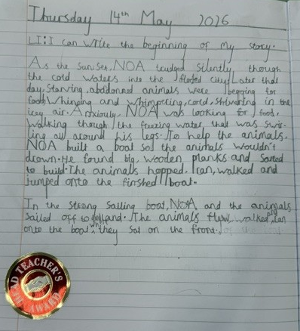
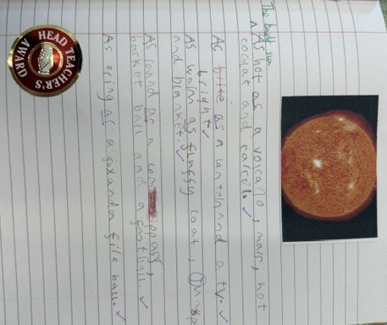

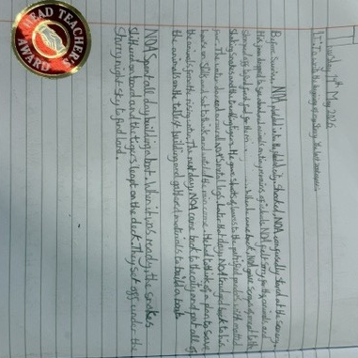


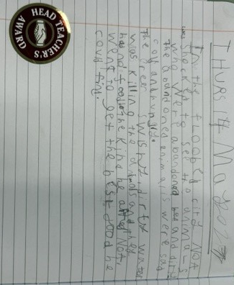


This week, there was a flurry of excited children from Year 4 who proudly shared their story openers with me- well done to Charlie, Fatima and Sorea!
I was also visited by Jos in Year 1 who had thought very carefully about his description to produce some very effective similes.
Pride Points Awards
Congratulations to all the children who reached 100 golden tokens. As a special treat each class were treated to a film afternoon.
The children have shown great perseverance over the last term to work together to collect enough pride points.
Class takeovers will be published throughout the week. Make sure you join our social to see what learning has taken place!

Slide 3





Spotlight on Attendance
We understand that families sometimes face difficult situations. However, by law, children should attend school during term time unless there are exceptional circumstances. Only the headteacher can approve these requests. Leave taken that is not authorised will be treated as Term-Time Leave. When leave cannot be approved:
Family holidays, even for weddings or visiting relatives.
Trips based on cheap flights or special holiday deals.
Medical treatment overseas - treatment can be arranged in the UK
How to request leave
Please submit your request as early as possible — ideally at least 4 weeks before the planned absence.
Use the school’s leave request form (available from the school office).
You will need to provide evidence to support your request.
Every request is looked at individually to make sure we understand your situation.
We are fully committed to improve school attendance, every lost moment a child is not in school or is late has a direct impact on their education.
Leave taken that is not authorised will be treated as Term-Time Leave. Term time leave will be referred to the School Attendance Support Service once your child has returned to school.
The table below summarises attendance concerns for spring 1.
Children Received Initial Warning Letter
Nursery | Reception | Year 1 | Year 2 | Year 3 | Year 4 | Year 5 | Year 6
 |  | 1 | 2 | 1 | 3 | 2 | 2
Children On a 4 Week Attendance Plan
Nursery | Reception | Year 1 | Year 2 | Year 3 | Year 4 | Year 5 | Year 6
 |  |  | 4 |  | 2 | 2 | 2
Children referred SASS for low attendance
Nursery | Reception | Year 1 | Year 2 | Year 3 | Year 4 | Year 5 | Year 6
 |  |  | 1 |  | 1
Term Time Leave Referrals to SASS
Nursery | Reception | Year 1 | Year 2 | Year 3 | Year 4 | Year 5 | Year 6
 |  | 1 |  | 1 |  | 1
Term Time Leave
Nursery | Reception | Year 1 | Year 2 | Year 3 | Year 4 | Year 5 | Year 6
 | 1 | 3 |  | 3 |  | 2 | 1
Date​ | Event​ | Year Group​
Monday 18th May | PGL residential until Wednesday 20th May | Year 6
Monday 18th May | Non-PGL Sports Camp | Year 6
Wednesday 20th May | Non-PGL Trip to Cineworld | Year 6
Wednesday 20th May | Nursery Stay & Play Session | Children aged 2 - 5
Thursday 21st May | Reception Stay & Learn Session | Reception
Friday 22nd May | Aqua Class Assembly | Year 1 Aqua Class
Friday 22nd May | Fun-filled family afternoon | ALL from 3.30pm
Our sign of the week this week was help. In assembly we thought about when someone might communicate using the help sign, such as: wanting help to play a game, or wanting help to complete our work.
Our aim is to promote inclusion throughout our school by teaching a single British Language sign each week. At home, you may wish to practice our sign of the week whilst talking. Our aim is to build a bank of signs for each of our children to use.

Slide 4
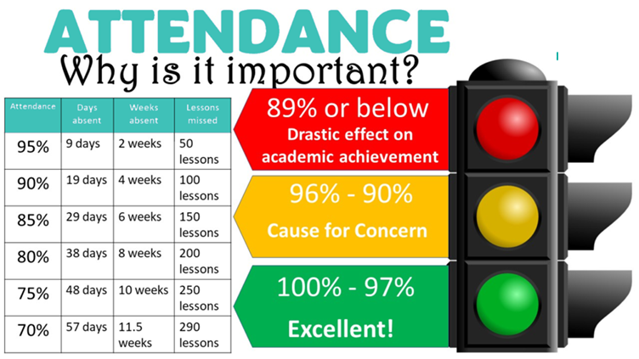
Whole School | 94.55%
Year Group ​ | Attendance 27th April- 1st May | Attendance 4th May – 8th May
Nursery | 91.4% | 89.3%
Reception | 94.3% | 93.5%
Year One | 93.3% | 95.3%
Year Two | 93.1% | 91.9%
Year Three | 97.1% | 95.9%
Year Four | 95% | 95.7%
Year Five | 96.9% | 97.3%
Year Six | 95.3% | 95.8%
Attendance and Punctuality
There has been a great improvement in children arriving to school on time. Teachers have been able to deliver key support groups before the start of the teaching day. We have also started to meet a number of parents over the past few weeks to discuss how punctuality can be improved.
If a child is late on five or more occasions per half term, a warning letter will be sent to parents or carers. If punctuality does not improve, you will be invited into school for a meeting to discuss this further and a punctuality support plan will be put into place. We fully understand that there are occasions when lateness is unavoidable and this will be considered.
Arriving on time is essential to ensure children can fully access their learning. Classroom doors are open from 8:40am to 8:50am. Nursery doors are open from 8.30am to 8.40am.
More information about attendance, including term time leave can be found on our website- https://www.edwardpauling.hounslow.sch.uk/page/?title=Attendance&pid=344

Slide 5
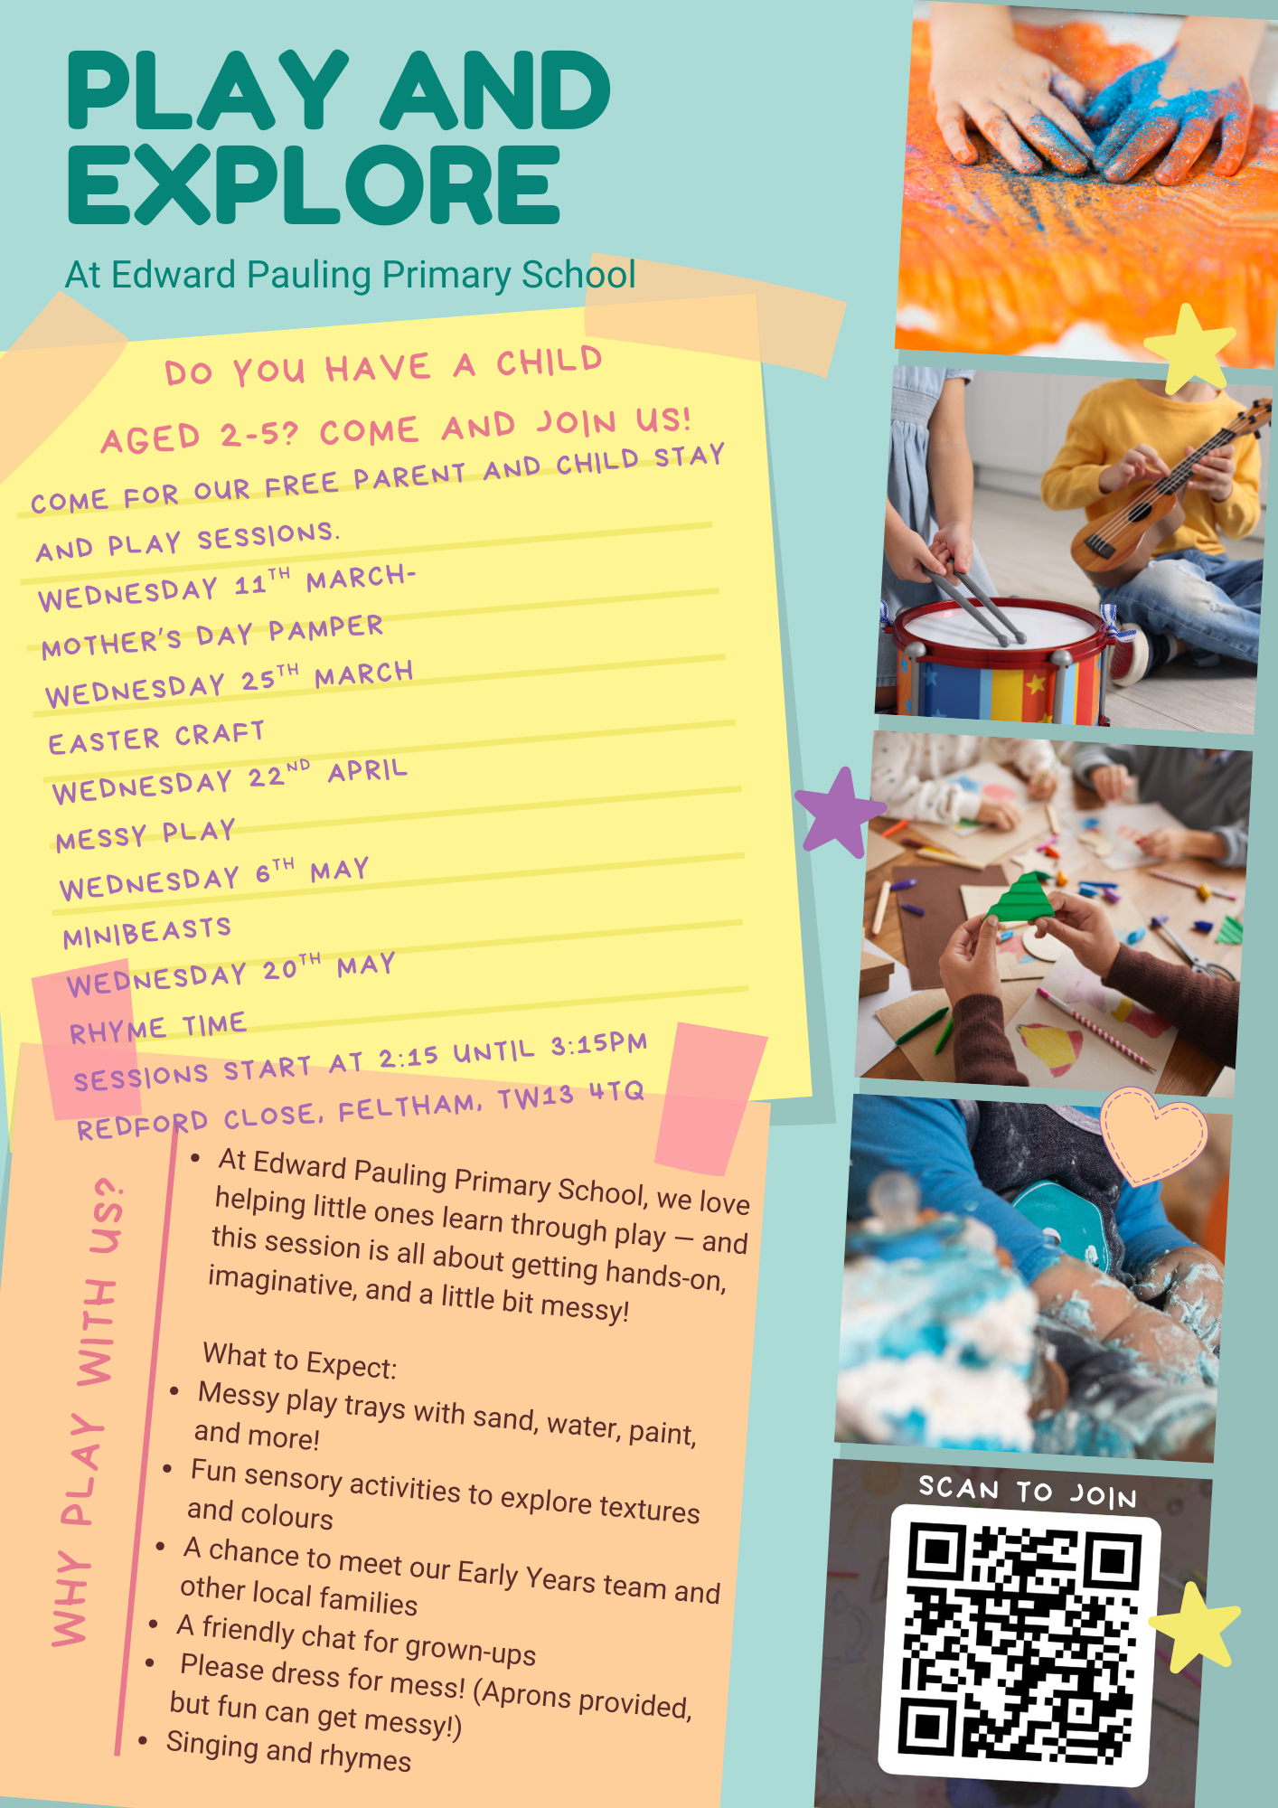

Slide 6
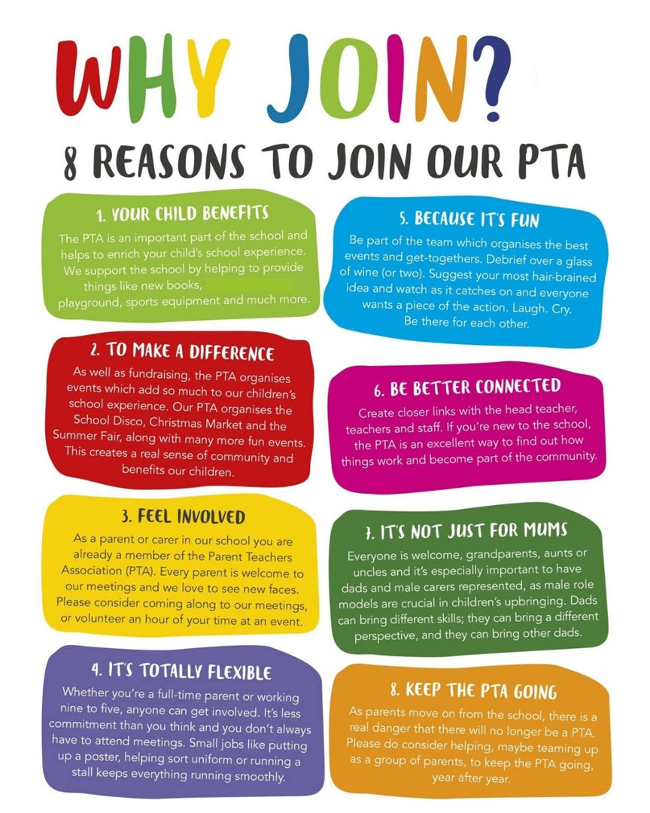
If you would like more information about supporting the PTA, please speak to a member of the office team.
Class takeovers will be published throughout the week. Make sure you join our social to see what learning has taken place!

Slide 7


Slide 8


