Slide 1
Aspirations
Assembly 3 22.06.2026
Notes:
https://www.youtube.com/watch?v=EkjJbWBUbUs&list=PLrLt4fBD0JjrHnPALYnCtZFPc1rYEWszS&index=4

Slide 2
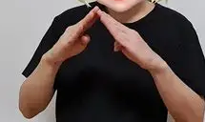
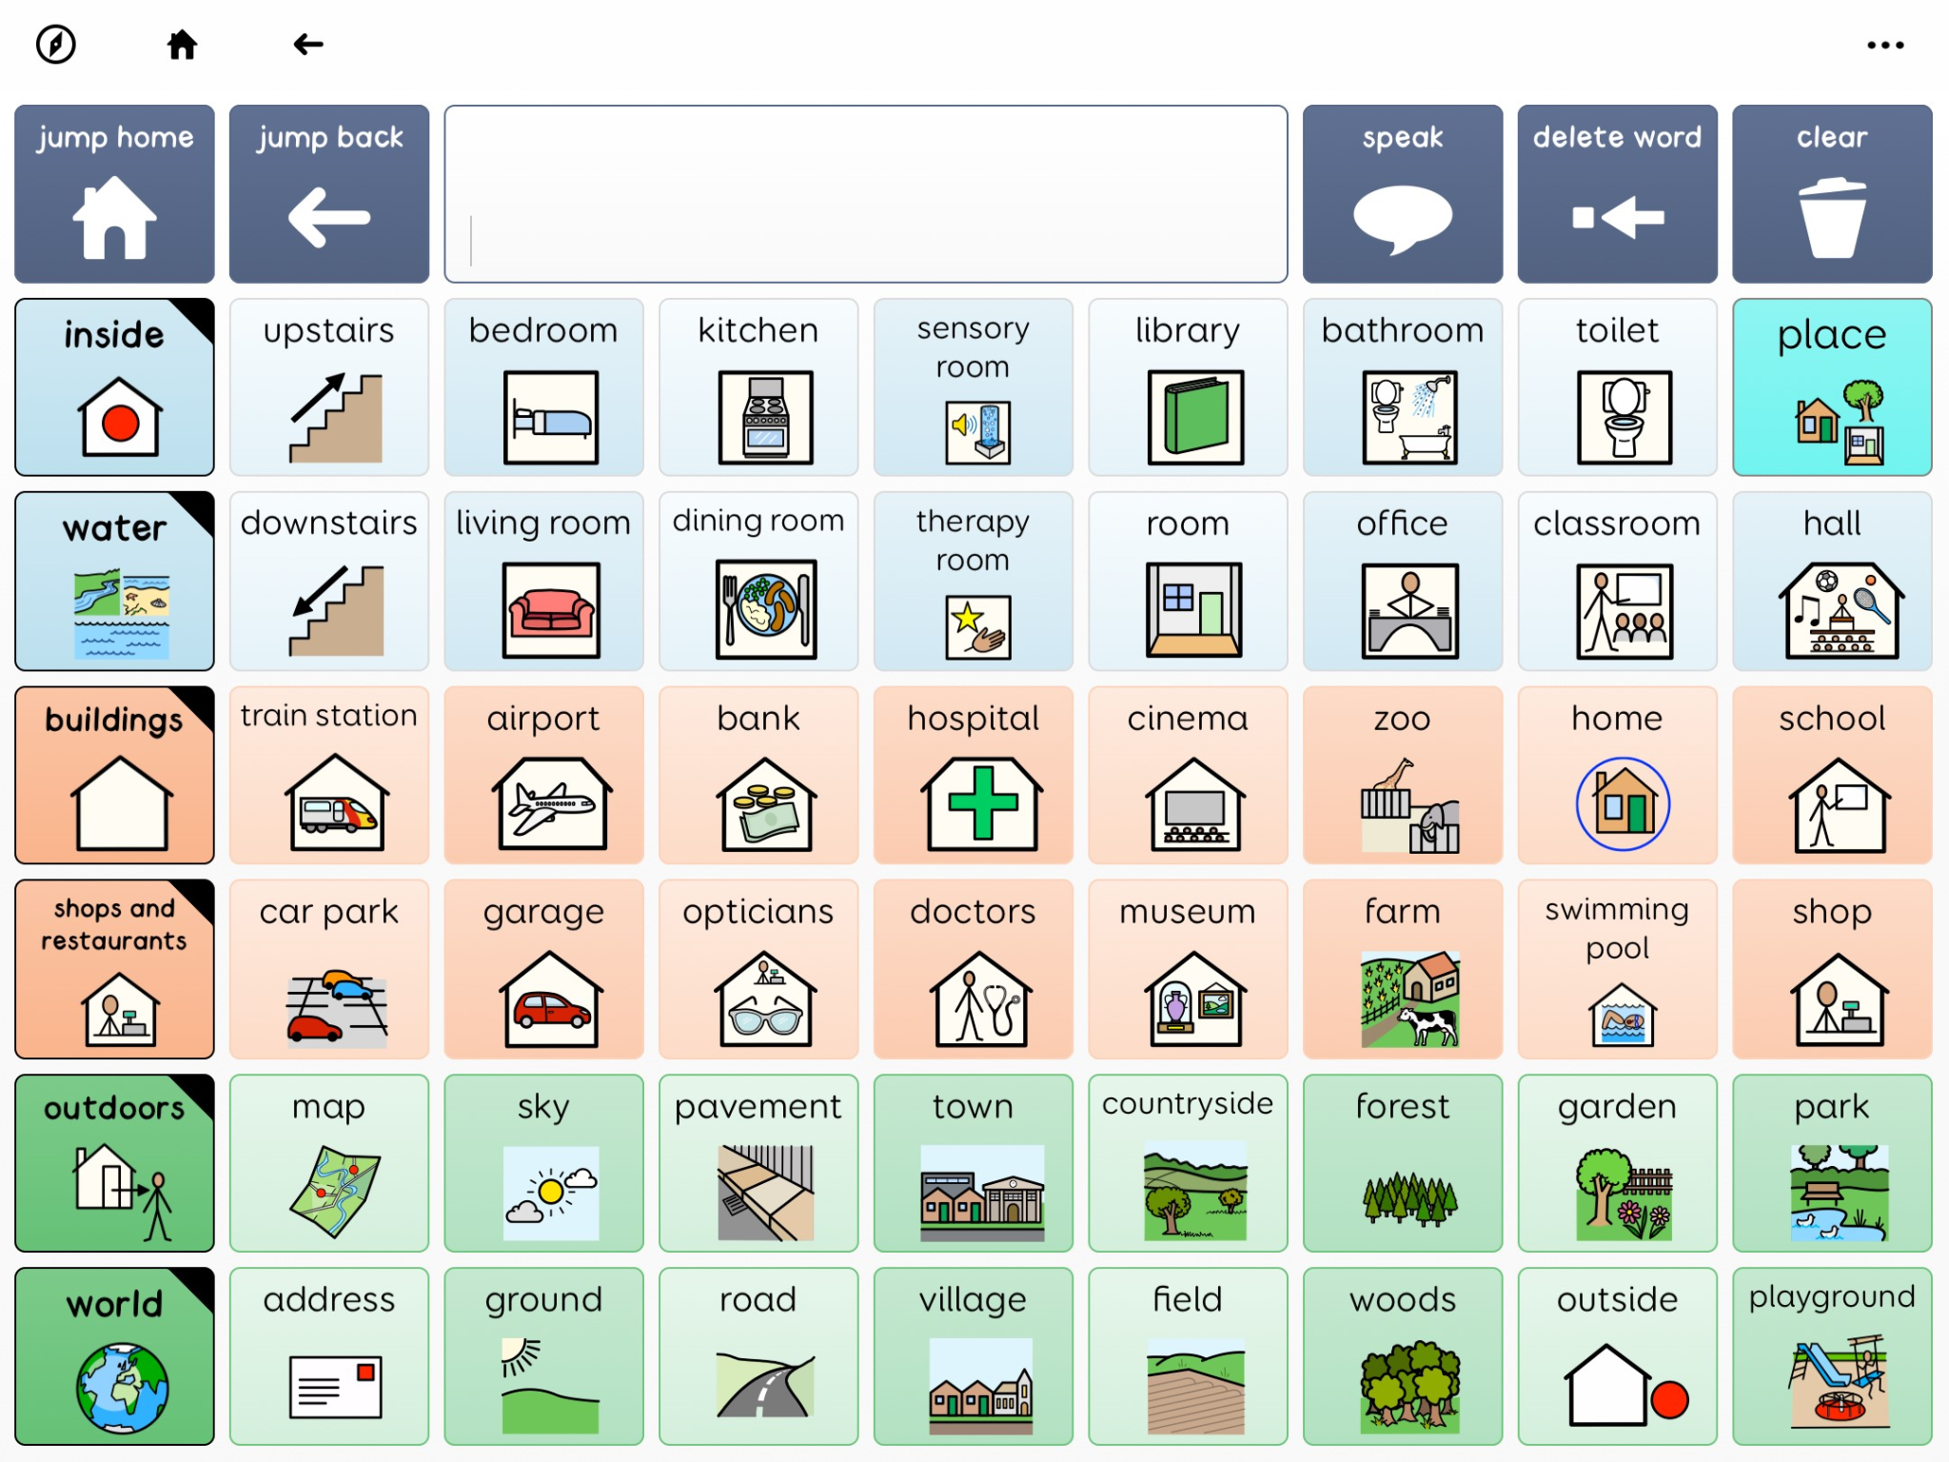
Last Sign and symbol of the week
Notes:
https://www.tiktok.com/@lets.make_a_difference/video/7559349147824950550

Slide 3
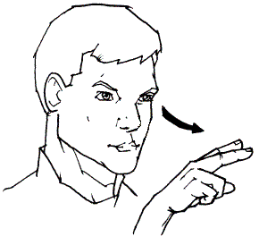
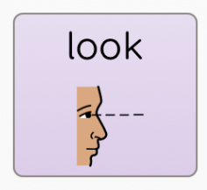
Sign and symbol of the week
Look

Slide 4
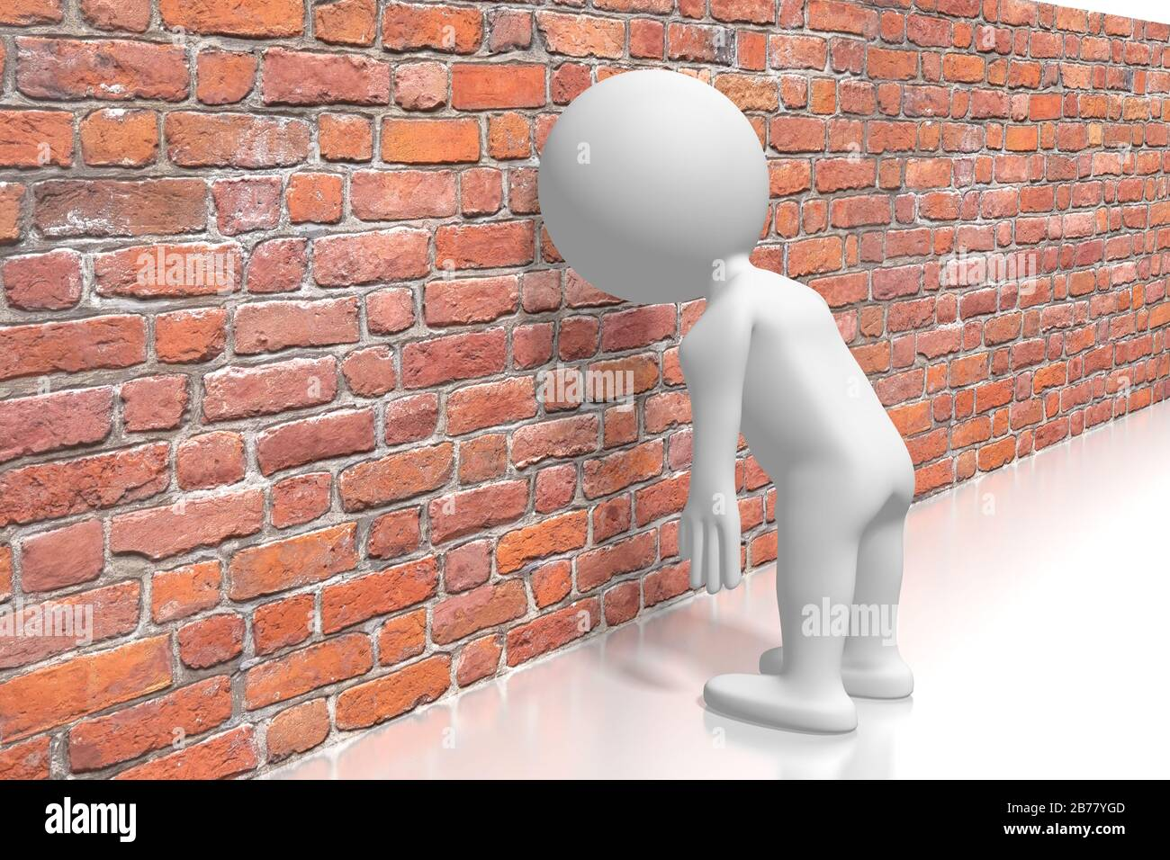
Recap: Have you ever hit a wall? What did you do? Next?
Notes:
Reflection- Make link between when someone is not being resilient, it as if they have hit a wall. They are unable to achieve.

Slide 5
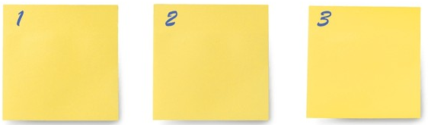
Recap what is ambition is…..

Slide 6
To set and achieve your goal.
To be resilient (don’t give up).
To have a positive mindset.

Slide 7
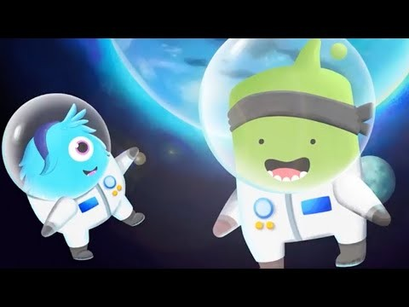
Watch: https://www.youtube.com/watch?v=2zrtHt3bBmQ
Notes:
https://www.youtube.com/watch?v=2zrtHt3bBmQ

Slide 8
What is the link between our value of aspiration and a growth mindset?
Notes:
Make the link between being resilient to having to have confidence

Slide 9

What does it mean to have a positive mindset?

Slide 10

Activity: On the left are the comment a person with a fixed mindset would have, what would the person with a growth mindset say?

