Slide 1

Learning To Succeed Together
Meet the Teacher 2026
Notes:
Prefects- view of school, what learning is like, how has school prepare for later life, things they like/enjoy about school.

Slide 2


Vision and Values
At Edward Pauling Primary School, every child deserves access to a broad and balanced curriculum that challenges and inspires. We are committed to building a community where every child is seen, heard, and valued.
We are: Kind, Resilient and Ambitious ​

Slide 3
Who is Who?
Meet the Year Group Team
Mrs Cooper – Class Teacher (Paris)
Ms El Hawary (Cario Class)
Mr Miller– Teaching assistant
Miss Beckles– Teaching assistant

Slide 4
Year Ahead
 | Autumn Term |  | Spring Term |  | Summer Term
Topic Name | History | Science | History / Art | RE | HIstory | Science
Trips and Experiences | Butser Ancient Farm, Hampshire Growing Food Project | Science Museum (Feel the Force) Disability Workshop | The British Museum Egyptian Day Growing Food Project | Staines and District Synagogue, Staines 1 Night Away: School Sleepover | Gunnersbury Park Museum £ Growing Food Project (Vegetable Sale) | Light it Up (Workshop Science Museum

Slide 5
Key Information
Homework-​ issued on a Friday, due back on Wednesday.
Maths A consolidation task that has been taught in the week.
Spelling Spelling rules will be taught in school but you should support your child to apply the spelling rule at home whilst learning their spellings. Spellings will be applied in a weekly dictation.
Writing Weekly Optional writing task
Reading Your child should be reading each night for at least 10-15 minutes. Books will be changed weekly. Other books should also be read at home.​
KIRF shared half termly and should be practiced little and offten so children learn the facts off by heart.
Potery each term a new poem to be learnt by heart, to improve children's confidence to perform and knowledge of language.
Library- We will visit the school library each week on a Monday .​

Slide 6
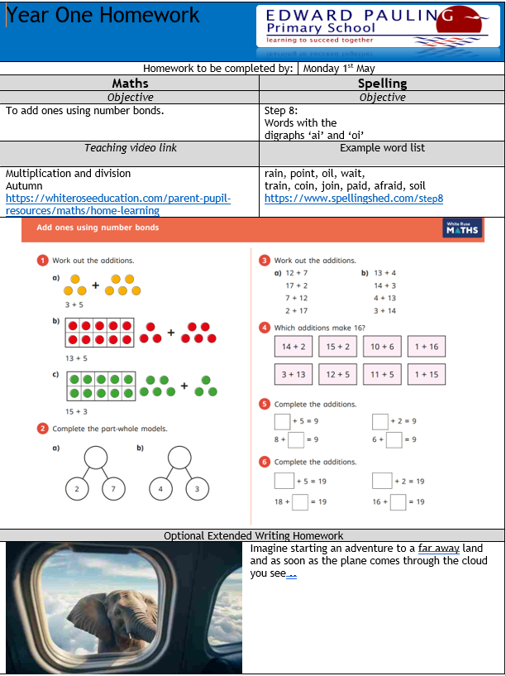
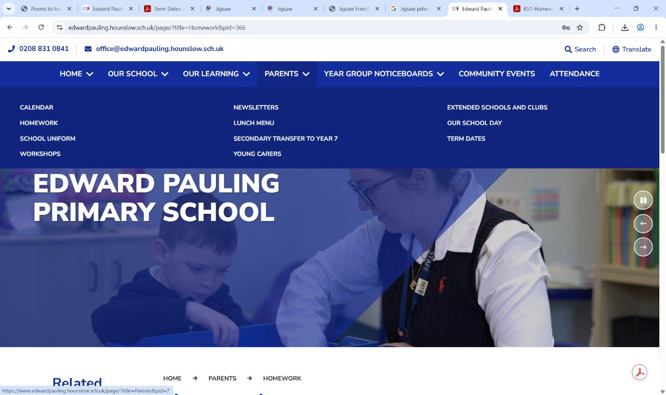
On our School Website our homework expectations can be found with further information how to support at home. Homework tasks are consolidation of learning that has been taught.

Slide 7


Slide 8
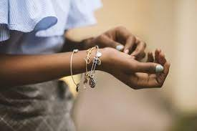
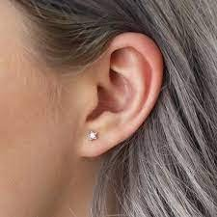
Uniform
PE- Children to come to school in their PE kits on a Tuesday and Friday.
PE T-shirts now come in 4 colours. Red, blue, green and yellow. When purchasing, please make sure you choose the colour of the house that your child is in. If you are unsure of the colour, please speak to the office.
Children are not aloud to wear branded sports team kit. Please don't be offended if school contact you to come to school to change their kit if they come to school wearing a branded team top.
Children should not wear nail varnish or jewellery to school (exception of religious jewellery )
Notes:
https://startingreception.co.uk/wp-content/uploads/2025/03/Starting-Reception.pdf

Slide 9
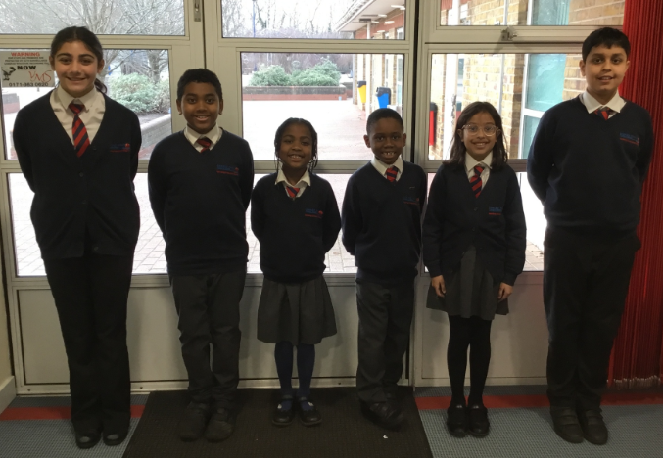
Our school uniform is a white buttoned long/short sleeve shirt with a school tie, plain black, charcoal grey or navy blue knee length uniform skirt or plain black, charcoal grey or navy blue classic uniform style, tailored straight-cut trousers.
Uniform can be purchased from the school

Slide 10
Book bags- Your child should bring their book bag, reading records and reading books each day.
Readings records are checked weekly by the teacher and will be signed.
Home reading should be reordered in your child's reading record.
Water Bottles- To ensure that the children stay hydrated throughout the day they should bring a named water bottle filled with water, not a juice drink.

Slide 11
We are a Nut-Free school. The school aims to protect children who have allergies to nuts yet also help them, as they grow up, to take responsibility as to what foods they can eat and to be aware of where they may be put at risk. We do not allow nuts or nut products in school lunch boxes or as a healthy snack.​
​
Nut-Free means that the following items should not be brought into school:​
Packs of nuts​
Peanut butter or Nutella sandwiches​
Fruit and cereal bars that contain nuts​
Chocolate bars or sweets that contain nuts​
Sesame seed rolls (children allergic to nuts may also have a severe reaction to sesame)​
Cakes made with nuts​
Any home cooked meals for packed lunches that are made from nuts​

Slide 12
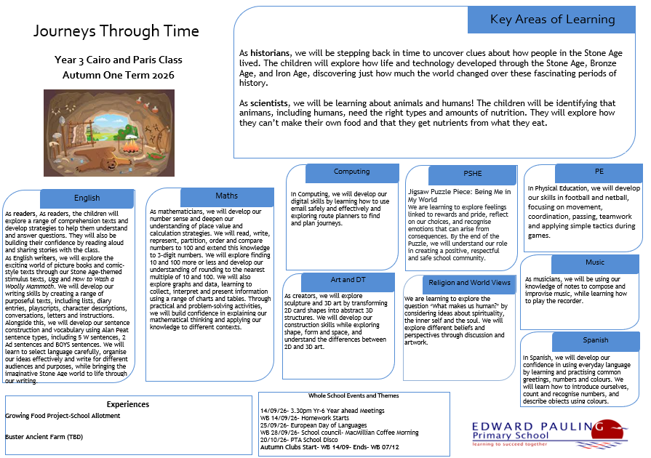
Term Ahead
Notes:
https://startingreception.co.uk/wp-content/uploads/2025/03/Starting-Reception.pdf

Slide 13
How can you support at home?
Timetables : 2, 5, 10, 3, 4 and 8
Read with your child everyday – other books as well as GR books please.
Support written tasks
Take your child out to libraries, museums, and visit London/other UK attractions.
Notes:
https://startingreception.co.uk/wp-content/uploads/2025/03/Starting-Reception.pdf

Slide 14
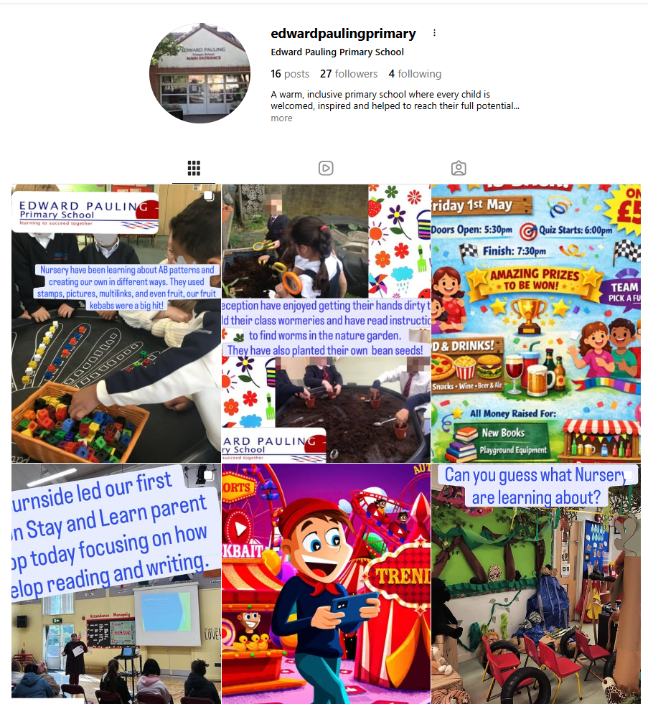
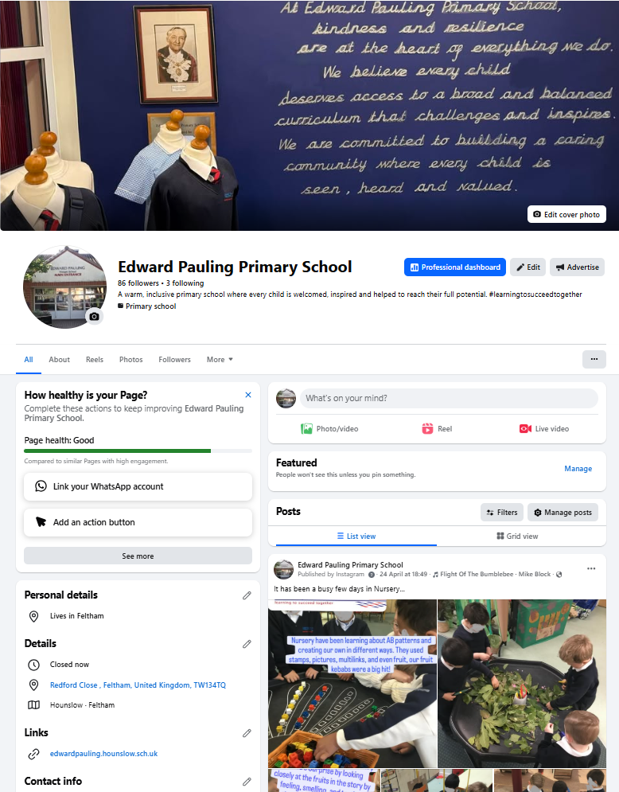
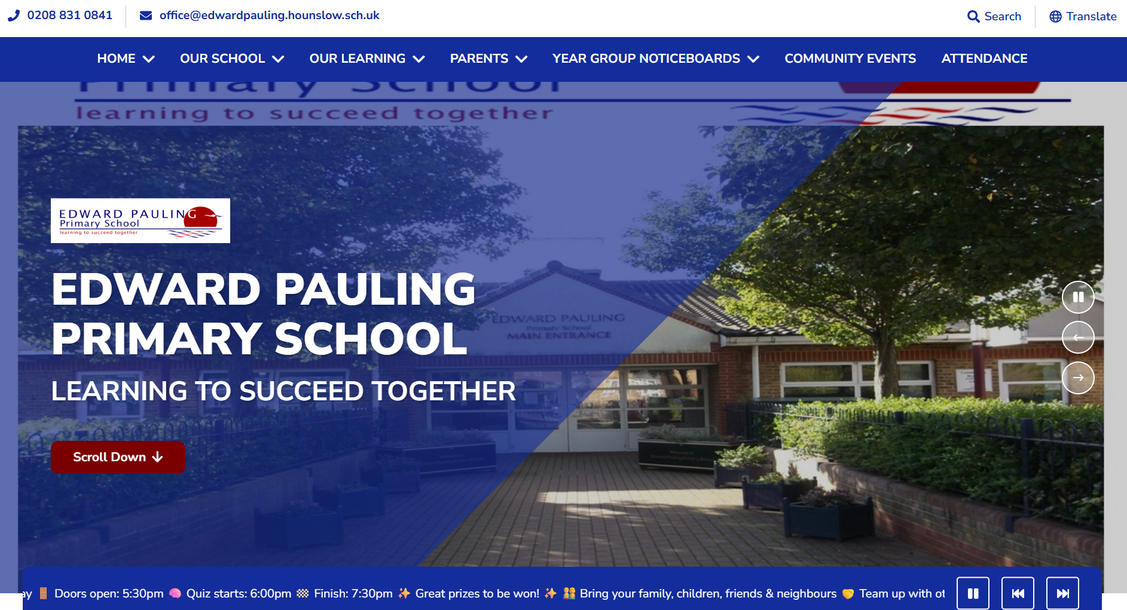
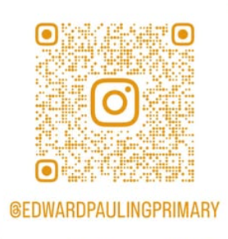
Stay in touch
Instagram
Facebook
School Website
www.edwardpauling.hounslow.sch.uk
https://www.facebook.com/
profile.php?id=61581992191099#
Notes:
Website- policies, class pages, curriculum , newsletters (Parents page)
Instagram and Facebook daily posts about school life

